Slide 1
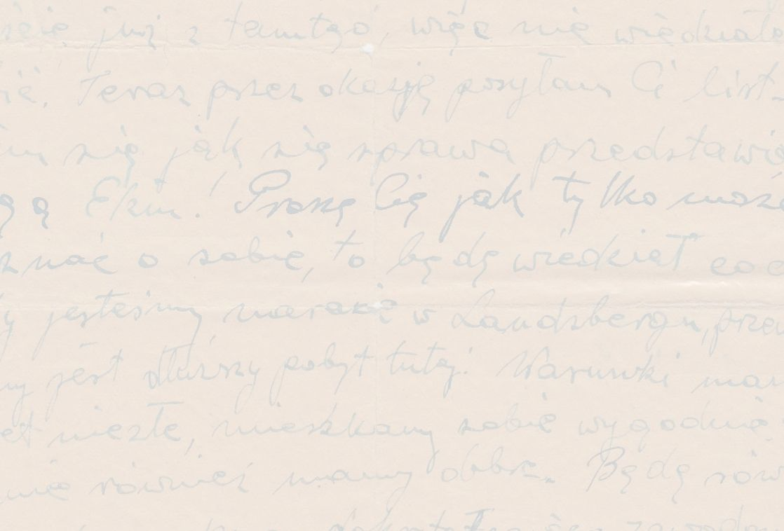
Life after the Holocaust
A story of survival

Slide 2
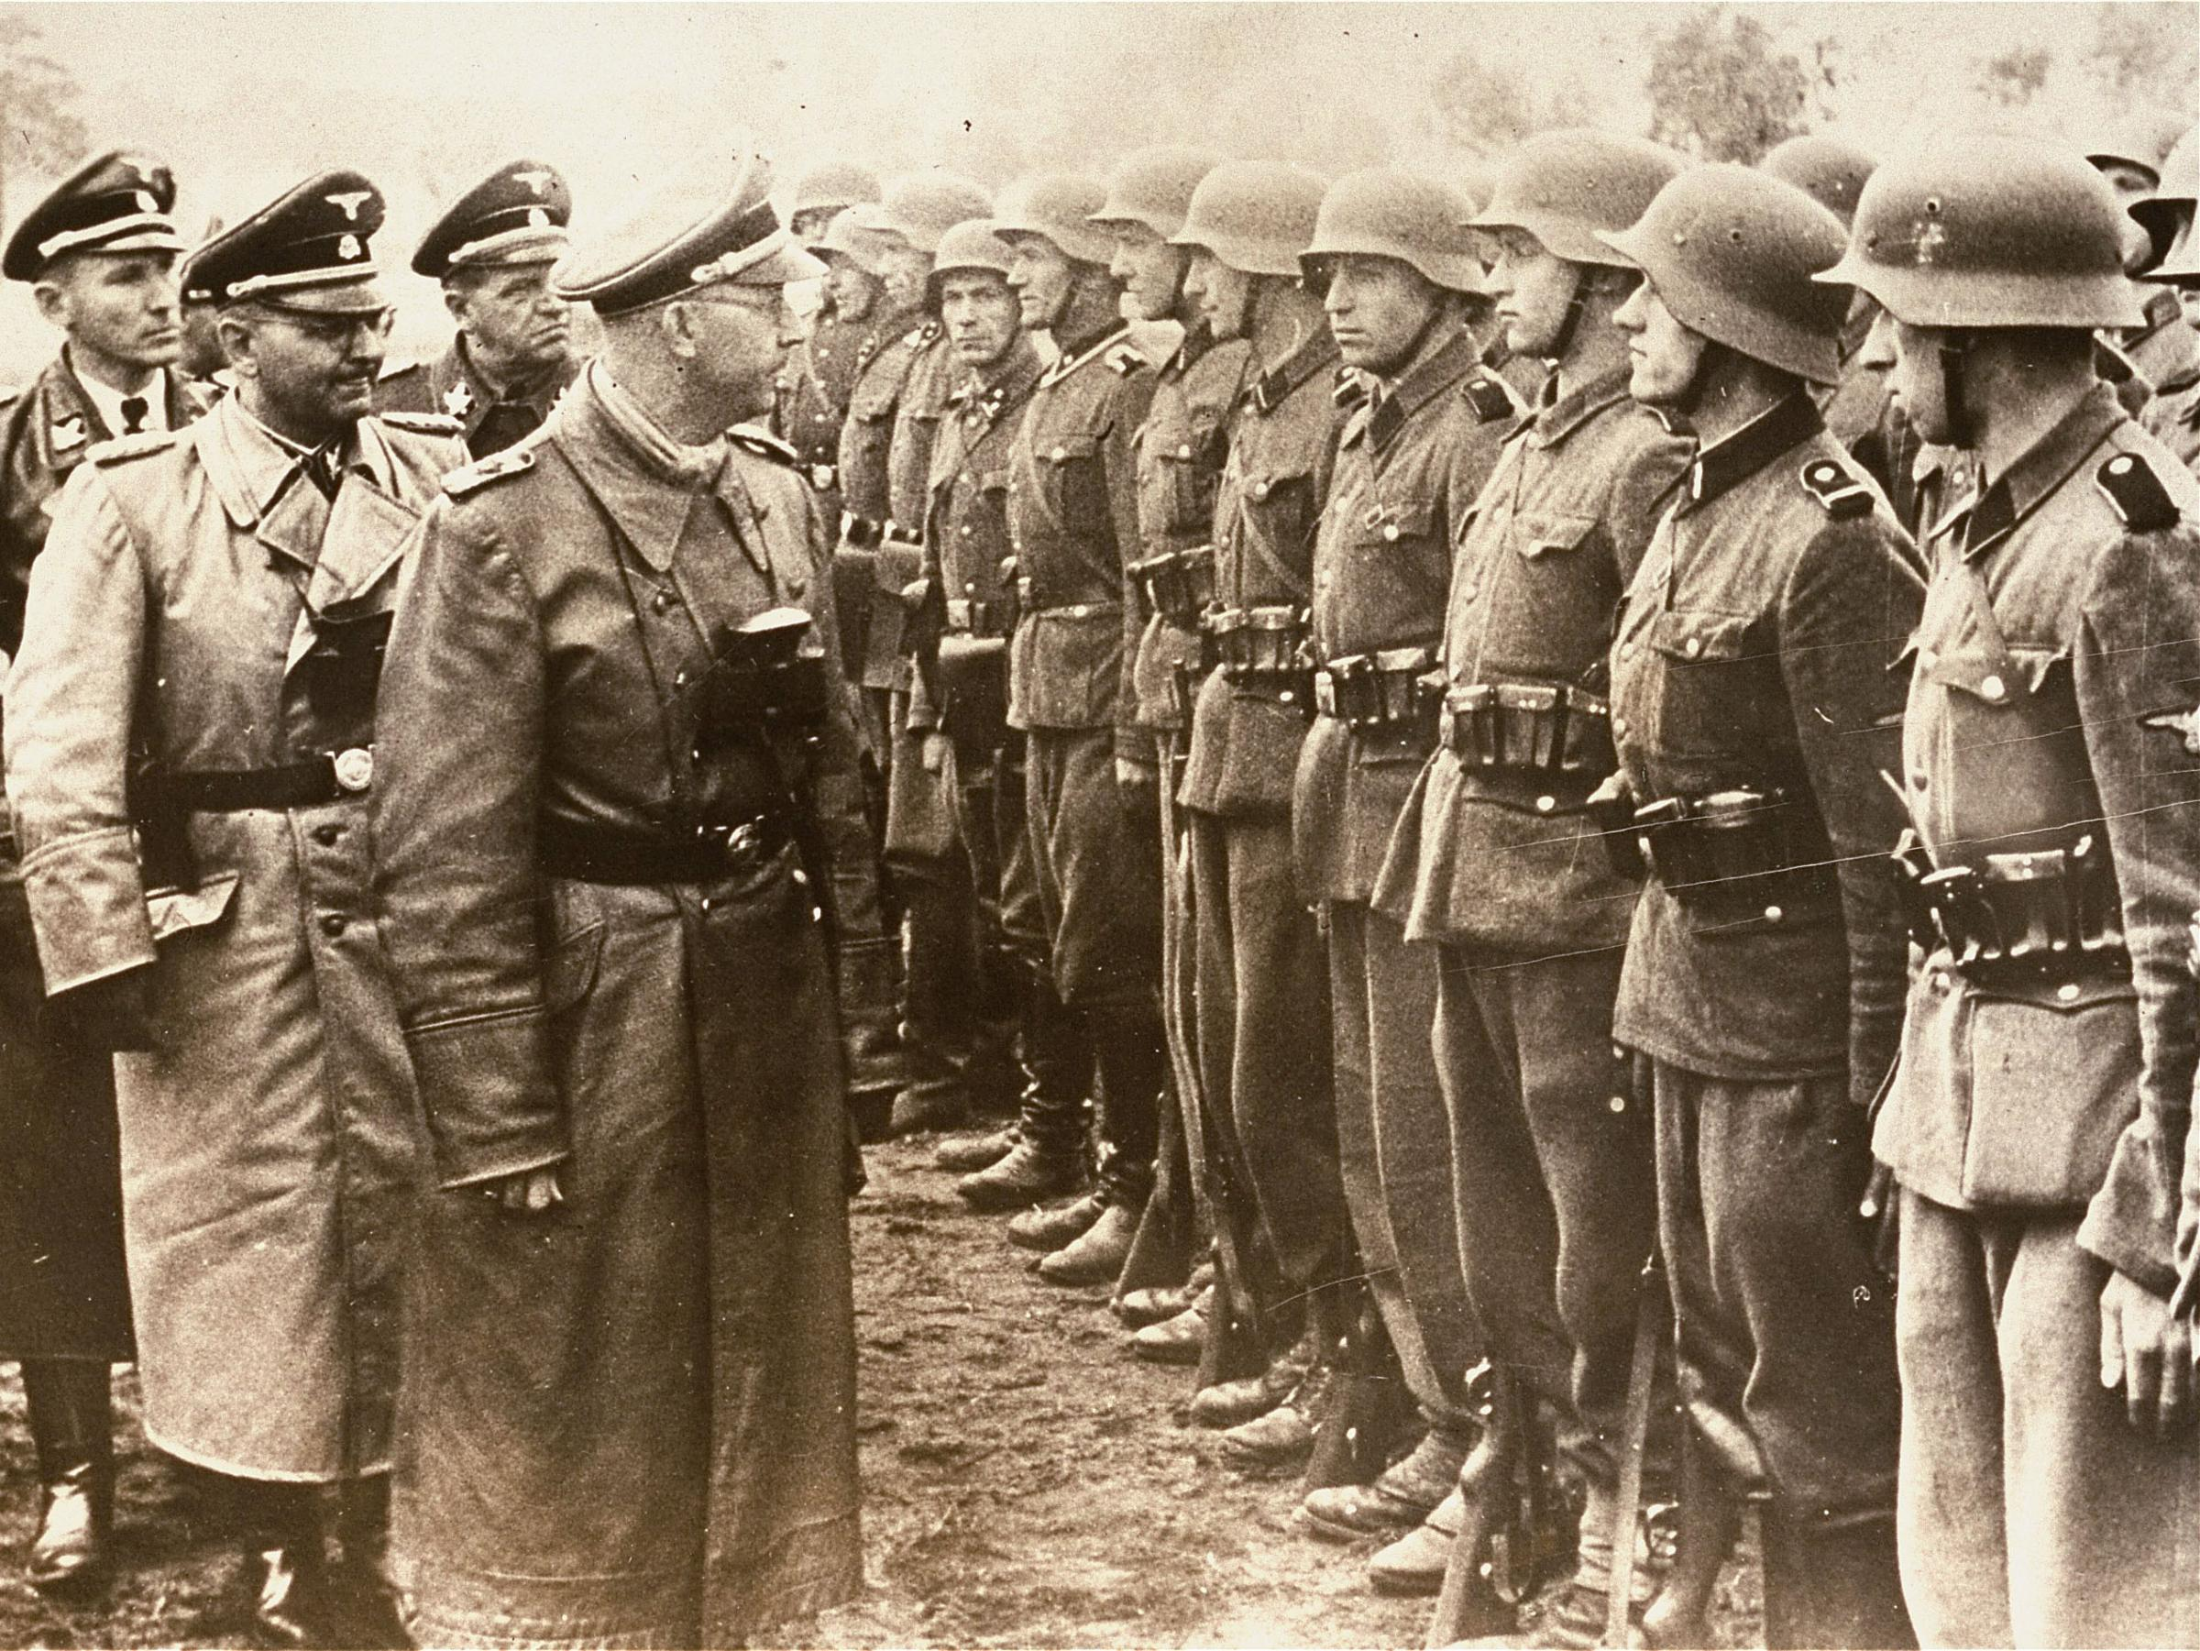

Slide 3
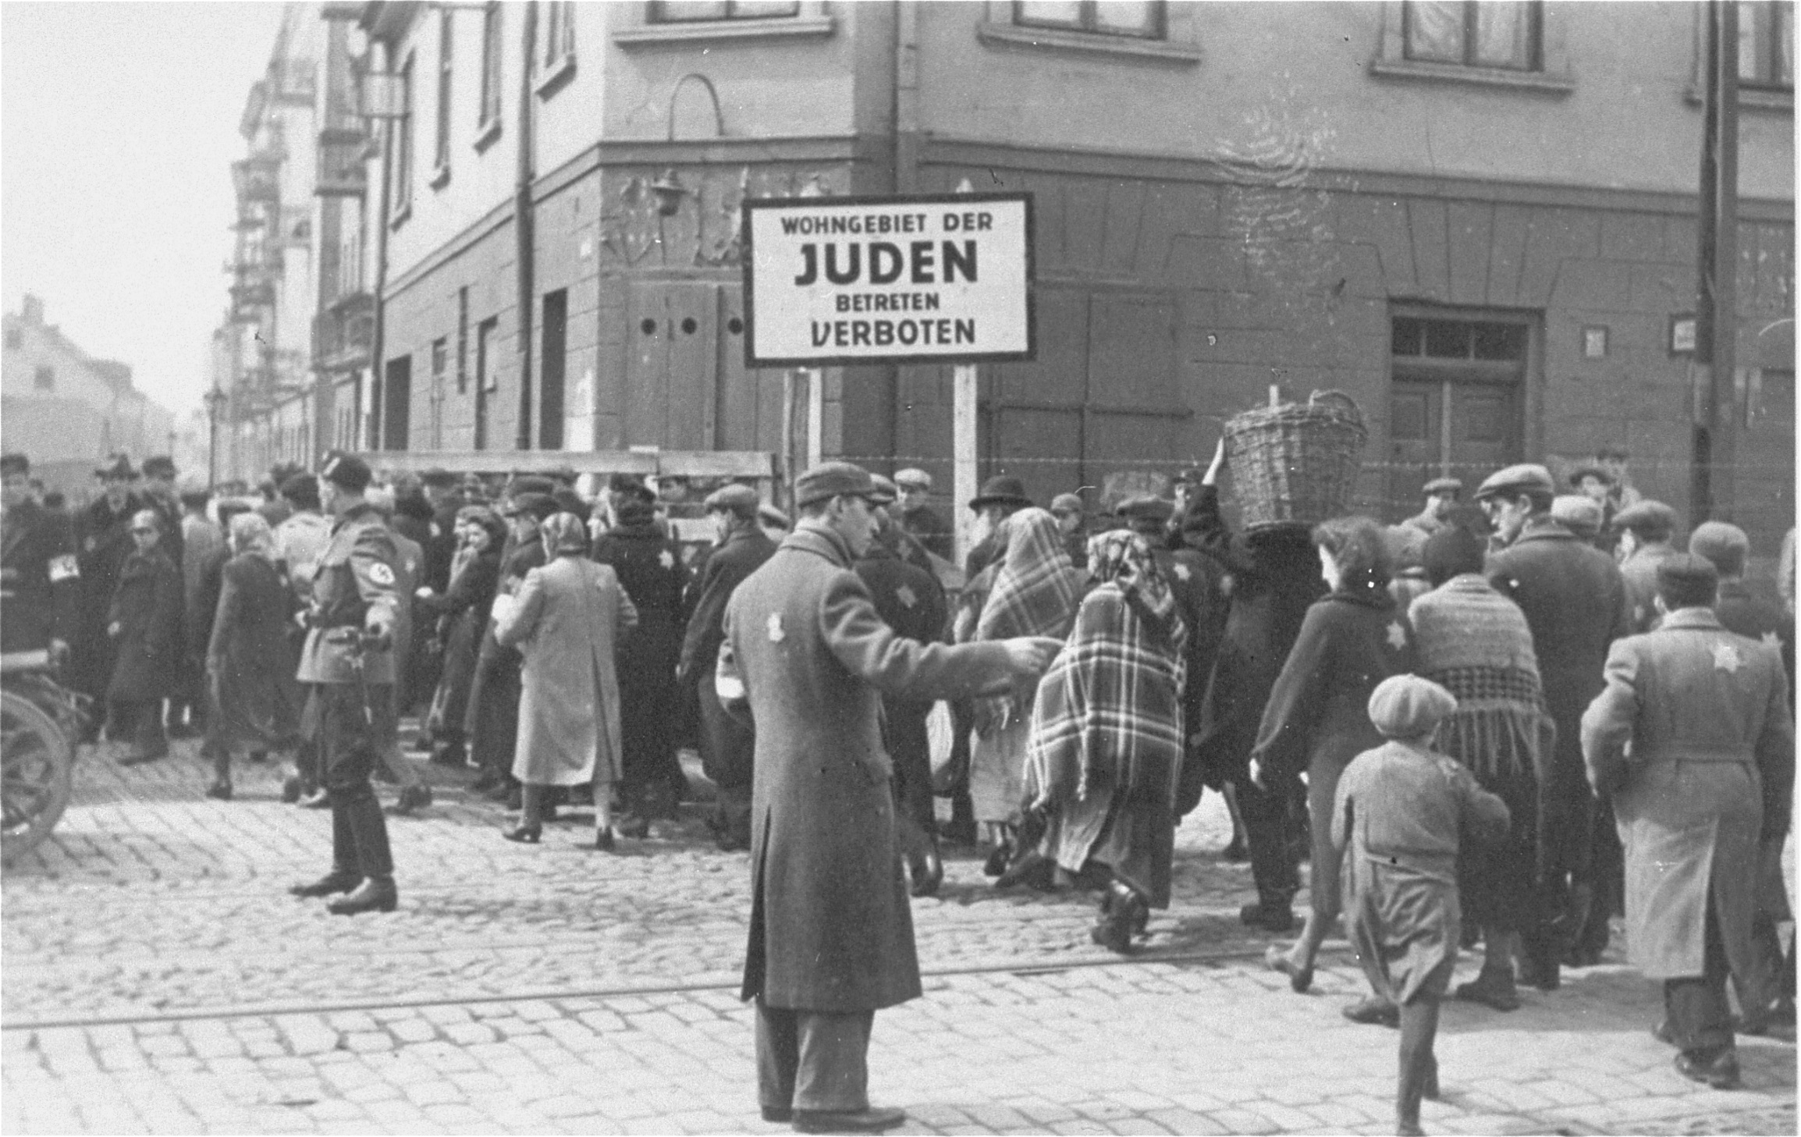

Slide 4
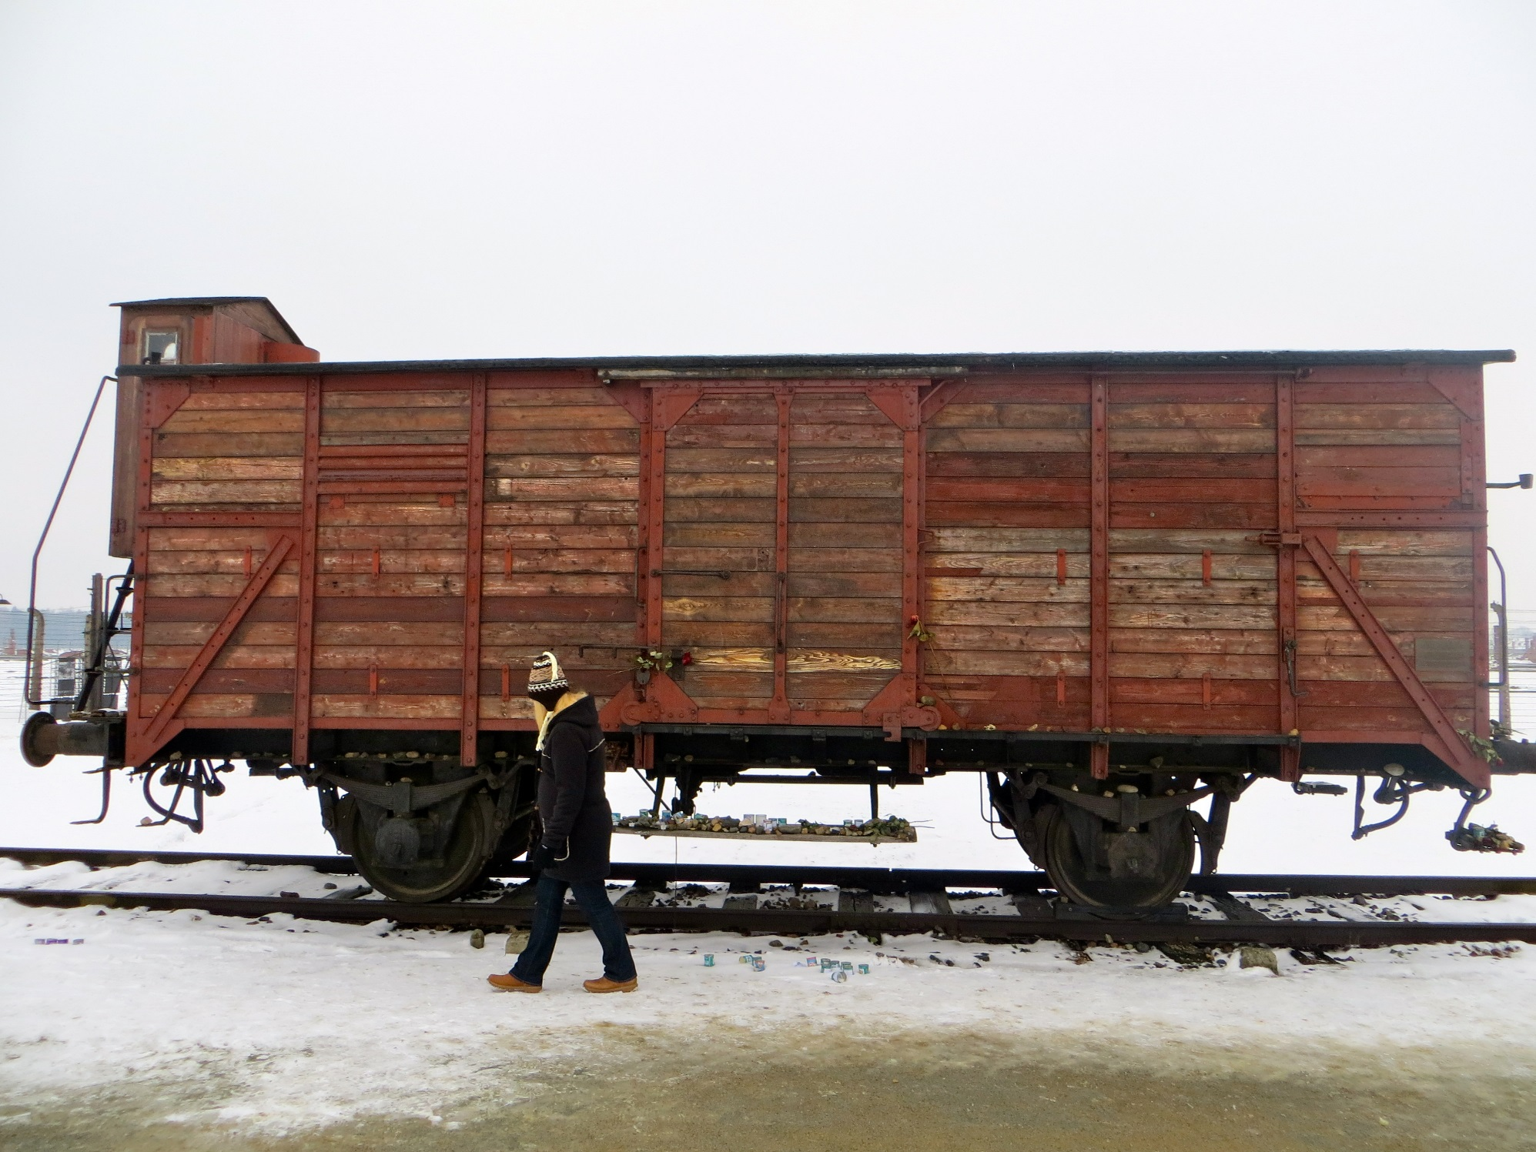

Slide 5
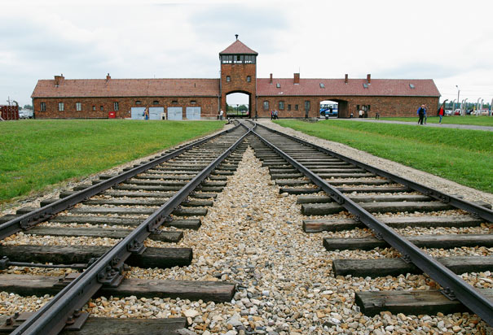

Slide 6
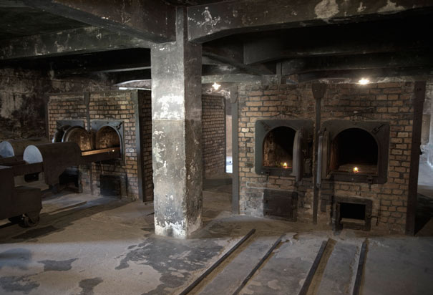
Crematorium

Slide 7
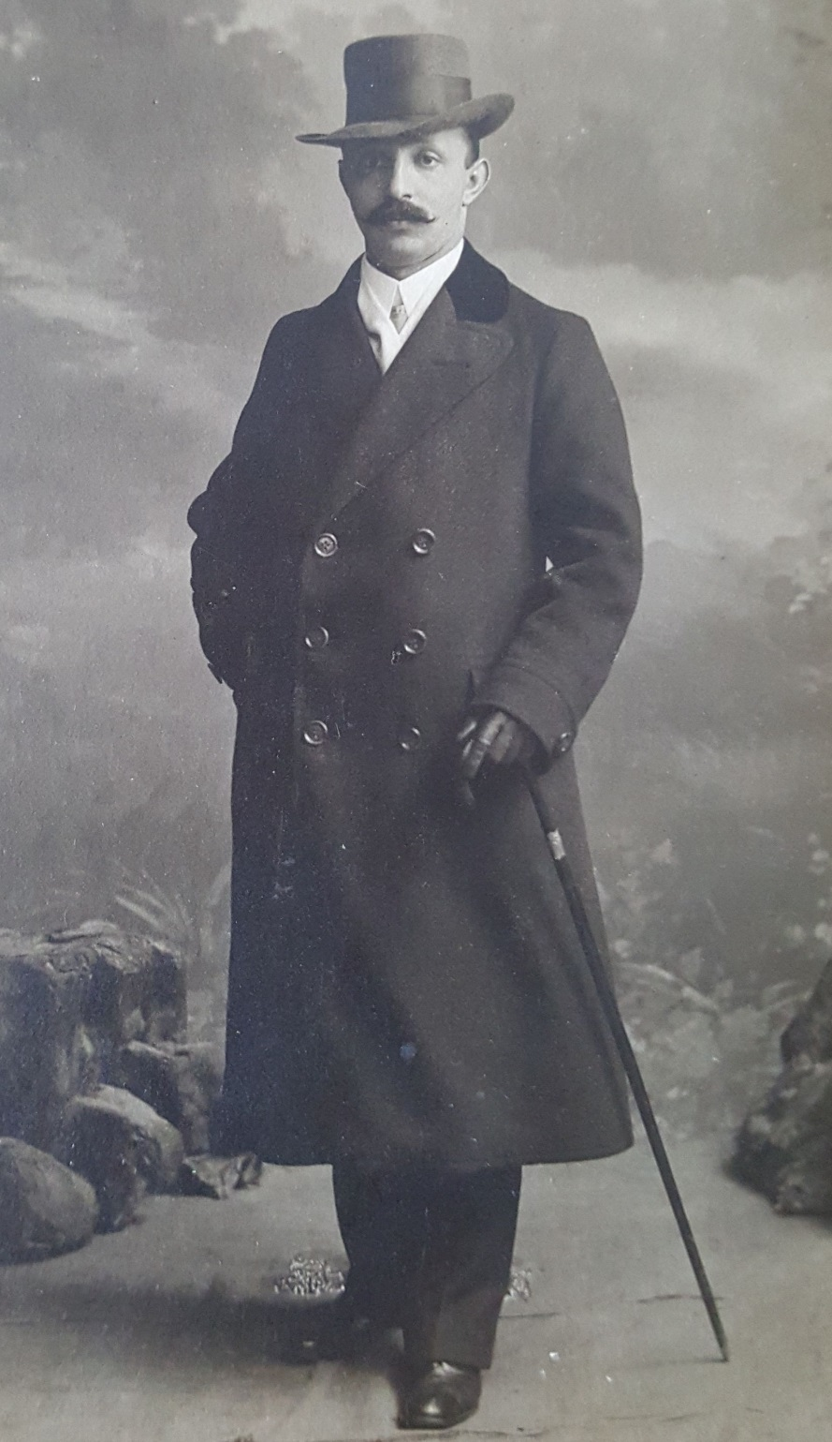
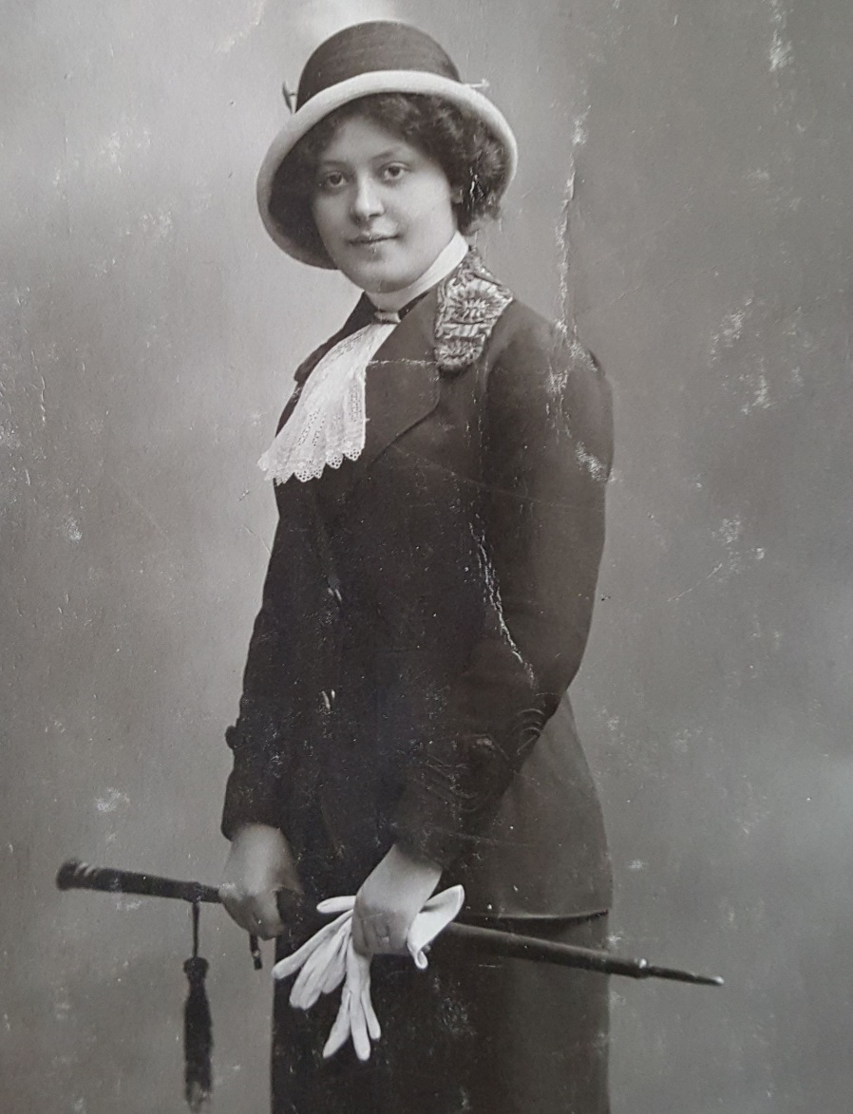

Luba Gumener
1920’s
Wolf Gumener

Slide 8
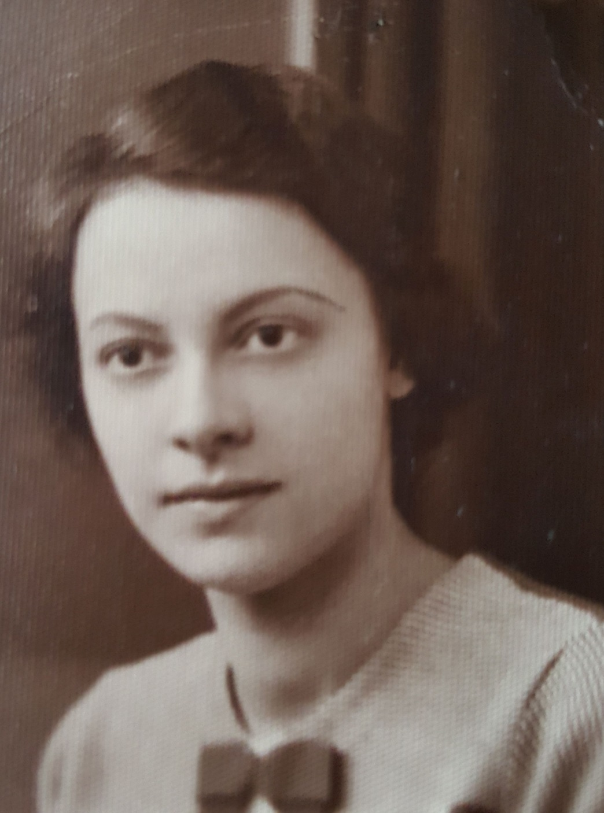
Regina Gumener

Slide 9
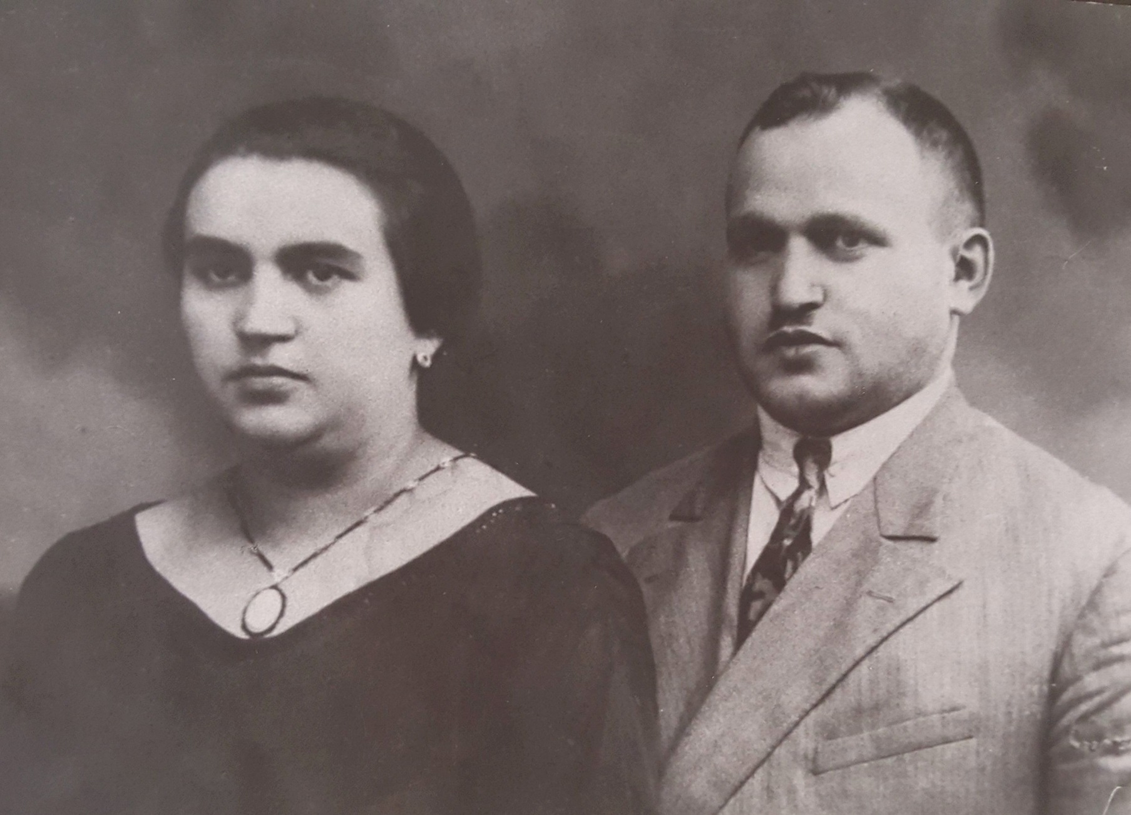
Tauba and Chaim Klajman

Slide 10
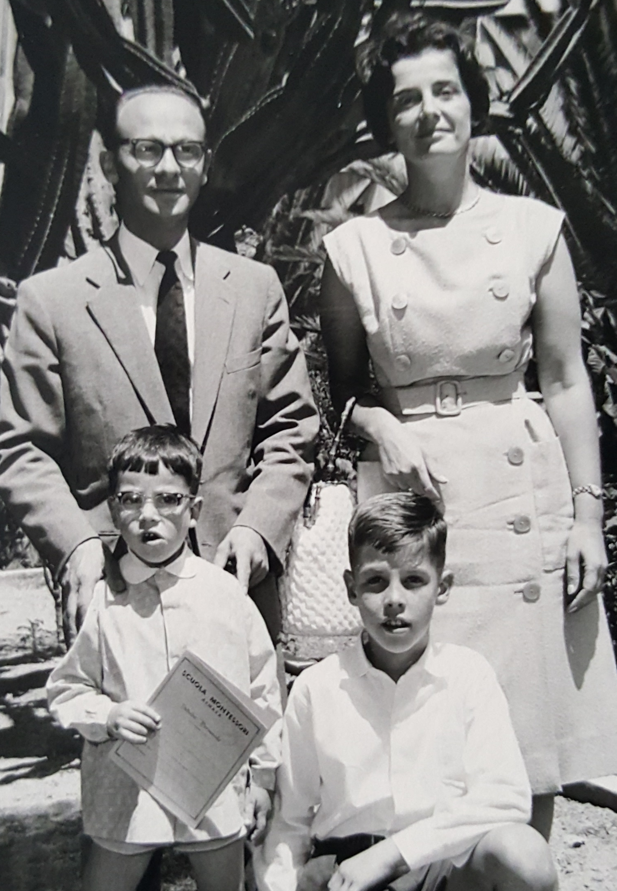

Slide 11
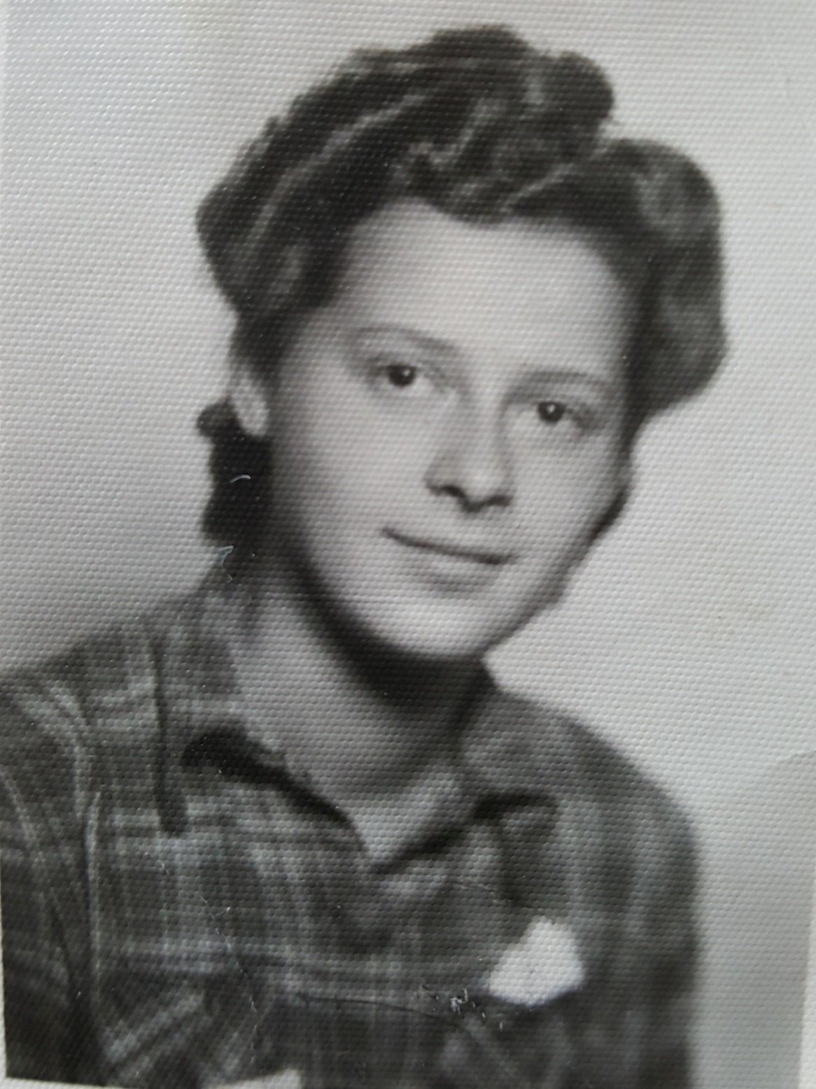
Elsa Gumener
After the liberation

Slide 12
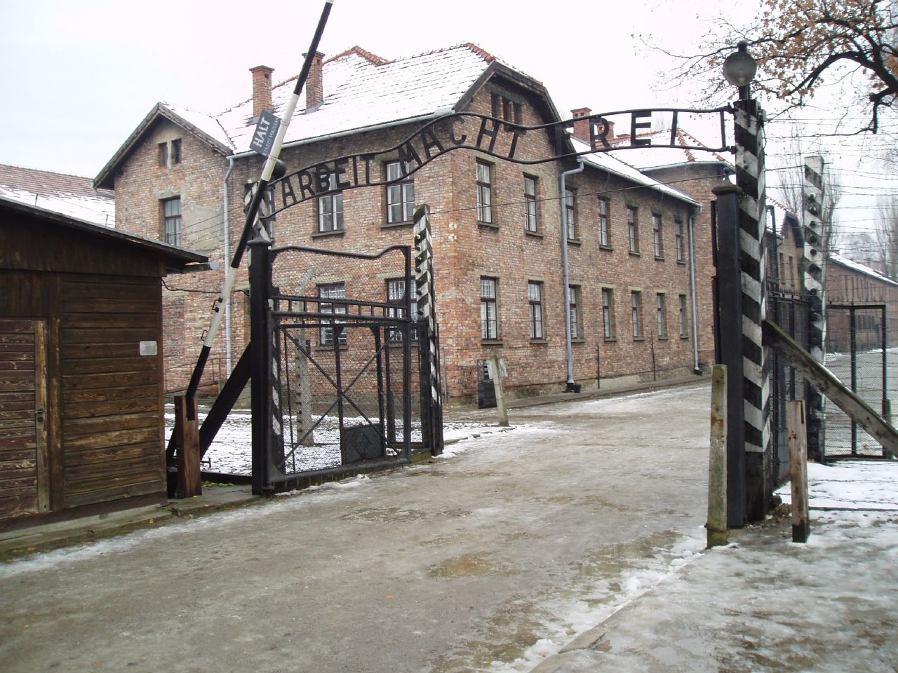

Slide 13
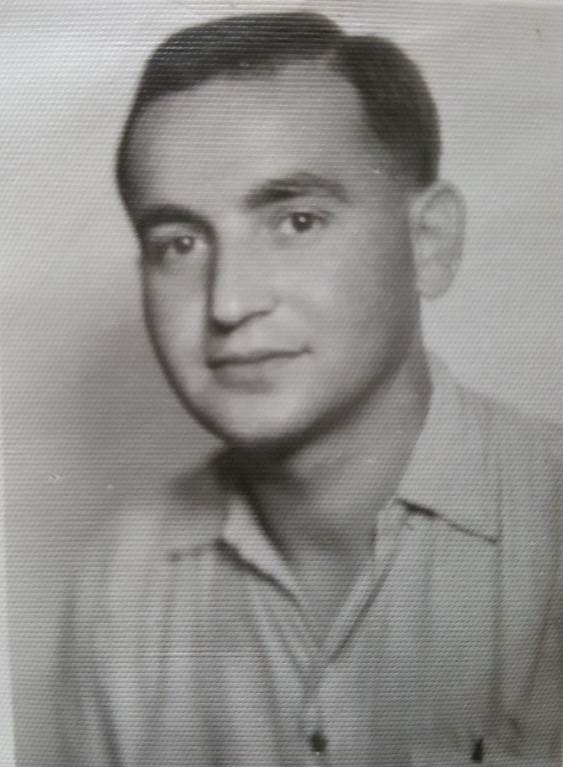
Wolf Klajman
Liberated May 1945

Slide 14
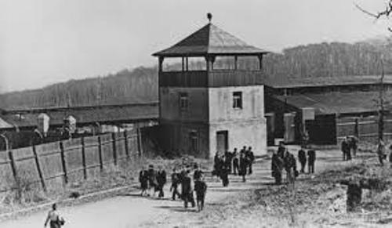
Buchenwald Concentration Camp

Slide 15
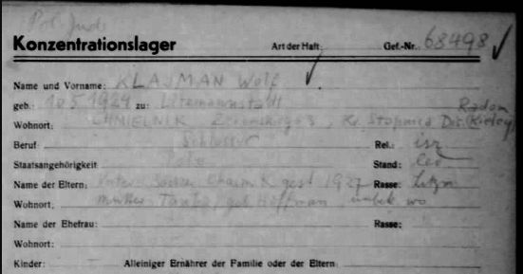

Slide 17

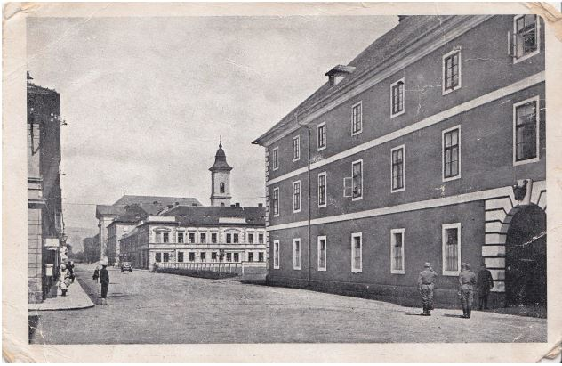
Terezin

Slide 18
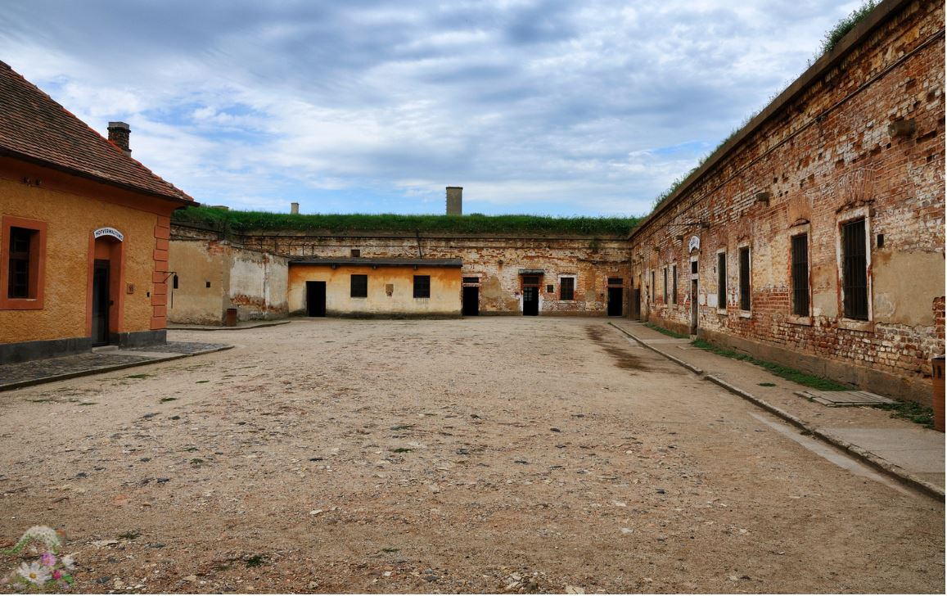
Theresienstadt, Czechoslovakia

Slide 19
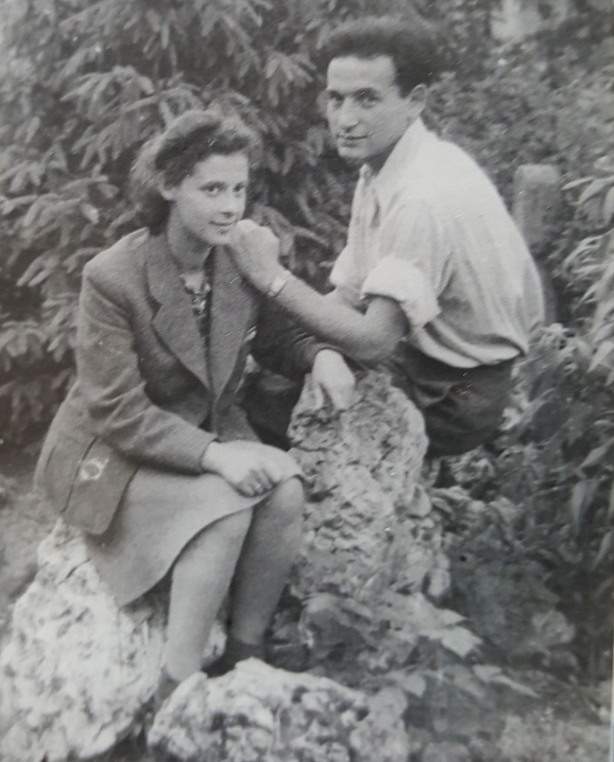
Wilek and Elsa spent time together, getting to know each other. Then they were a couple – but soon to be separated

Slide 20
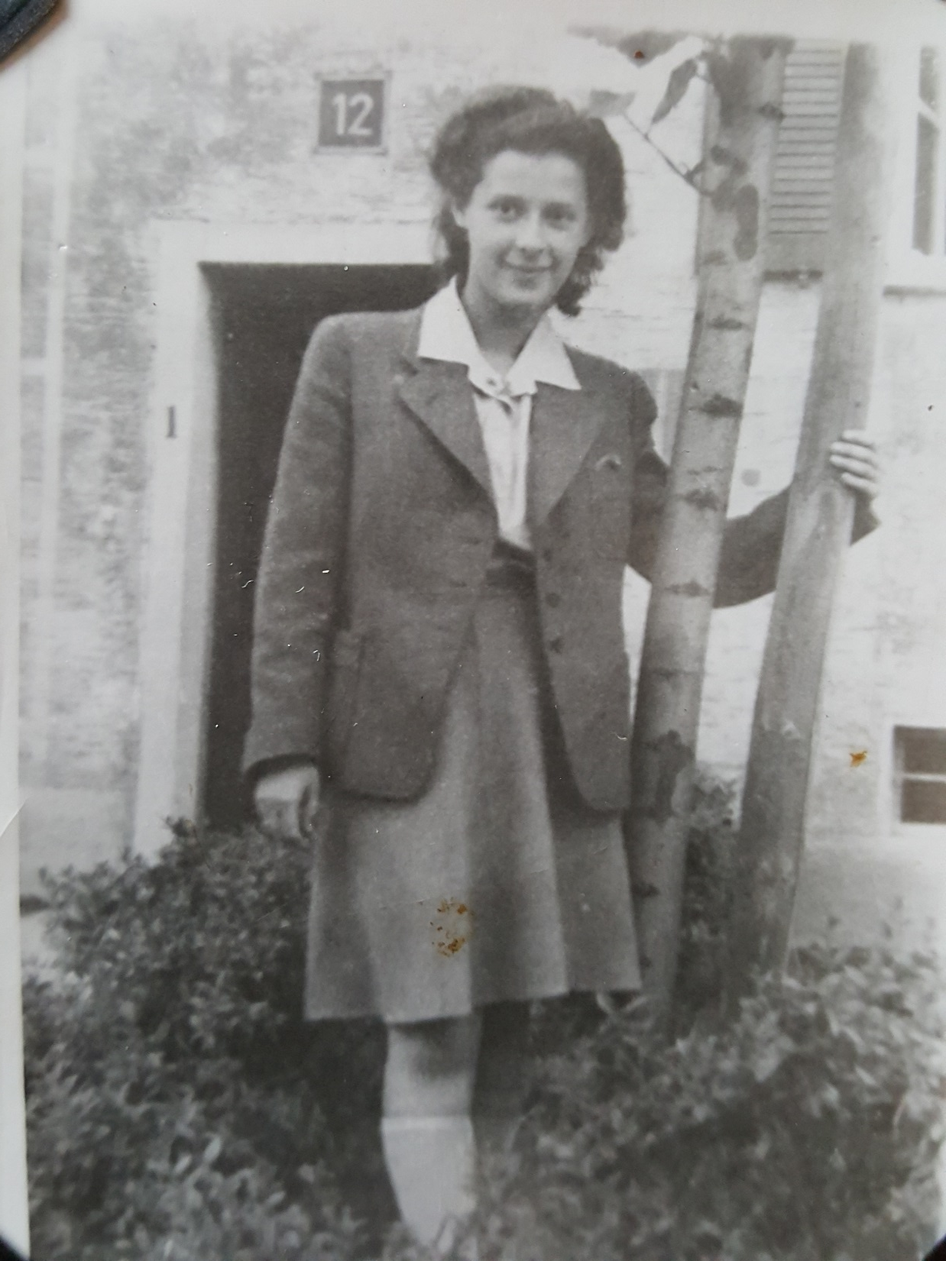
Elsa looking young enough
for the Kinderheim, to be transported to England.

Slide 21


Slide 22
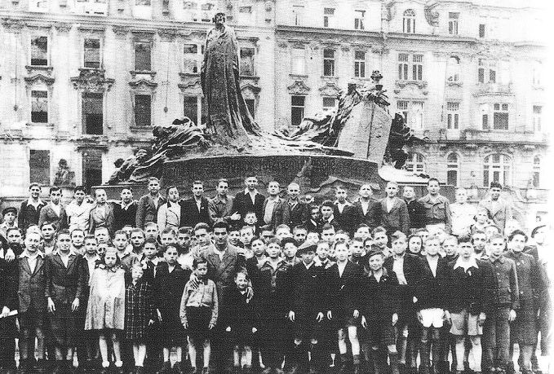

Slide 23
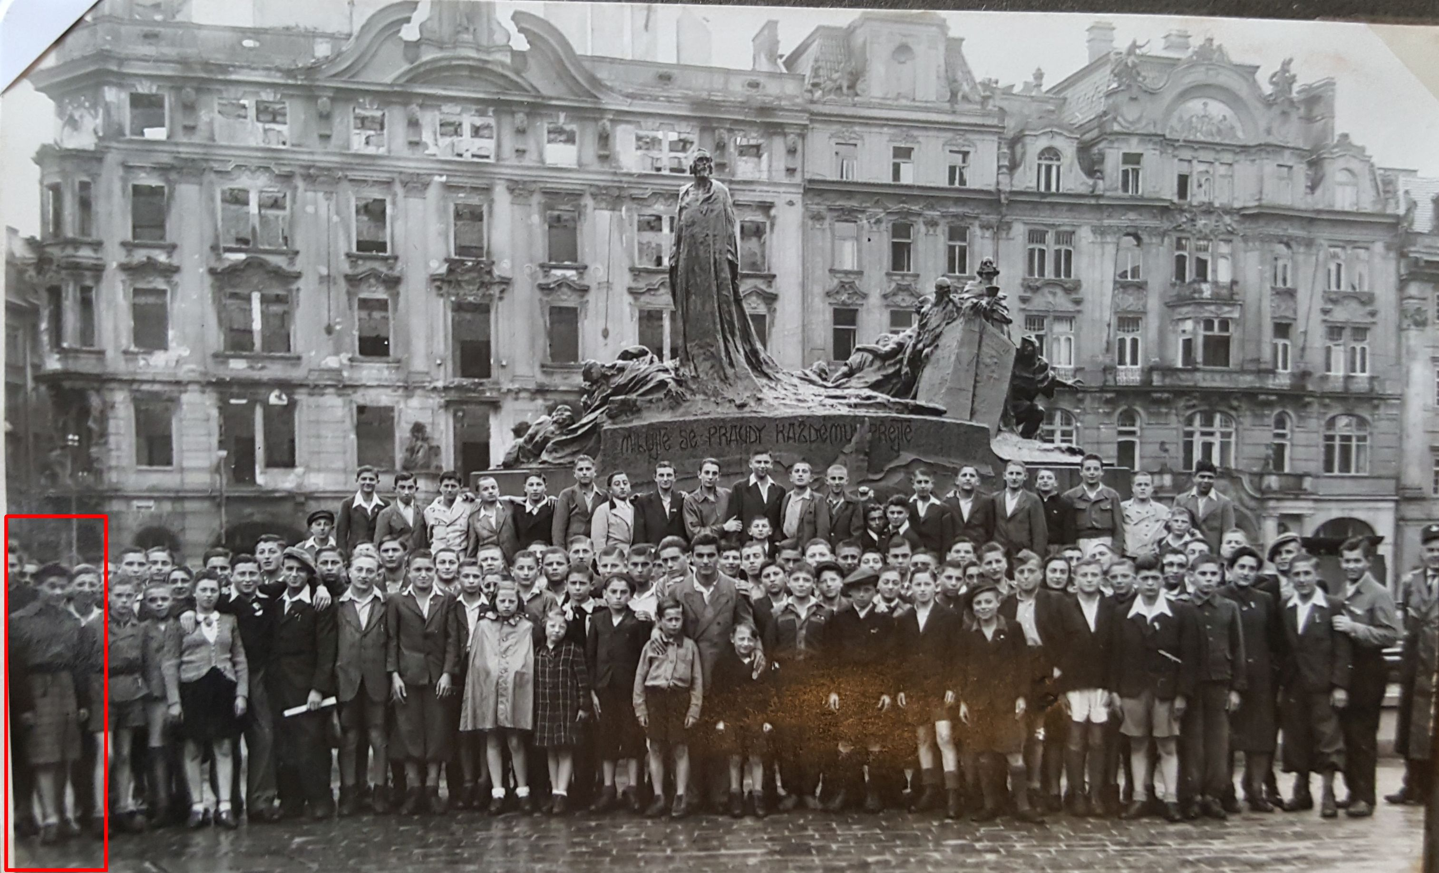

Slide 24
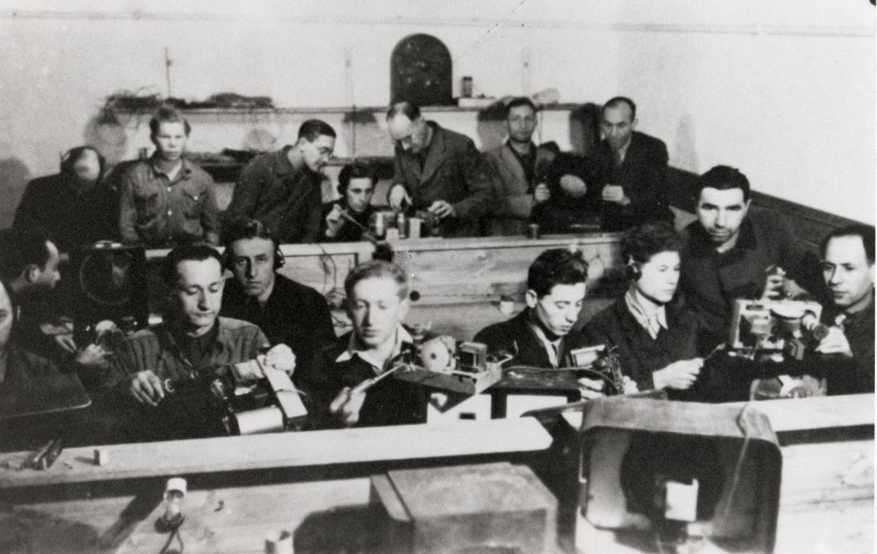
Landsberg ORT vocational school
(Obchestvo Remeslenogo Truda: Association for the Promotion of Skilled Trades")

Slide 26
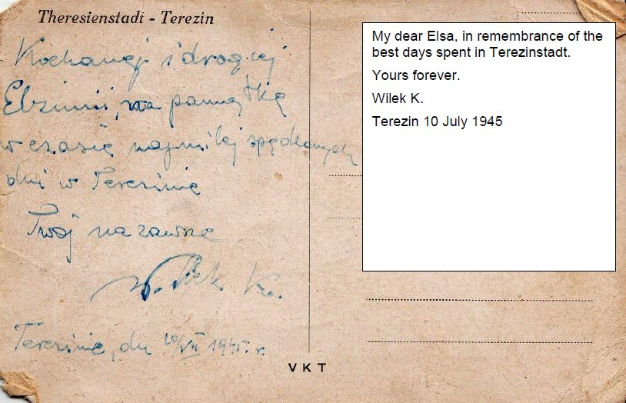

Slide 27
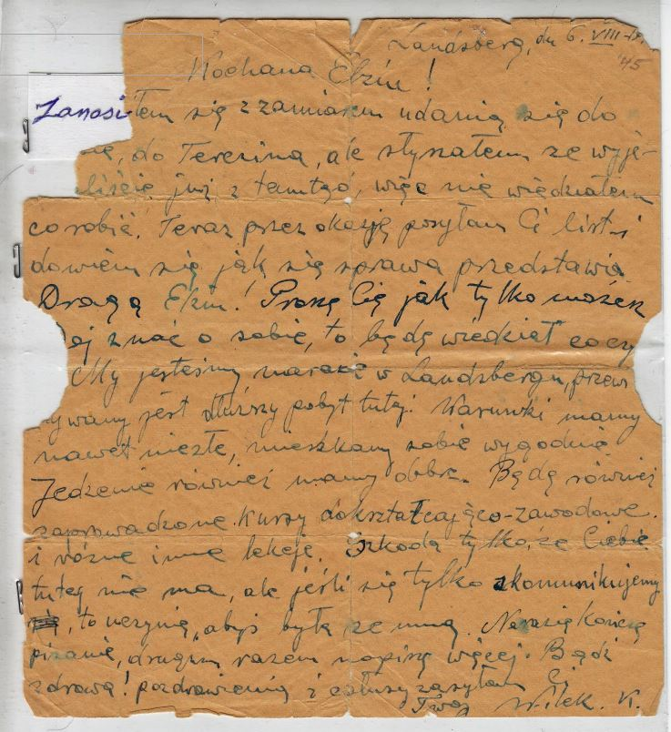

Slide 28
Landsberg, August 6, 1945
Dear Elzia !
I have been thinking of coming to you in Terezin, but I heard that you already left there, so I wasn't sure what to do. Now I have a chance to send you a letter in hopes of finding out what the situation is.
Dear Elzia! Please tell me know your news as soon as you can, so that I can know how you are.
In the meantime, we are in Landsberg, we are expected to be here for quite a while. The conditions are not bad; we are living comfortably. The food is good, too. Soon they will organize education and profession-oriented classes. It's a pity that you are not here, but as soon as we can communicate, I will make it so that you can join me.
For now, I end this letter. Next time I will write more. Be well!
I send you greetings and kisses.
Your Wilek K.

Slide 29
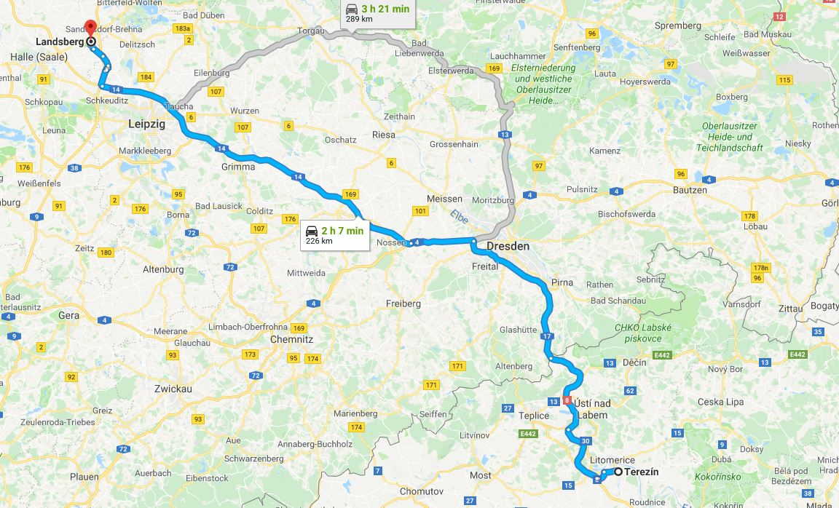

Slide 30
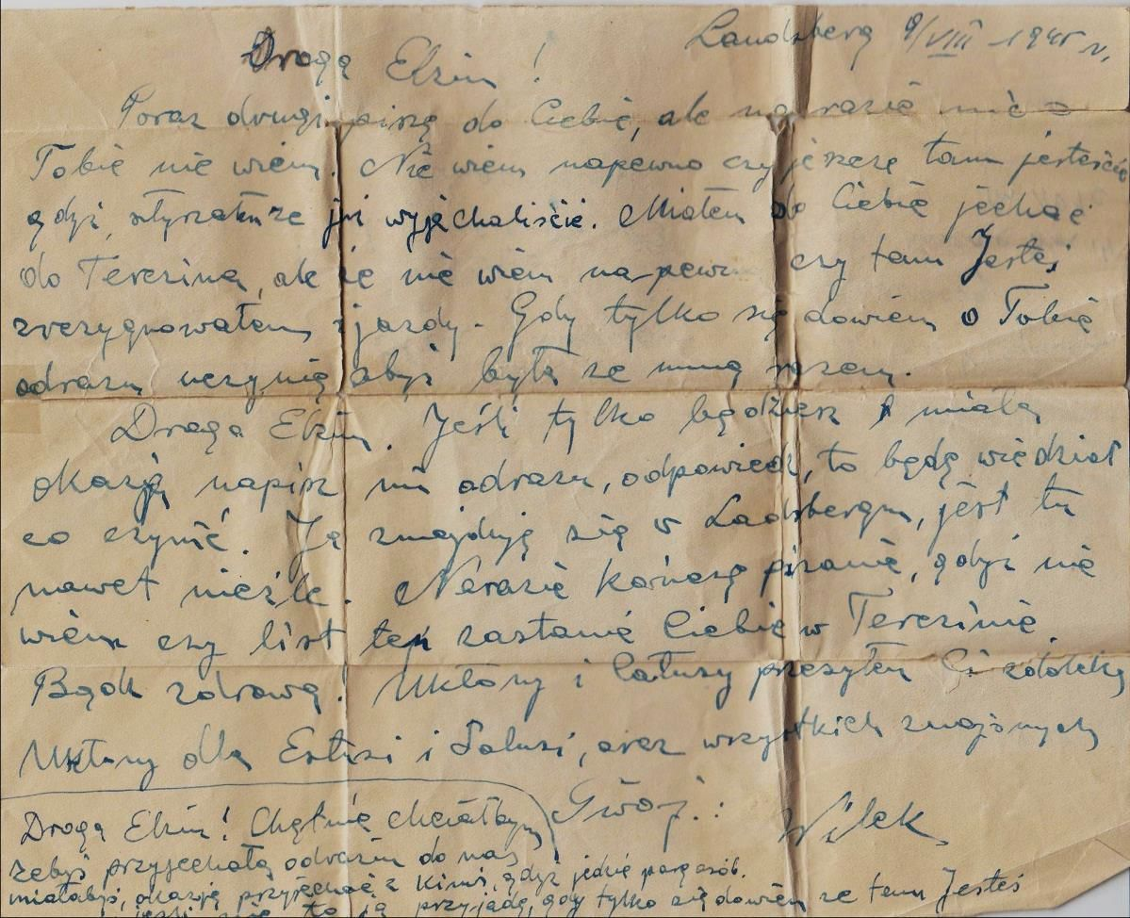

Slide 31
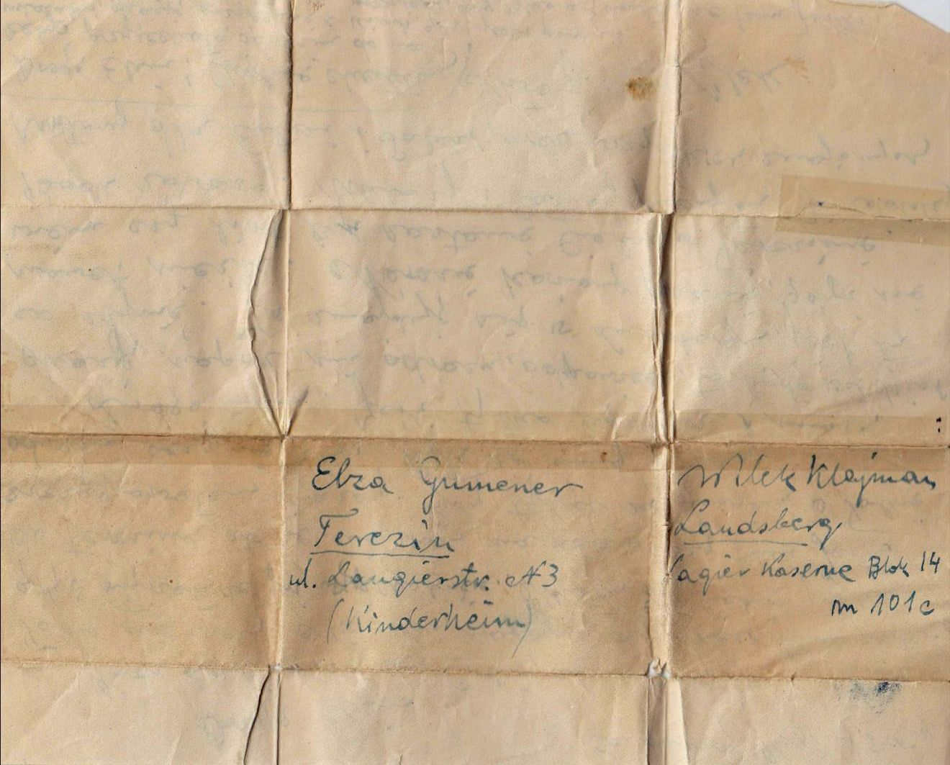

Slide 32
August 9, 1945
Dear Elsa,
This is the second time I am writing to you and I still don’t know anything about your plans. I don’t know for sure if you are still there because I heard that you already left. I planned to go to Terezin, but I am not sure if you are still there, so I decided not to go. If I hear that you are there, I will do my best to get together.
Dear Elsa, if you have a chance, write to me and I will know what to do. I am in Landsberg and it looks like it’s not too bad.
I am ending this letter because I’m not sure it will reach you. Be well. Hello and kisses from far away.
Wilek

Slide 33
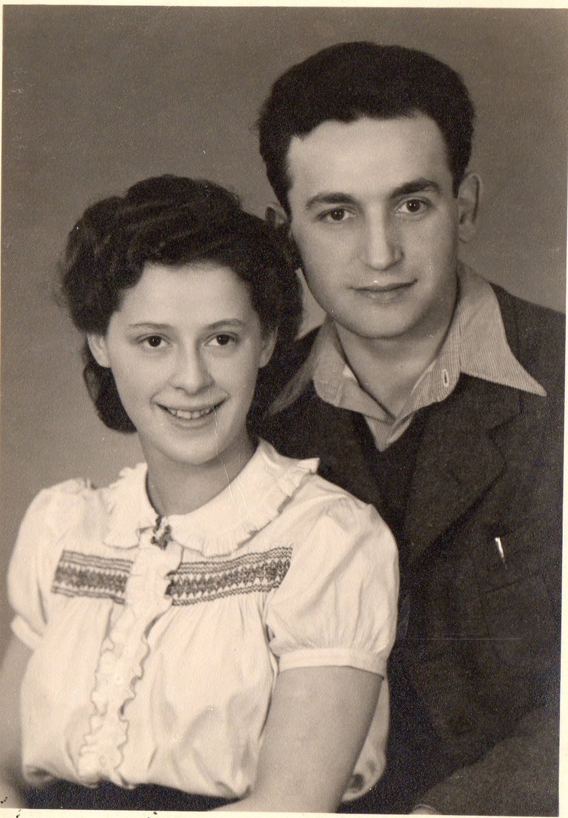
Together again

Slide 34
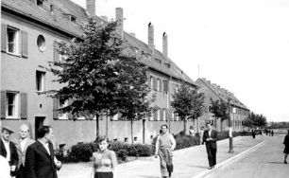

Slide 35
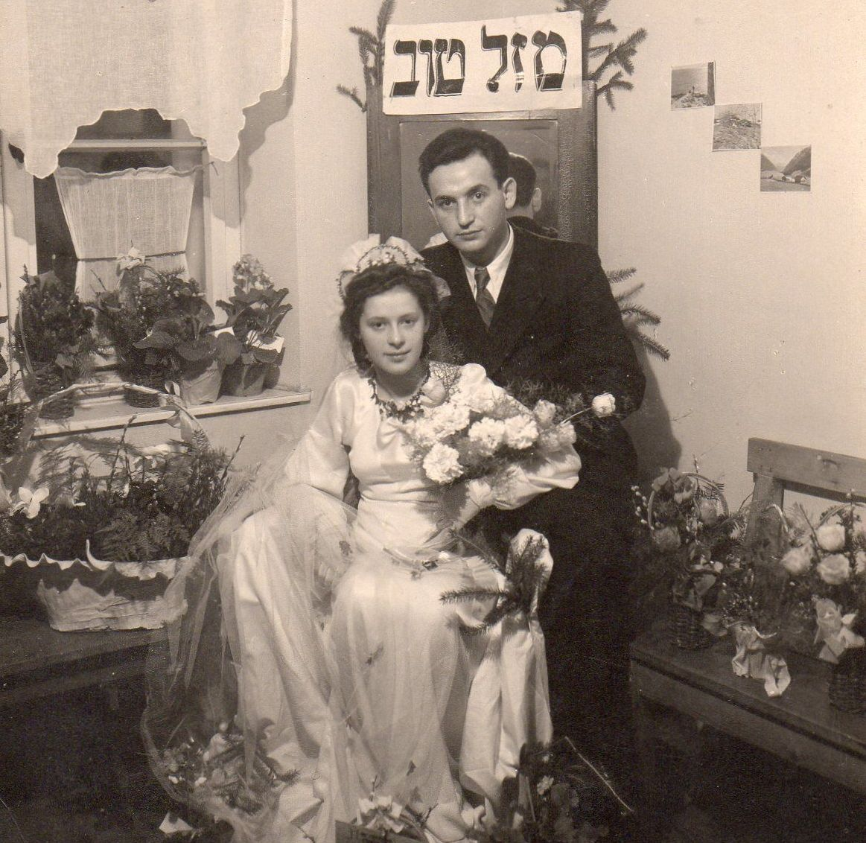

Slide 36
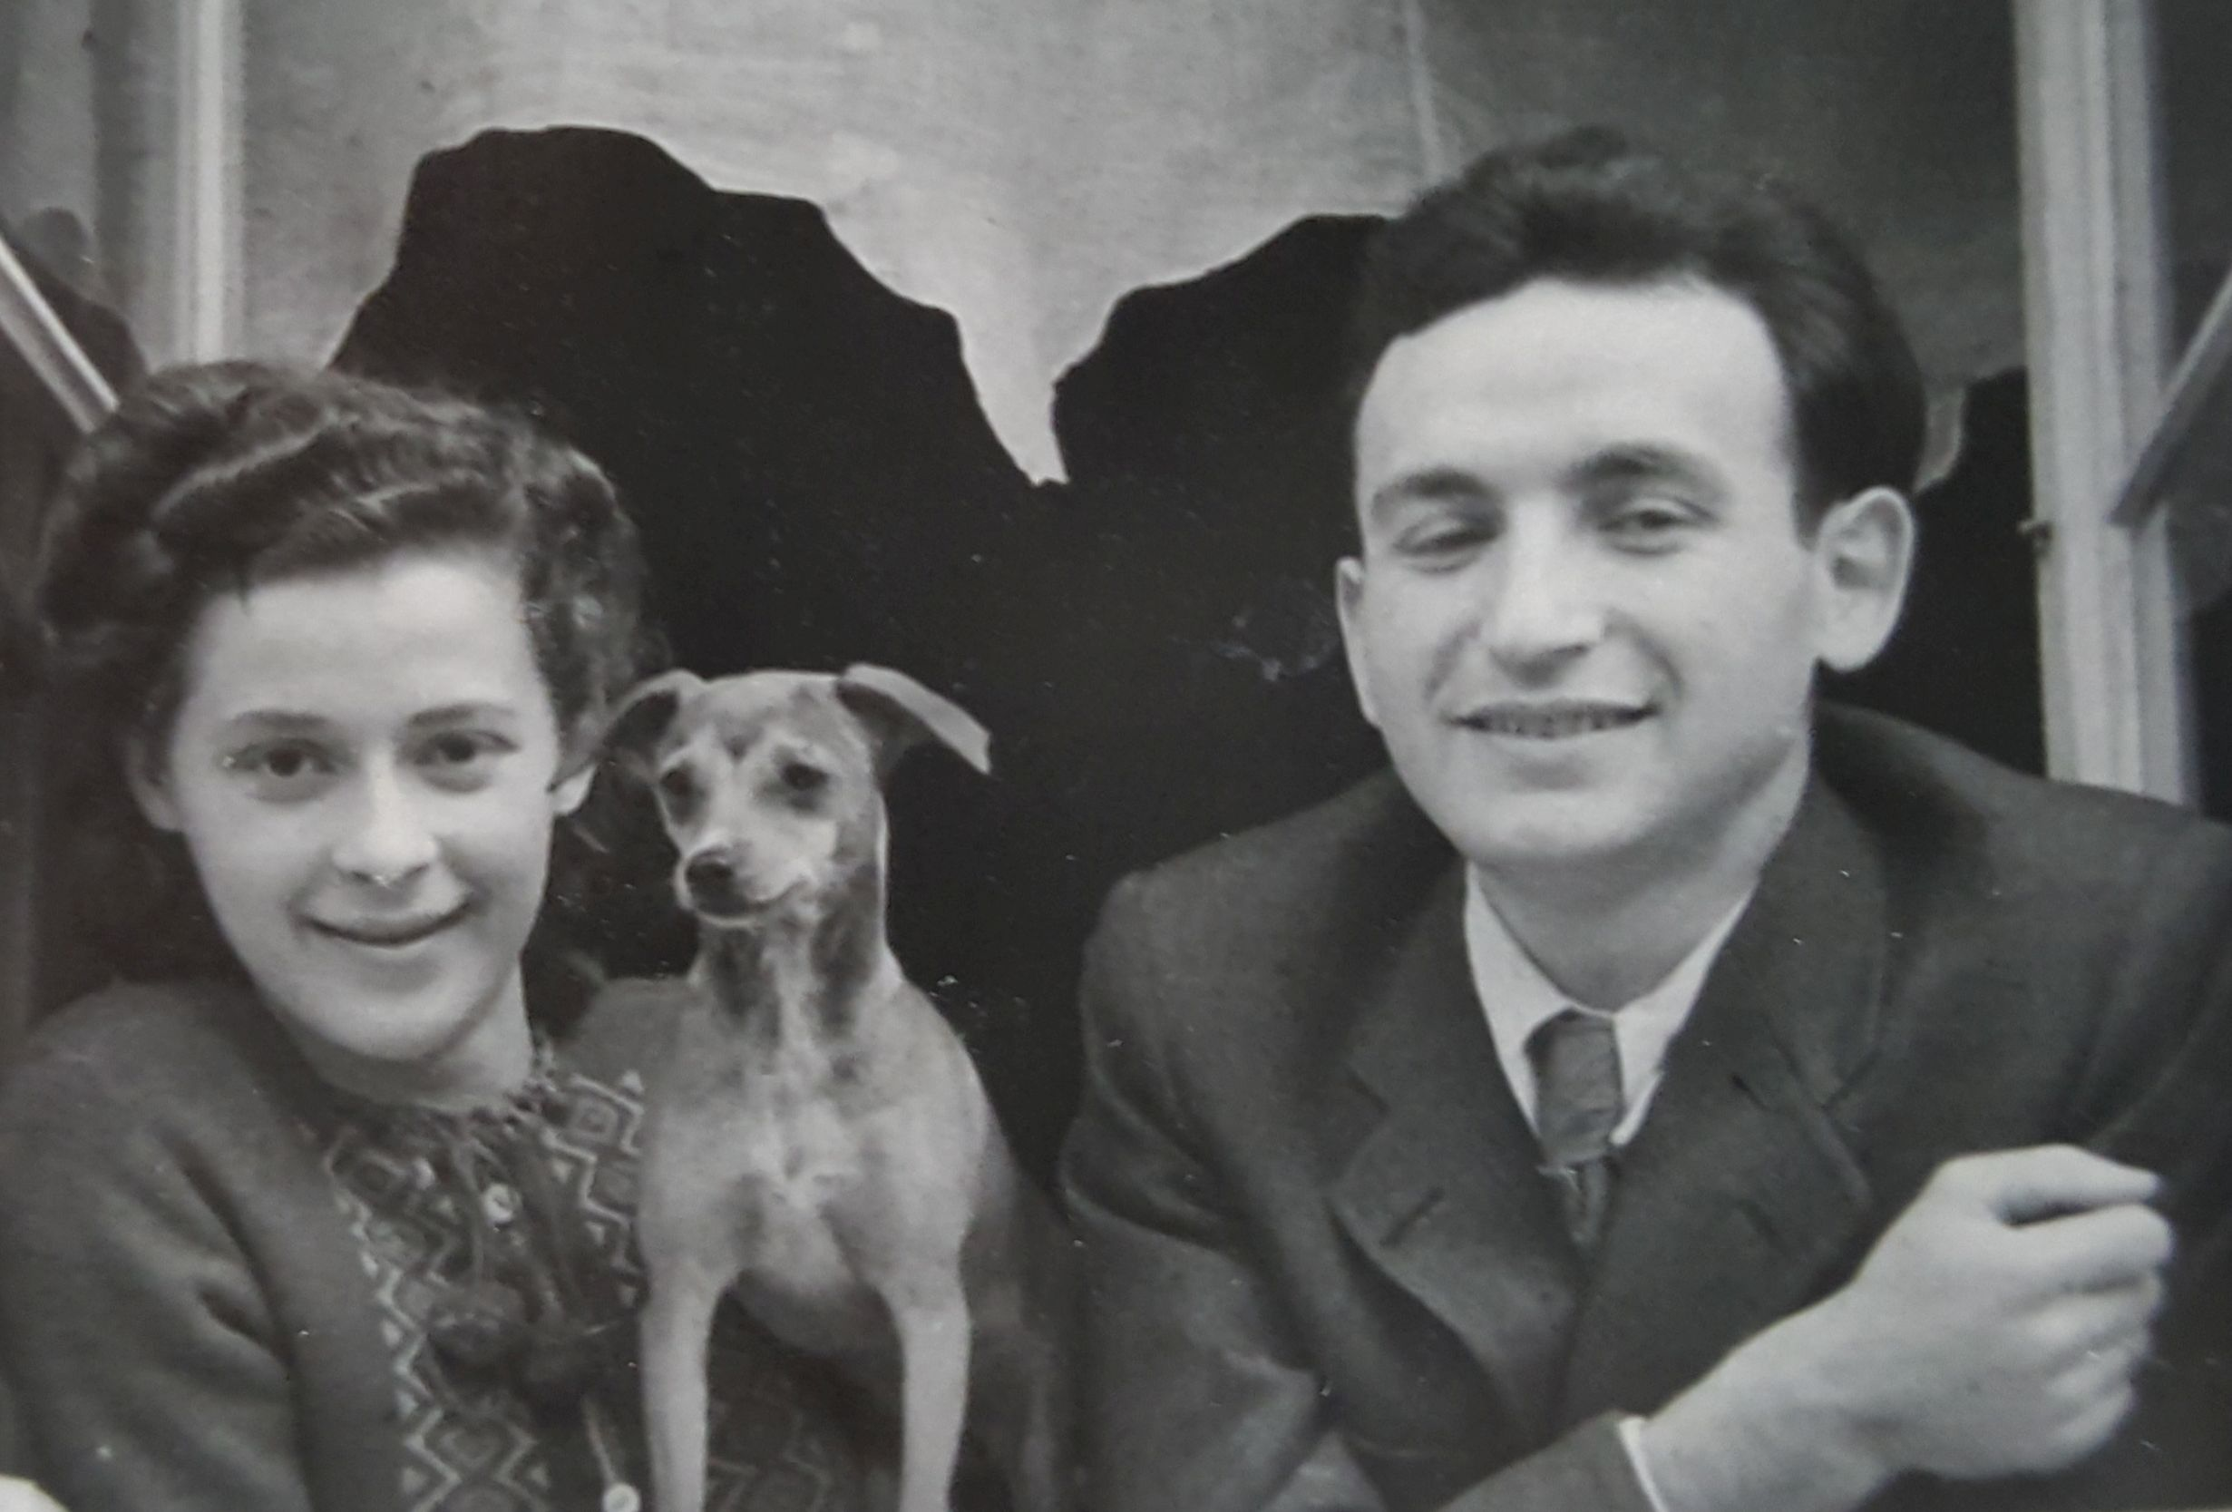

Slide 37
The displaced persons that were trying to come to America had to have a sponsor and a place to live before their arrival,
a guarantee that they would not displace American workers and,
even more preferable, was that they had a relative that is an American citizen.
Voluntary social service agencies, created by religious and ethnic groups, helped the refugees settle into American life

Slide 38
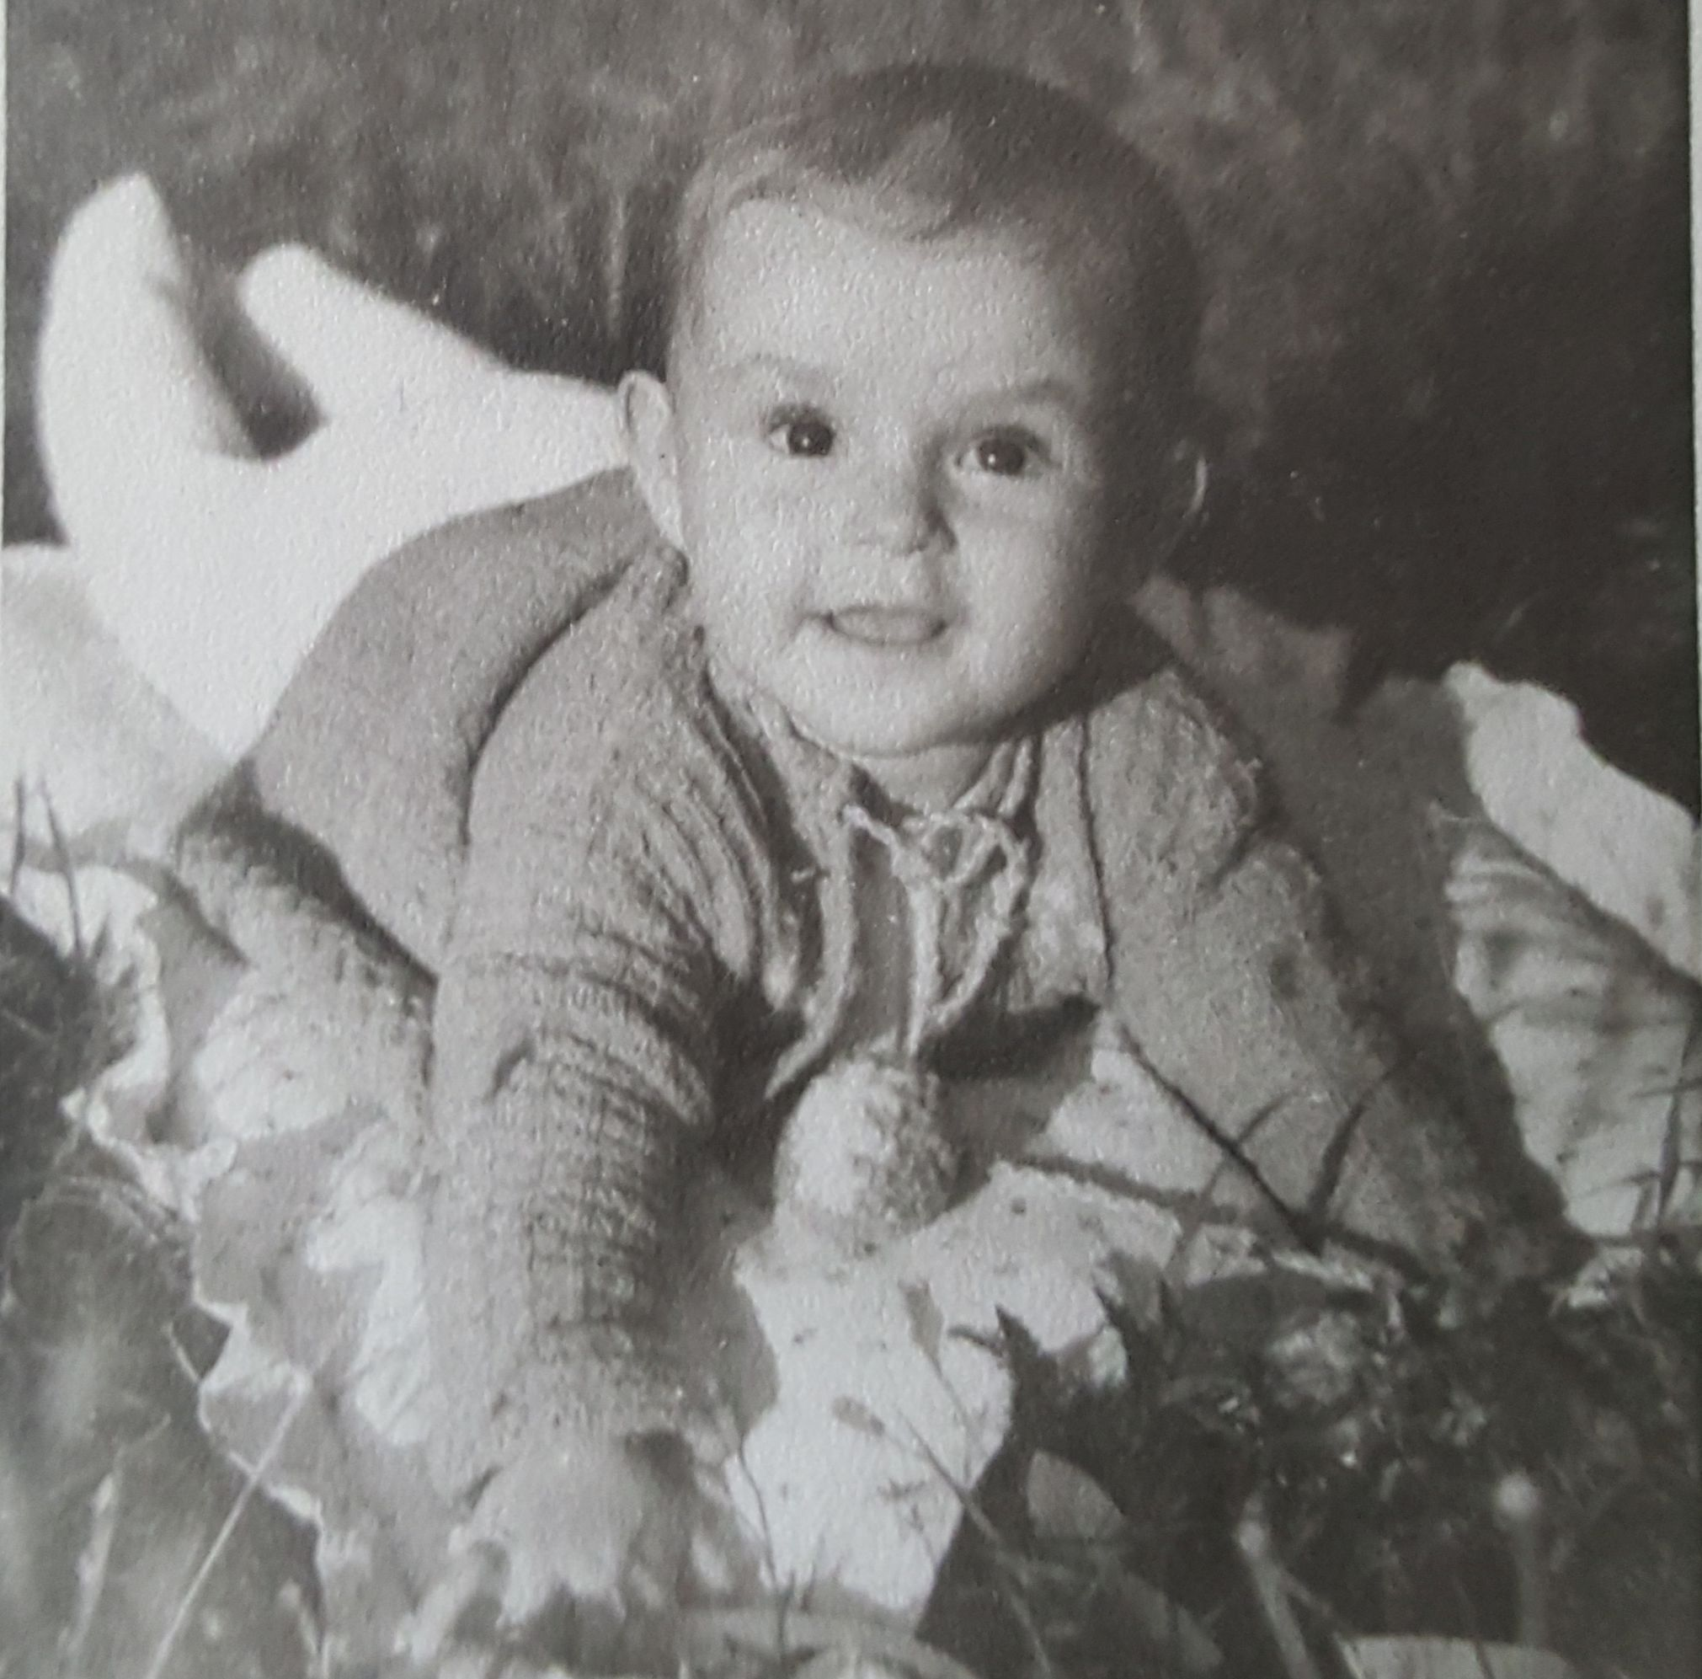

Slide 39
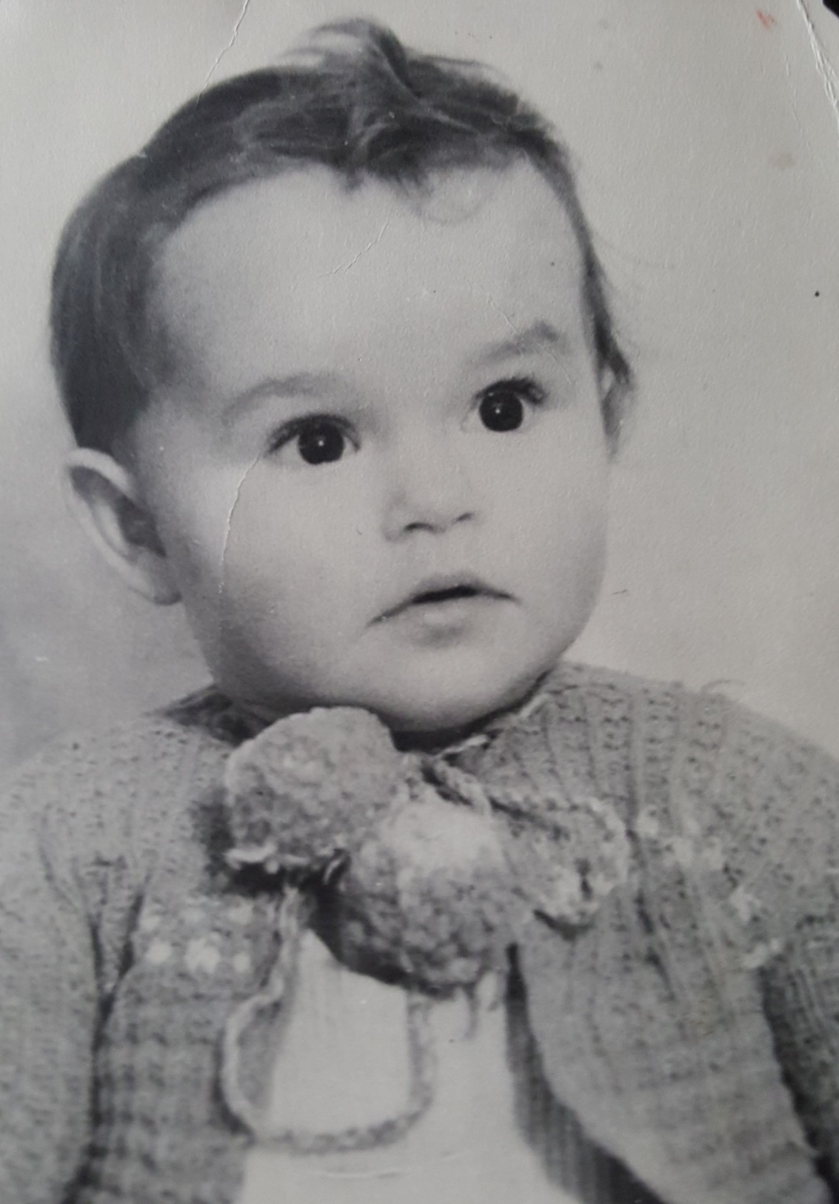

Slide 40
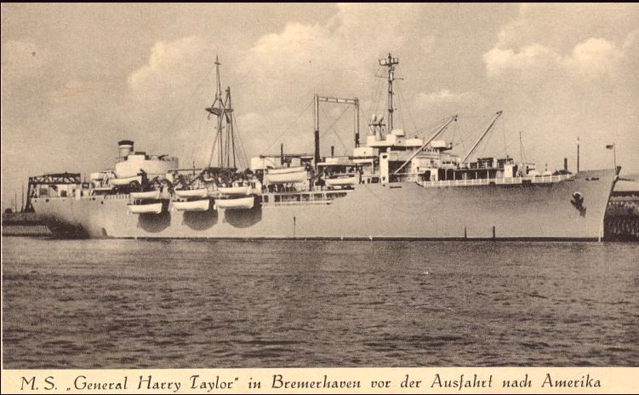
USNS General Harry Taylor served the Military Sealift Command, carrying refugees and displaced persons from Europe to America and Australia.

Slide 41
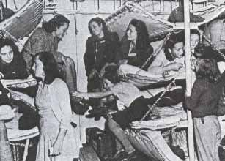
A typical women’s space on the ship

Slide 42
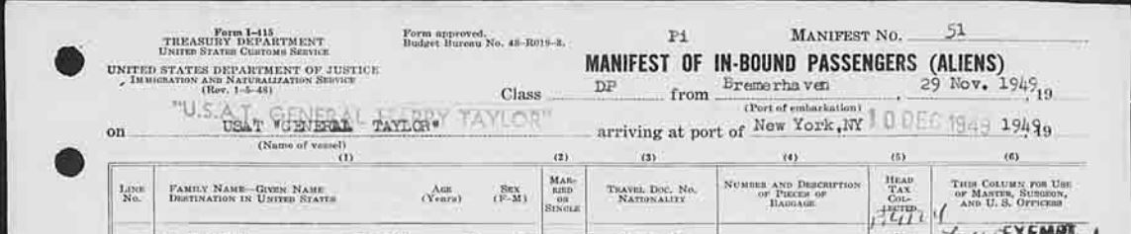
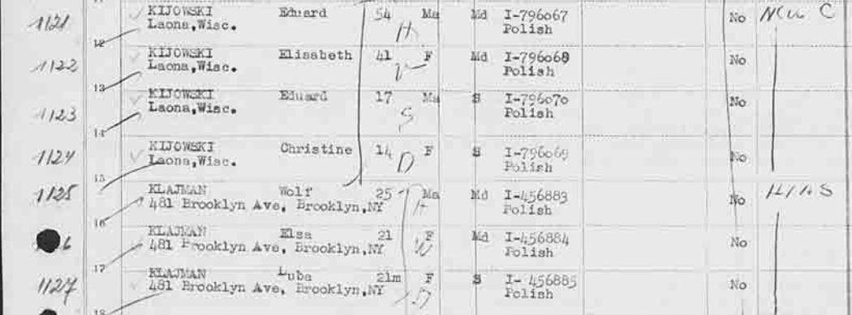

Slide 43
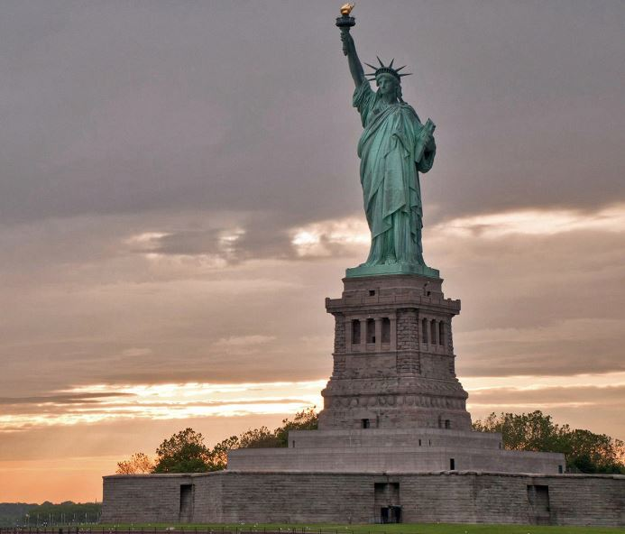
Welcome to America!

Slide 44
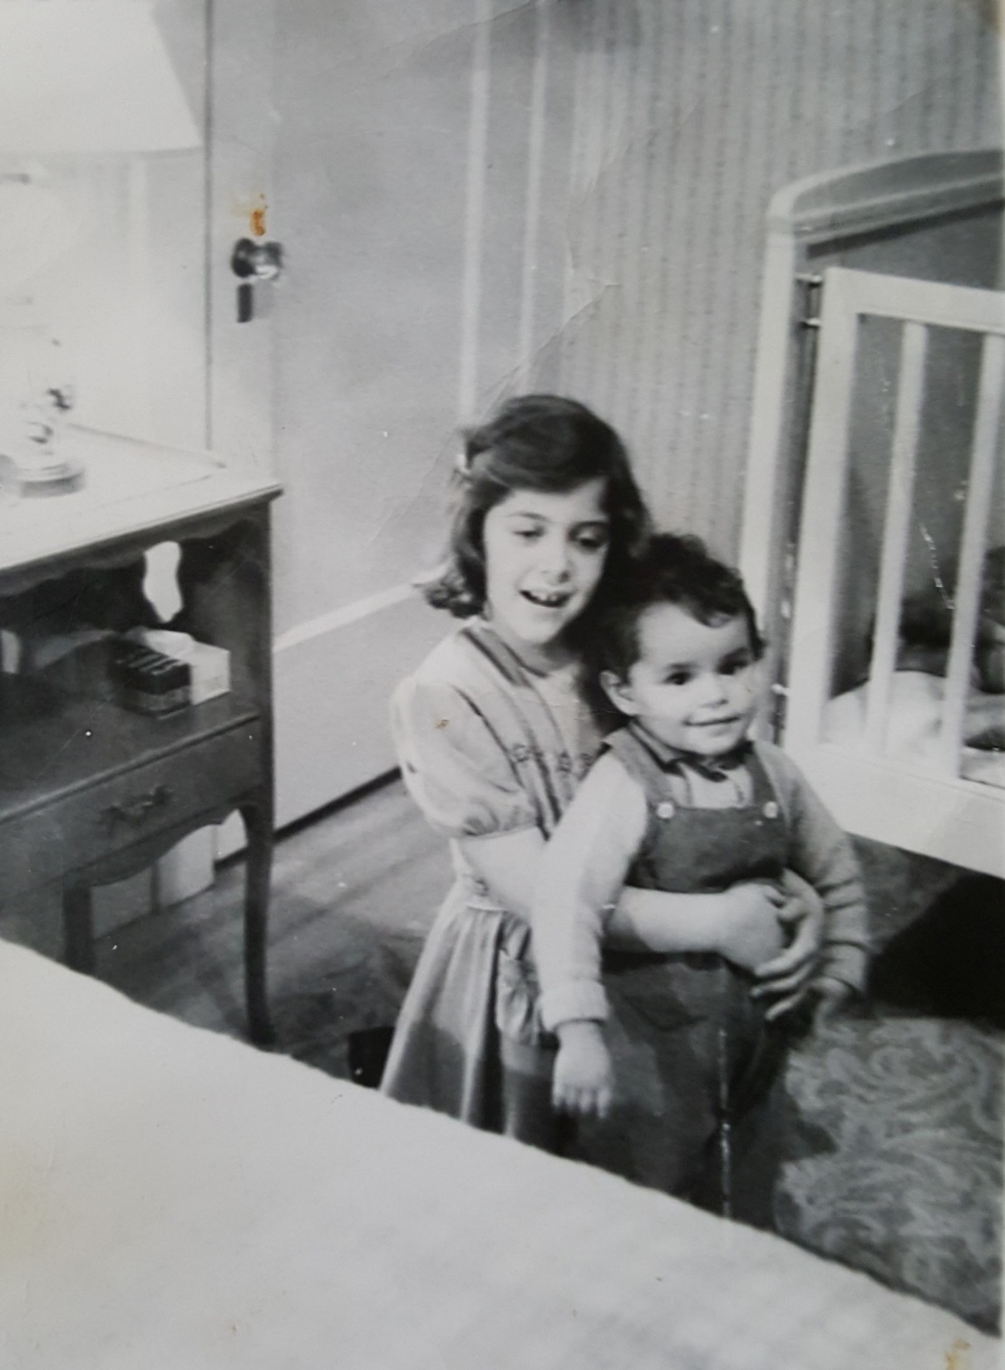
Cousin Bette and little Luba

Slide 45
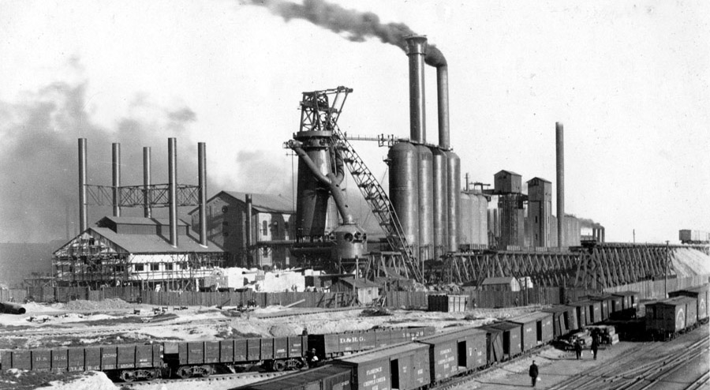

Slide 46
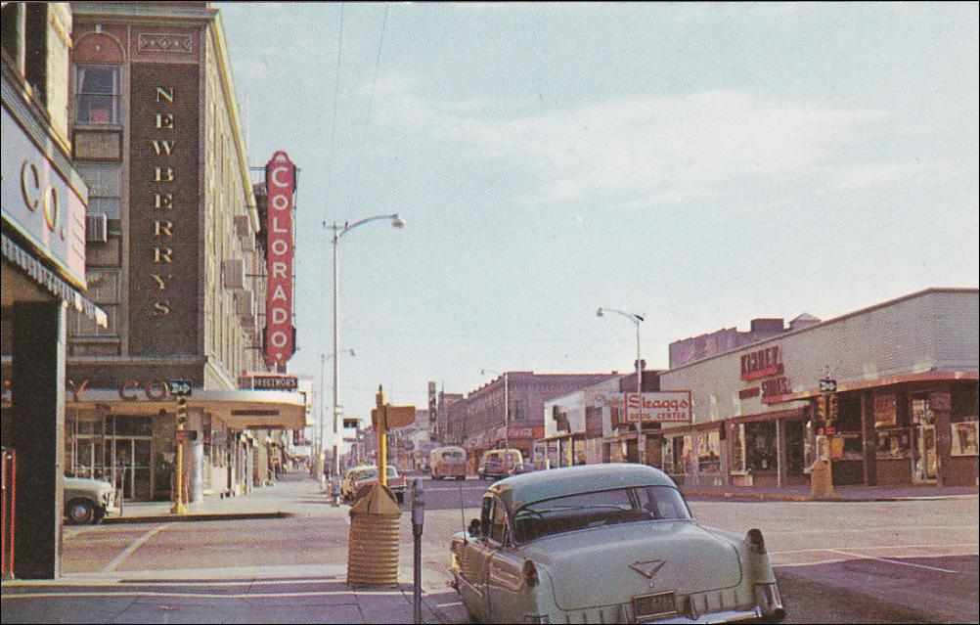
Downtown Pueblo Colorado

Slide 47
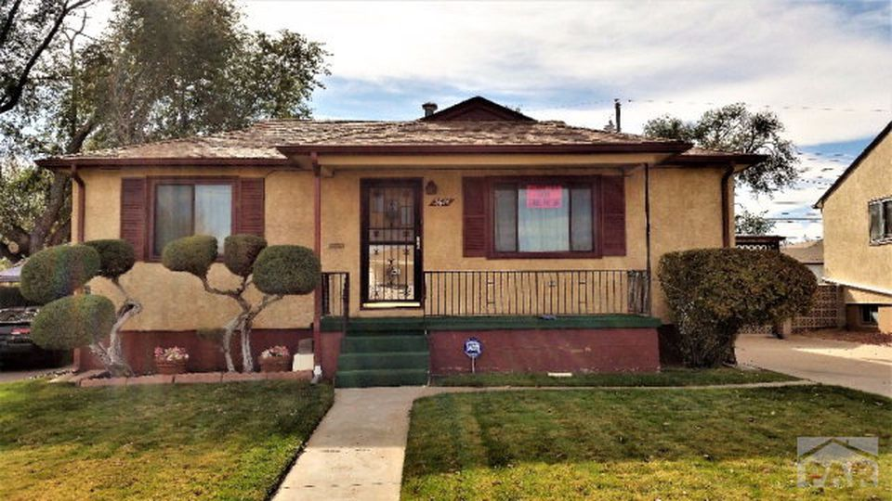

Slide 48
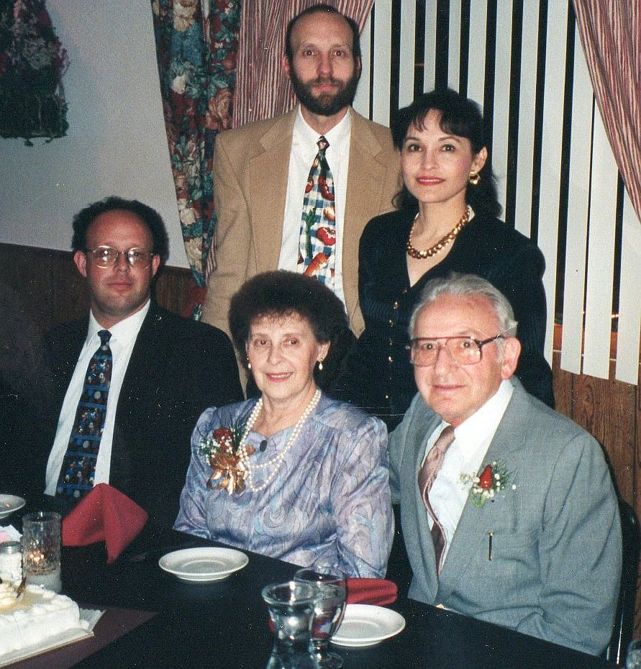
Elsa and Bill’s 50th wedding anniversary. With Henry, Linda and Danny

Slide 49
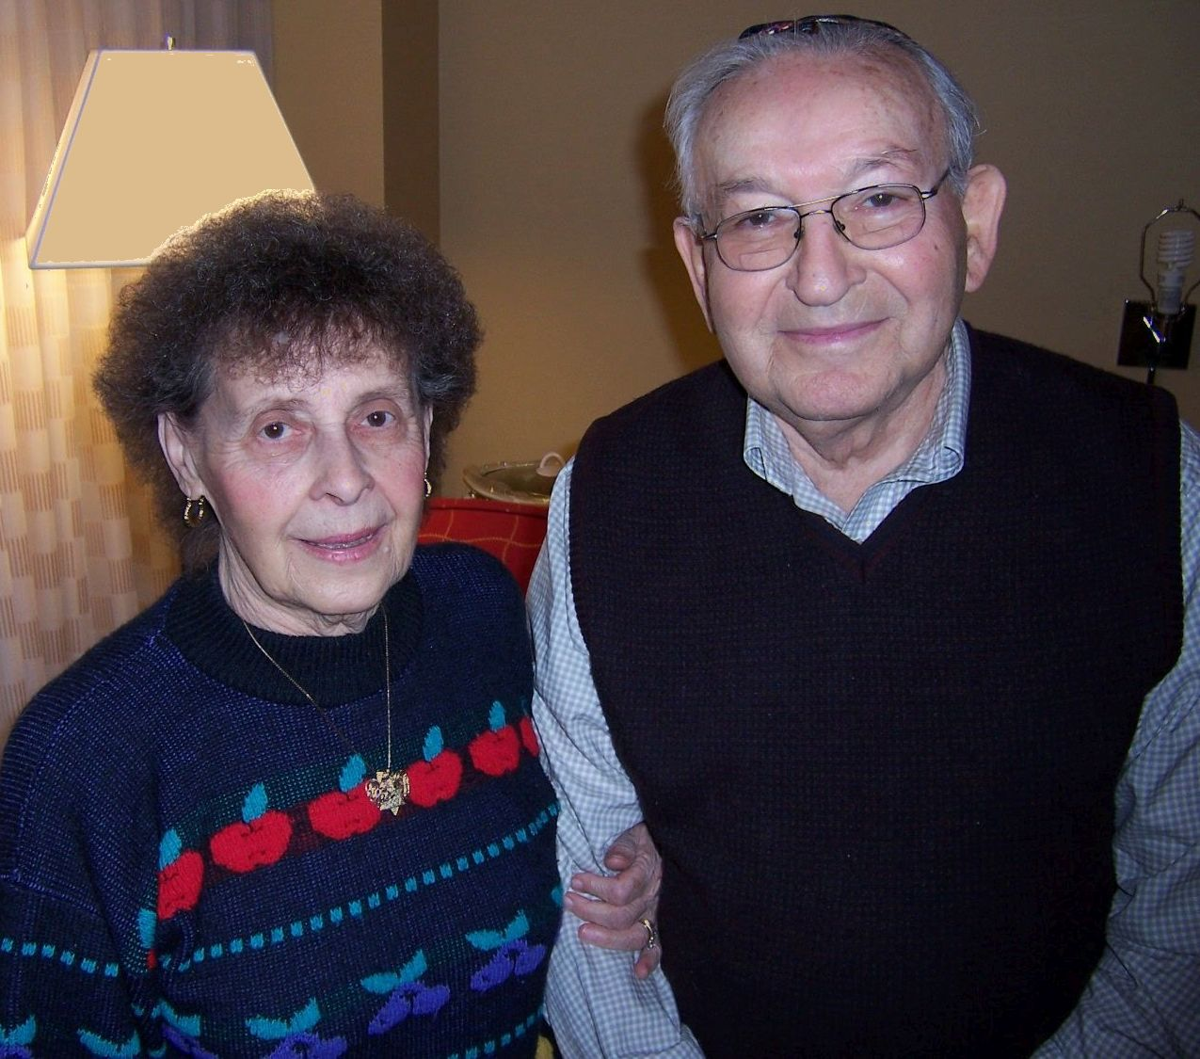
Growing old together.
Bill died in March of 2013. Elsa died in January, 2017.

Slide 50
“Dear Elsa,
This card is not extravagant nor expensive. The words are not written by a faceless, nameless writer. It is written by me, from my heart.
We have been on the life journey together for a long time, through bumpy roads and through colorful mountain byways.
We have been friends and lovers for half a century. I hope we continue as we grow older.
I love you. Happy birthday, Bill.”

Slide 51
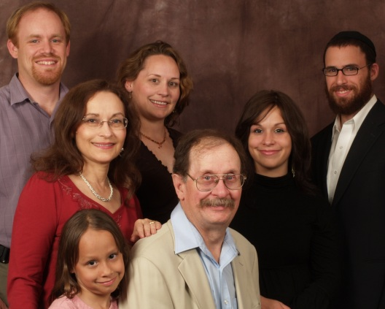

Slide 52
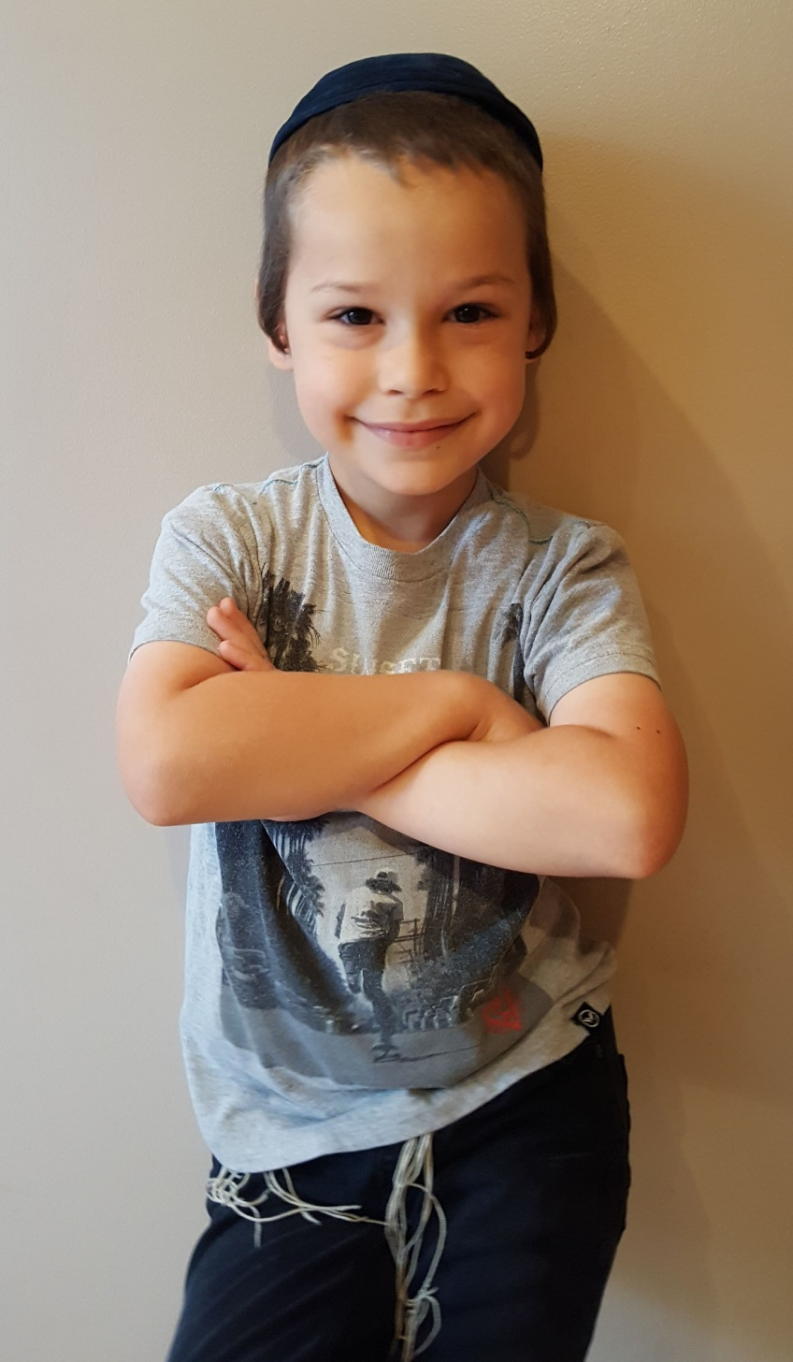
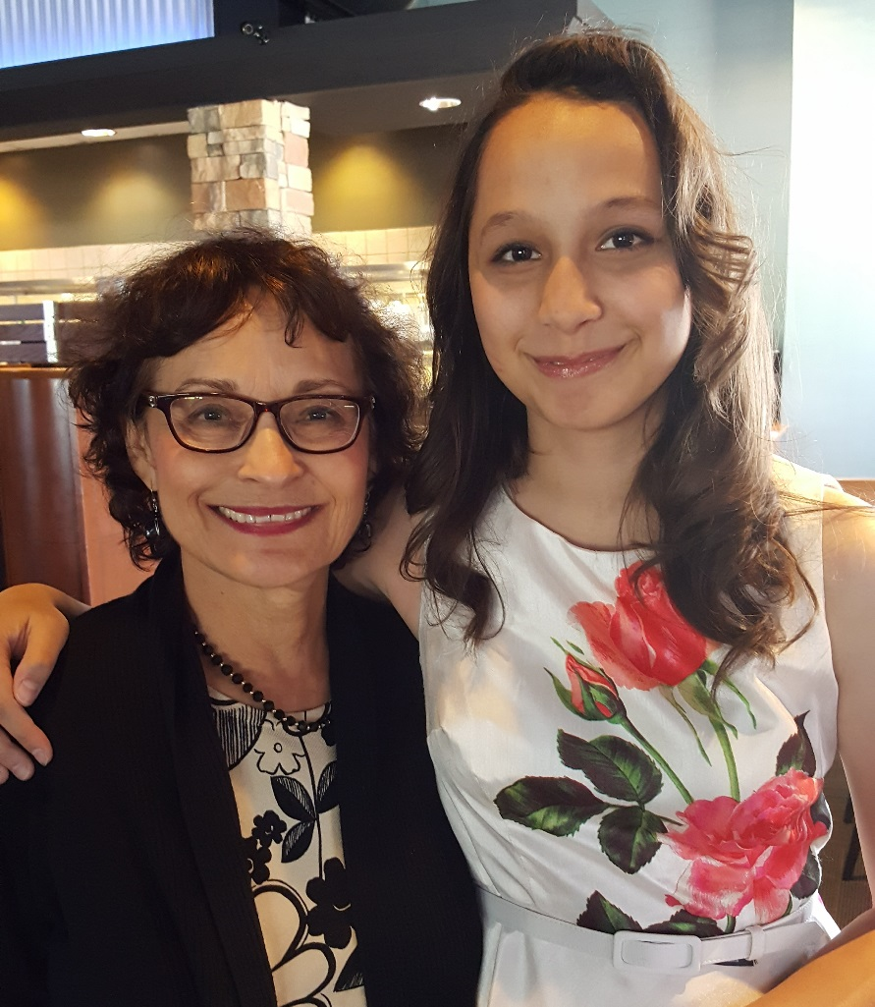
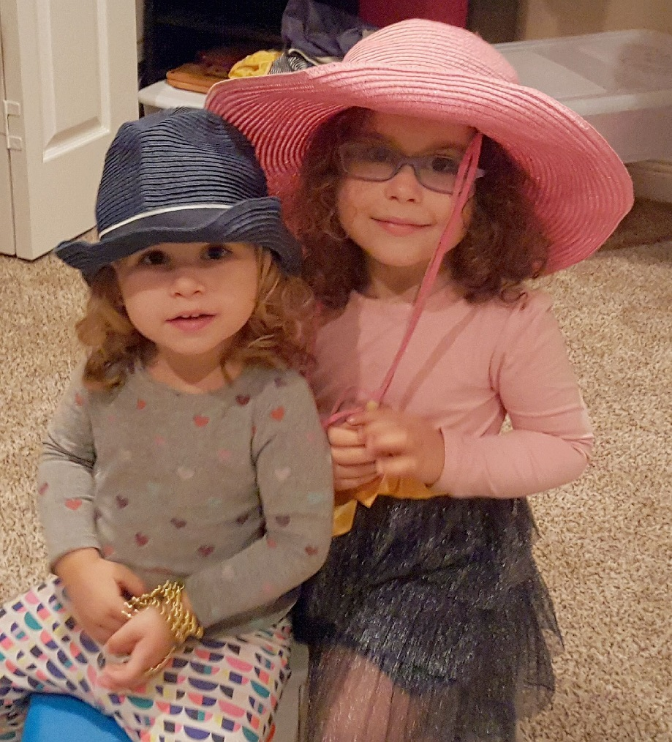
L'dor vador
Eda and Chanale
Linda and Sophia
Yossel

Slide 53
Life after the Holocaust
A story of survival

