Slide 1

Suitcase Project
By Nicole Neuman & Jamie Jennings

Slide 2
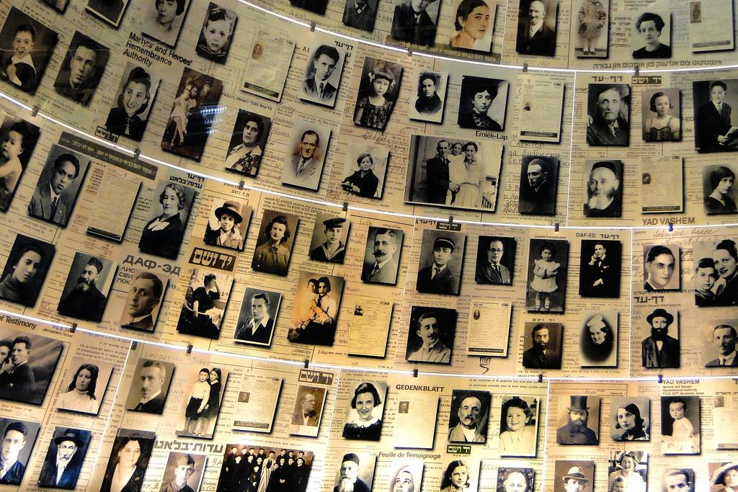
Lesson:
Getting to either know a specific person from the Holocaust, or gain understanding of what it was like for a person who lived through it.
Objective:
By the End of the lesson, students will be able to have a perspective on how people felt, why they packed the things they did, and why they carried on even though there was so much unknown.

Slide 3
Academic Standards
Students will be able to gather and evaluate information from multiple sources while considering the origin, credibility, point of view, authority, structure, and context of the source.
Construct and evaluate explanations and arguments using multiple sources and relevant, verified information.
Evaluate the methods utilized by people and institutions to promote change.
Identify the role of individuals, groups, and institutions in people’s struggle for safety, freedom, equality and justice.
Analyze the relationships between historical sources and the secondary interpretations made from them.
Analyze the multiple and complex causes and effects of events in the past.

Slide 4
Key Vocabulary Documents Provided
For Students
Suitcase Vocabulary List
Individual Profile Cards: United States Holocaust Memorial Museum
Books:
I Have Lived A Thousand Years: Growing Up in the Holocaust by Livia Bitton-Jackson
Night by Elie Wiesel
A Diary of a Young Girl by Anne Frank
Etc.
Timeline Examples:
Example 1
Example 2

Slide 5
Procedures for Delivering Lesson:
Pick a Person/Biography/Individual Profile Card
Timeline:
Do a timeline using one of these: Requirements:
-Power Point: -10 points about the person’s life
-Google Slide: -Dates (Month & Year)
-Word Doc: -Pictures
-Hand Drawn: -Grammatically Correct
-Each point must have an inference about what
your person might have been feeling.

Slide 6

Suitcase Project:
Students will have to either get a suitcase or get a box and turn it into a replica of a suitcase that a person of the Holocaust may have taken with them once they were captured.
Graded Appearance: How authentic did the student make his or her suitcase look? What kind of things did he or she do to make it eye catching?
Inside: What kind of things were put into the suitcase that represents the person, book, or individual profile card the student has chosen to do for this project? Do the items represent the person the student is studying?
Organization: How organized and neat is the project? Is it well put together?
Writing Exercise: Did the student present an essay explaining what was in the suitcase and why they feel these items best represent the person they chose?

Slide 7
Writing Exercise:
Assignment:
Suitcase Writing Assignment
Requirements:
-Restate and write complete sentences.
-Grammatically correct.

Slide 8
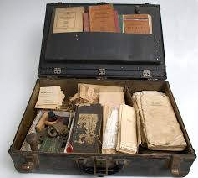
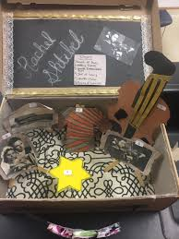
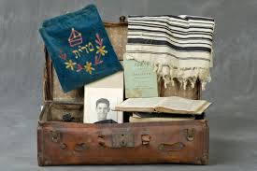
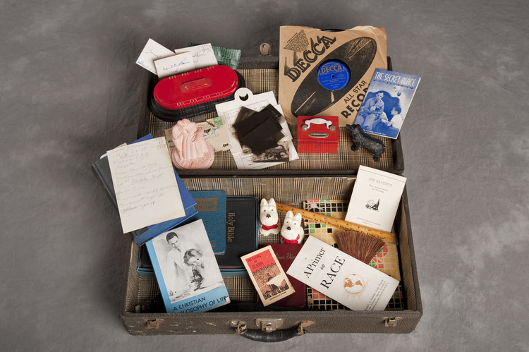
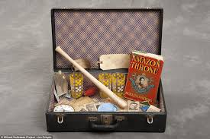
Assessment Plan:
Timelines: 50 Points
Suitcase Project: 100 Points
Writing Assignment: 25 Points

