Slide 1
LA’DOR VADOR
FROM GENERATION TO GENERATION:
5th Grade Students Interpret Art & Poetry
Created By Children of Terezin
Presented by Valerie Prescott & Mindy Dyson
5th Grade Teachers from Champaign Community Unit 4

Slide 2
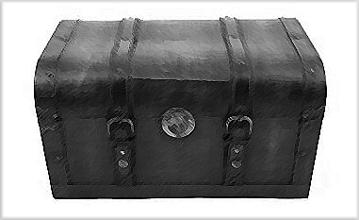
Introducing Dr. Kahn &
The Trunk Project
Education Trunks were developed to assist in your teaching. Illinois State Code mandates teaching of the Holocaust at elementary and secondary levels, usually done in 5th, 8th, and 10th grades. The resources you choose will provide you with a ready-to-use unit that is grade-appropriate and relevant to all learning styles. We have assembled materials that reflect varying levels of readability. You can select from a variety of print, audiovisual, and electronic resources.

Slide 3
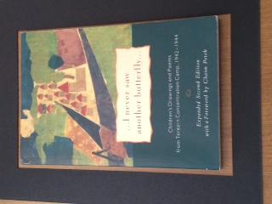
Purpose
This is a culminating activity for students to synthesize information and express their emotions and feelings about the Holocaust.

Slide 4
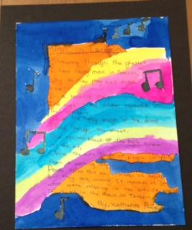
Components of Activity
Social Studies
Reading
Writing
Visual Arts
Music

Slide 5
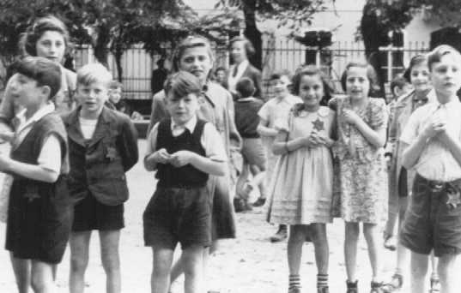
A Gift from The Führer
Lesson 1
Provide students with a brief history of Terezin
  Why was it built?
  Who was the population?
  The role of arts in the camp

Slide 6
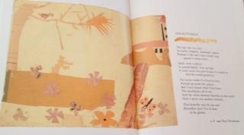
Lesson 2
  Share examples of primary sources from I Never Saw Another Butterfly
    Poems and paintings from children in camp
  Select a few poems and ask students to lead a whole class discussion
    Analyze meaning of poems
    Discuss the figurative language used in poems
  Use Turn to Your Partner to have further discussion on poems

Slide 7
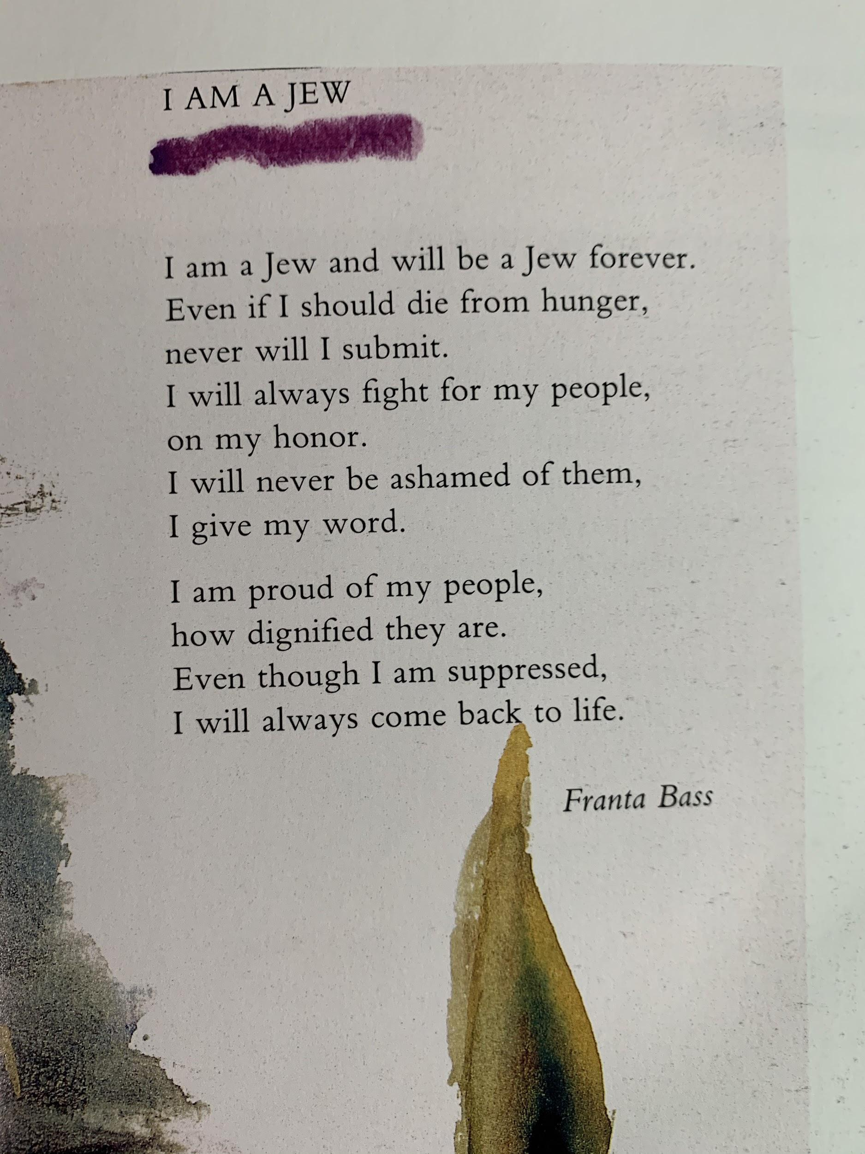

Slide 8
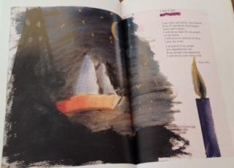
Lesson 3
Using the examples from I Never Saw Another Butterfly as guidance, students write one or multiple poems
Students choose one poem to publish on watercolor canvas
Students write poem
with pencil on watercolor
canvas

Slide 9
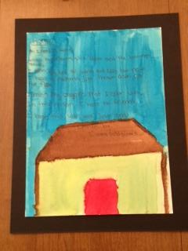
Lesson 4
  Collaborate with art teacher to co-teach lessons
  Focus on mixing watercolors and the use of colors for meanings
  Students visualize their poem and then paint their visualizations
  After paintings dry, students copy their poems using a fine-tip black marker

Slide 10
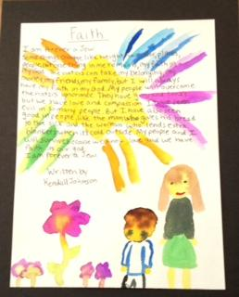
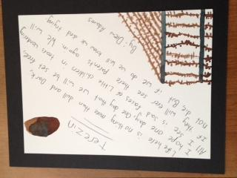
Share Time
Students share their poems

Slide 11
Common Core Standards
Reading, Speaking, & Listening:
  Quote accurately from a text when explaining what the text says explicitly and when drawing inferences from the text (RL.5.1 & RI.5.1)
  Analyze how visual and multimedia elements contribute to the meaning, tone, or beauty of a text (e.g., graphic novel, multimedia presentation of fiction, folktale, myth, poem) (RL.5.7)
  Engage effectively in a range of collaborative discussions (one-on-one, in groups, and teacher-led) with diverse partners on grade 5 topics and texts, building on others’ ideas and expressing their own clearly. (SL.5.1)
  Demonstrate understanding of figurative language, word relationships, and nuances in word meanings (L.5.5)
Writing:
  Use precise language and domain-specific vocabulary to inform about or explain the topic (W.5.2d)
  Use concrete words and phrases and sensory details to convey experiences and events precisely. (W.5.3d)
  Produce clear and coherent writing in which the development and organization are appropriate to task, purpose, and audience. (W.5.4)
  With guidance and support from peers and adults, develop and strengthen writing as needed by planning, revising, editing, rewriting, or trying a new approach (W.5.5)
  With some guidance and support from adults, use technology, including the Internet, to produce and publish writing as well as to interact and collaborate with others; demonstrate sufficient command of keyboarding skills to type a minimum of two pages in a single sitting. (W.5.6)
  Write routinely over extended time frames (time for research, reflection, and revision) and shorter time frames (a single sitting or a day or two) for a range of discipline-specific tasks, purposes, and audiences. (W.5.10)

Slide 12
Art Standards
Visual Arts:
Identify, describe, and visually document places and/or objects of personal significance (VA:Cr2.3.5a)
Compare one’s own interpretation of a work of art with the interpretation of others ( VA:Re7.1.5a)
Identify and analyze cultural associations suggested by visual imagery (VA:Re7.2.5a)
Interpret art by analyzing characteristics of form and structure, contextual information, subject matter, visual elements, and use of media to identify ideas and moods conveyed (VA.Re8.1.5a)
Identify how art is used to inform or change beliefs, values, or behaviors of an individual or society (VA:Cn11.1.5a)

Slide 13
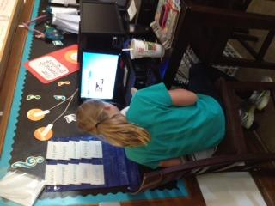
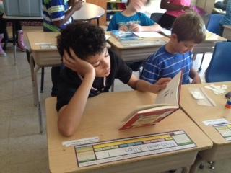
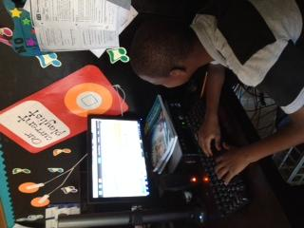
Enrichment Activities: Technology & Collaboration
Synthesize knowledge learned throughout Holocaust Unit by blogging with other 5th grade students using Holocaust - based texts

Slide 14
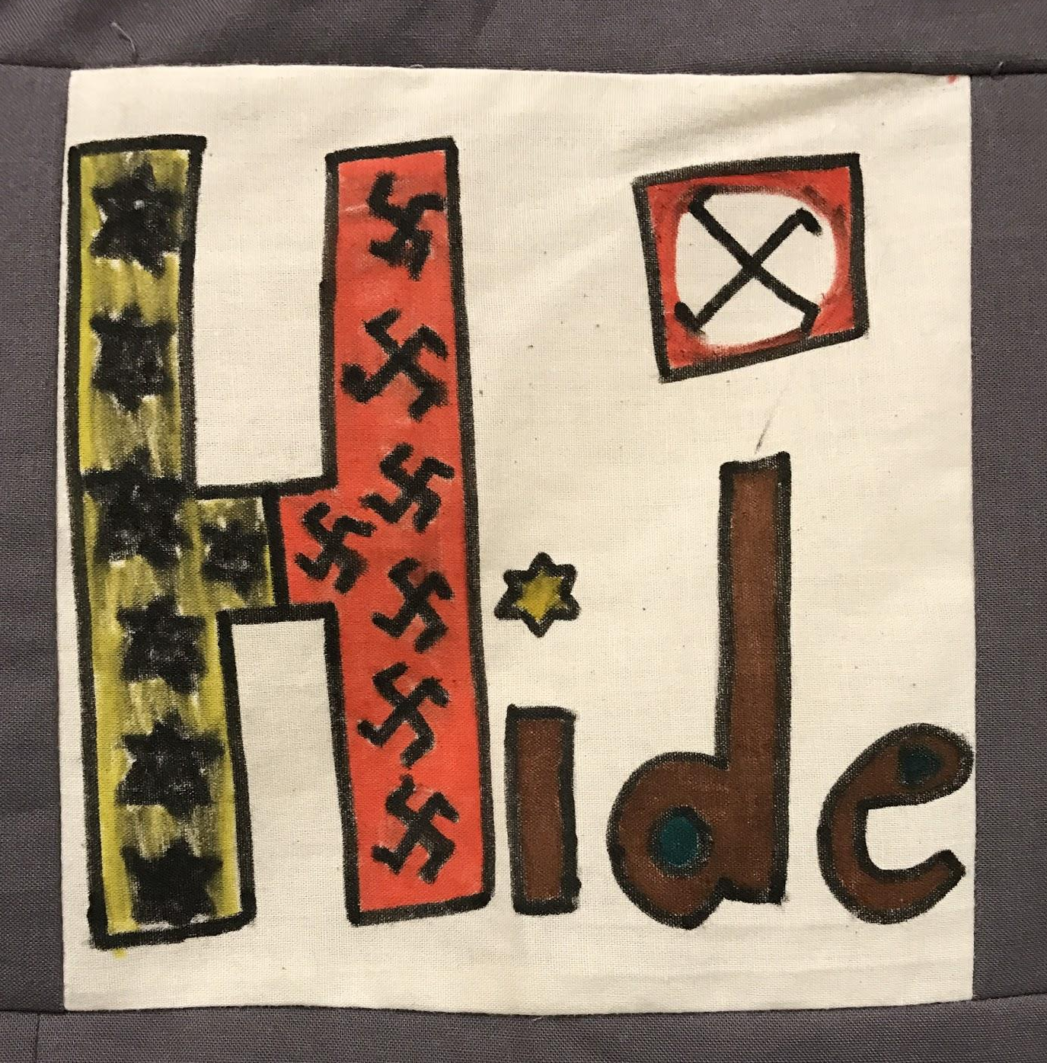
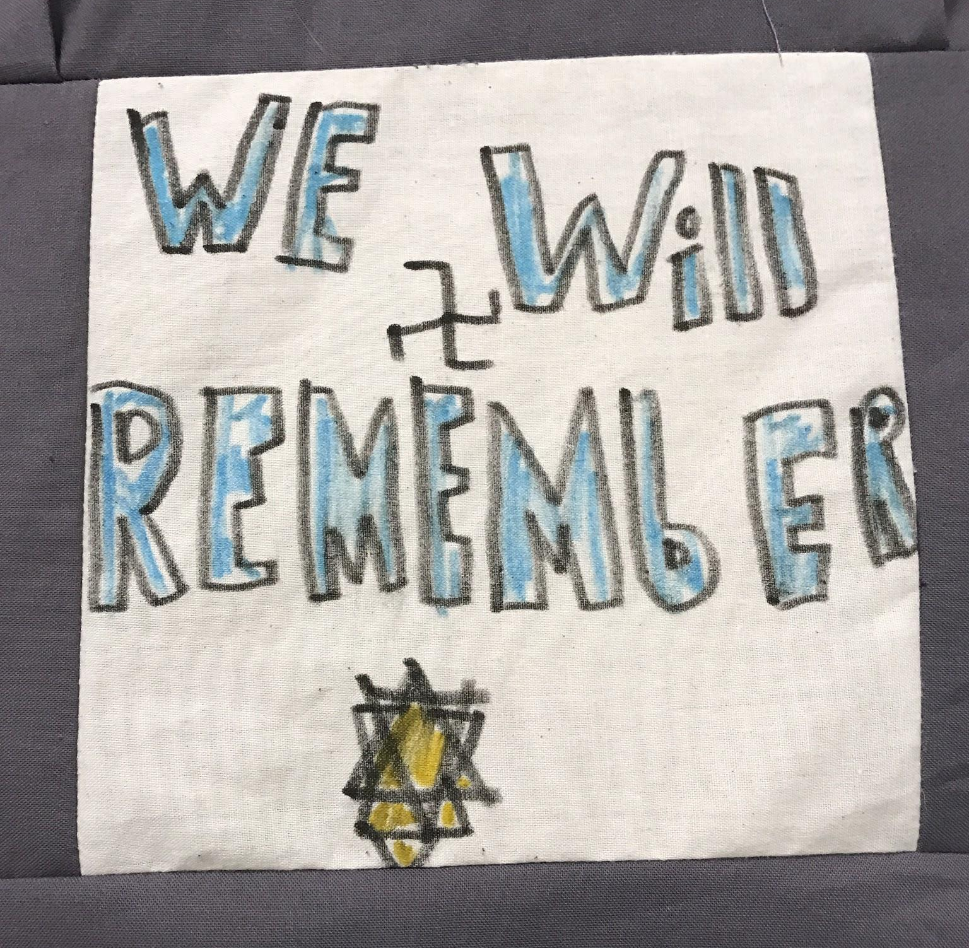
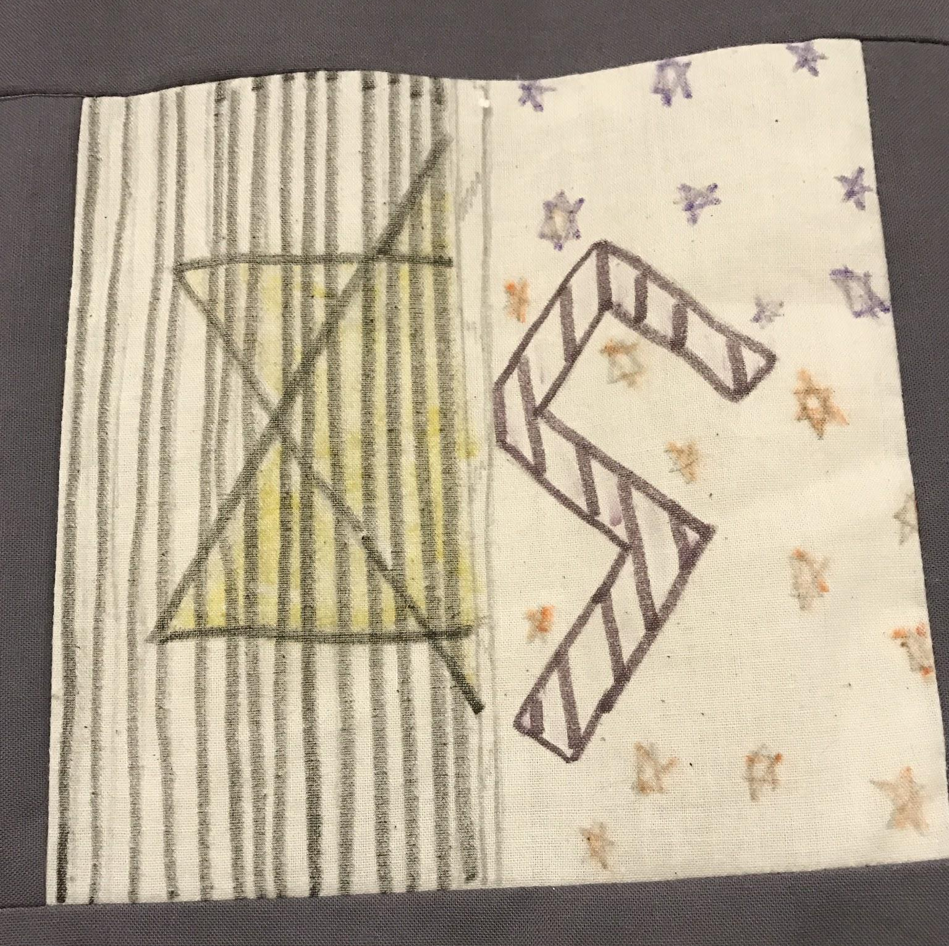
Enrichment Activities: Art Analysis & Creation
Synthesize knowledge learned throughout Holocaust Unit by creating a quilt square with visual arts component of what the Holocaust means to each student

Slide 15











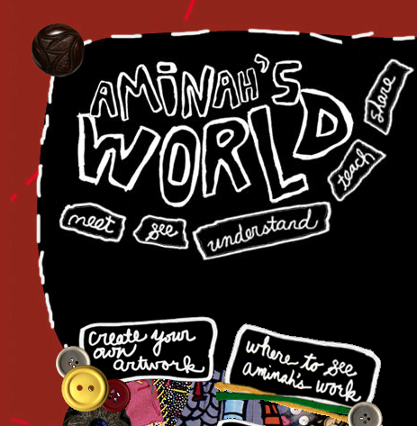




Virtual Opportunities
BLOGGING | VISUAL ARTS | MUSIC | DRAMA

Slide 16
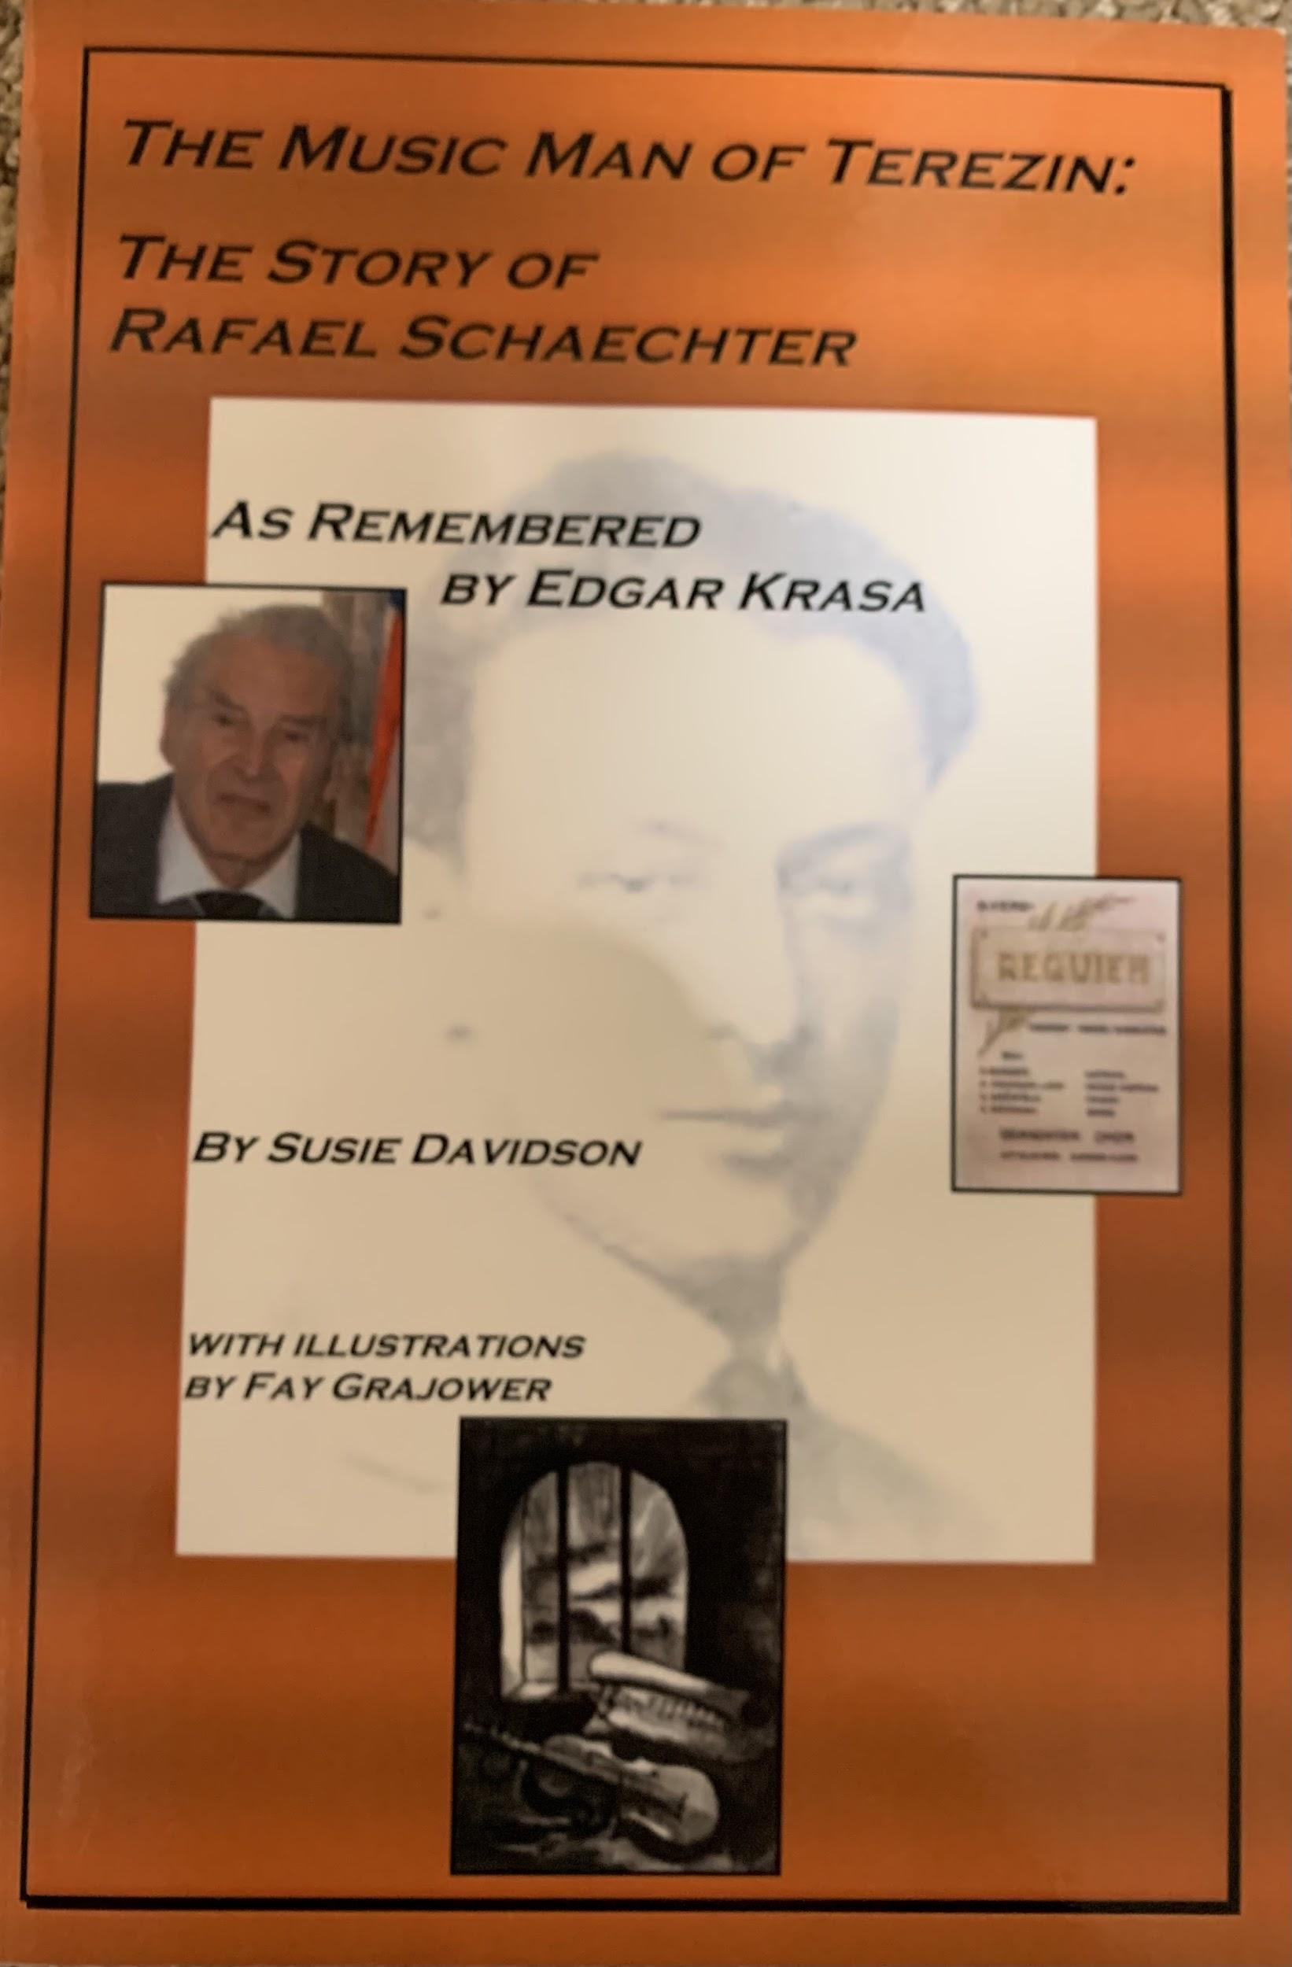
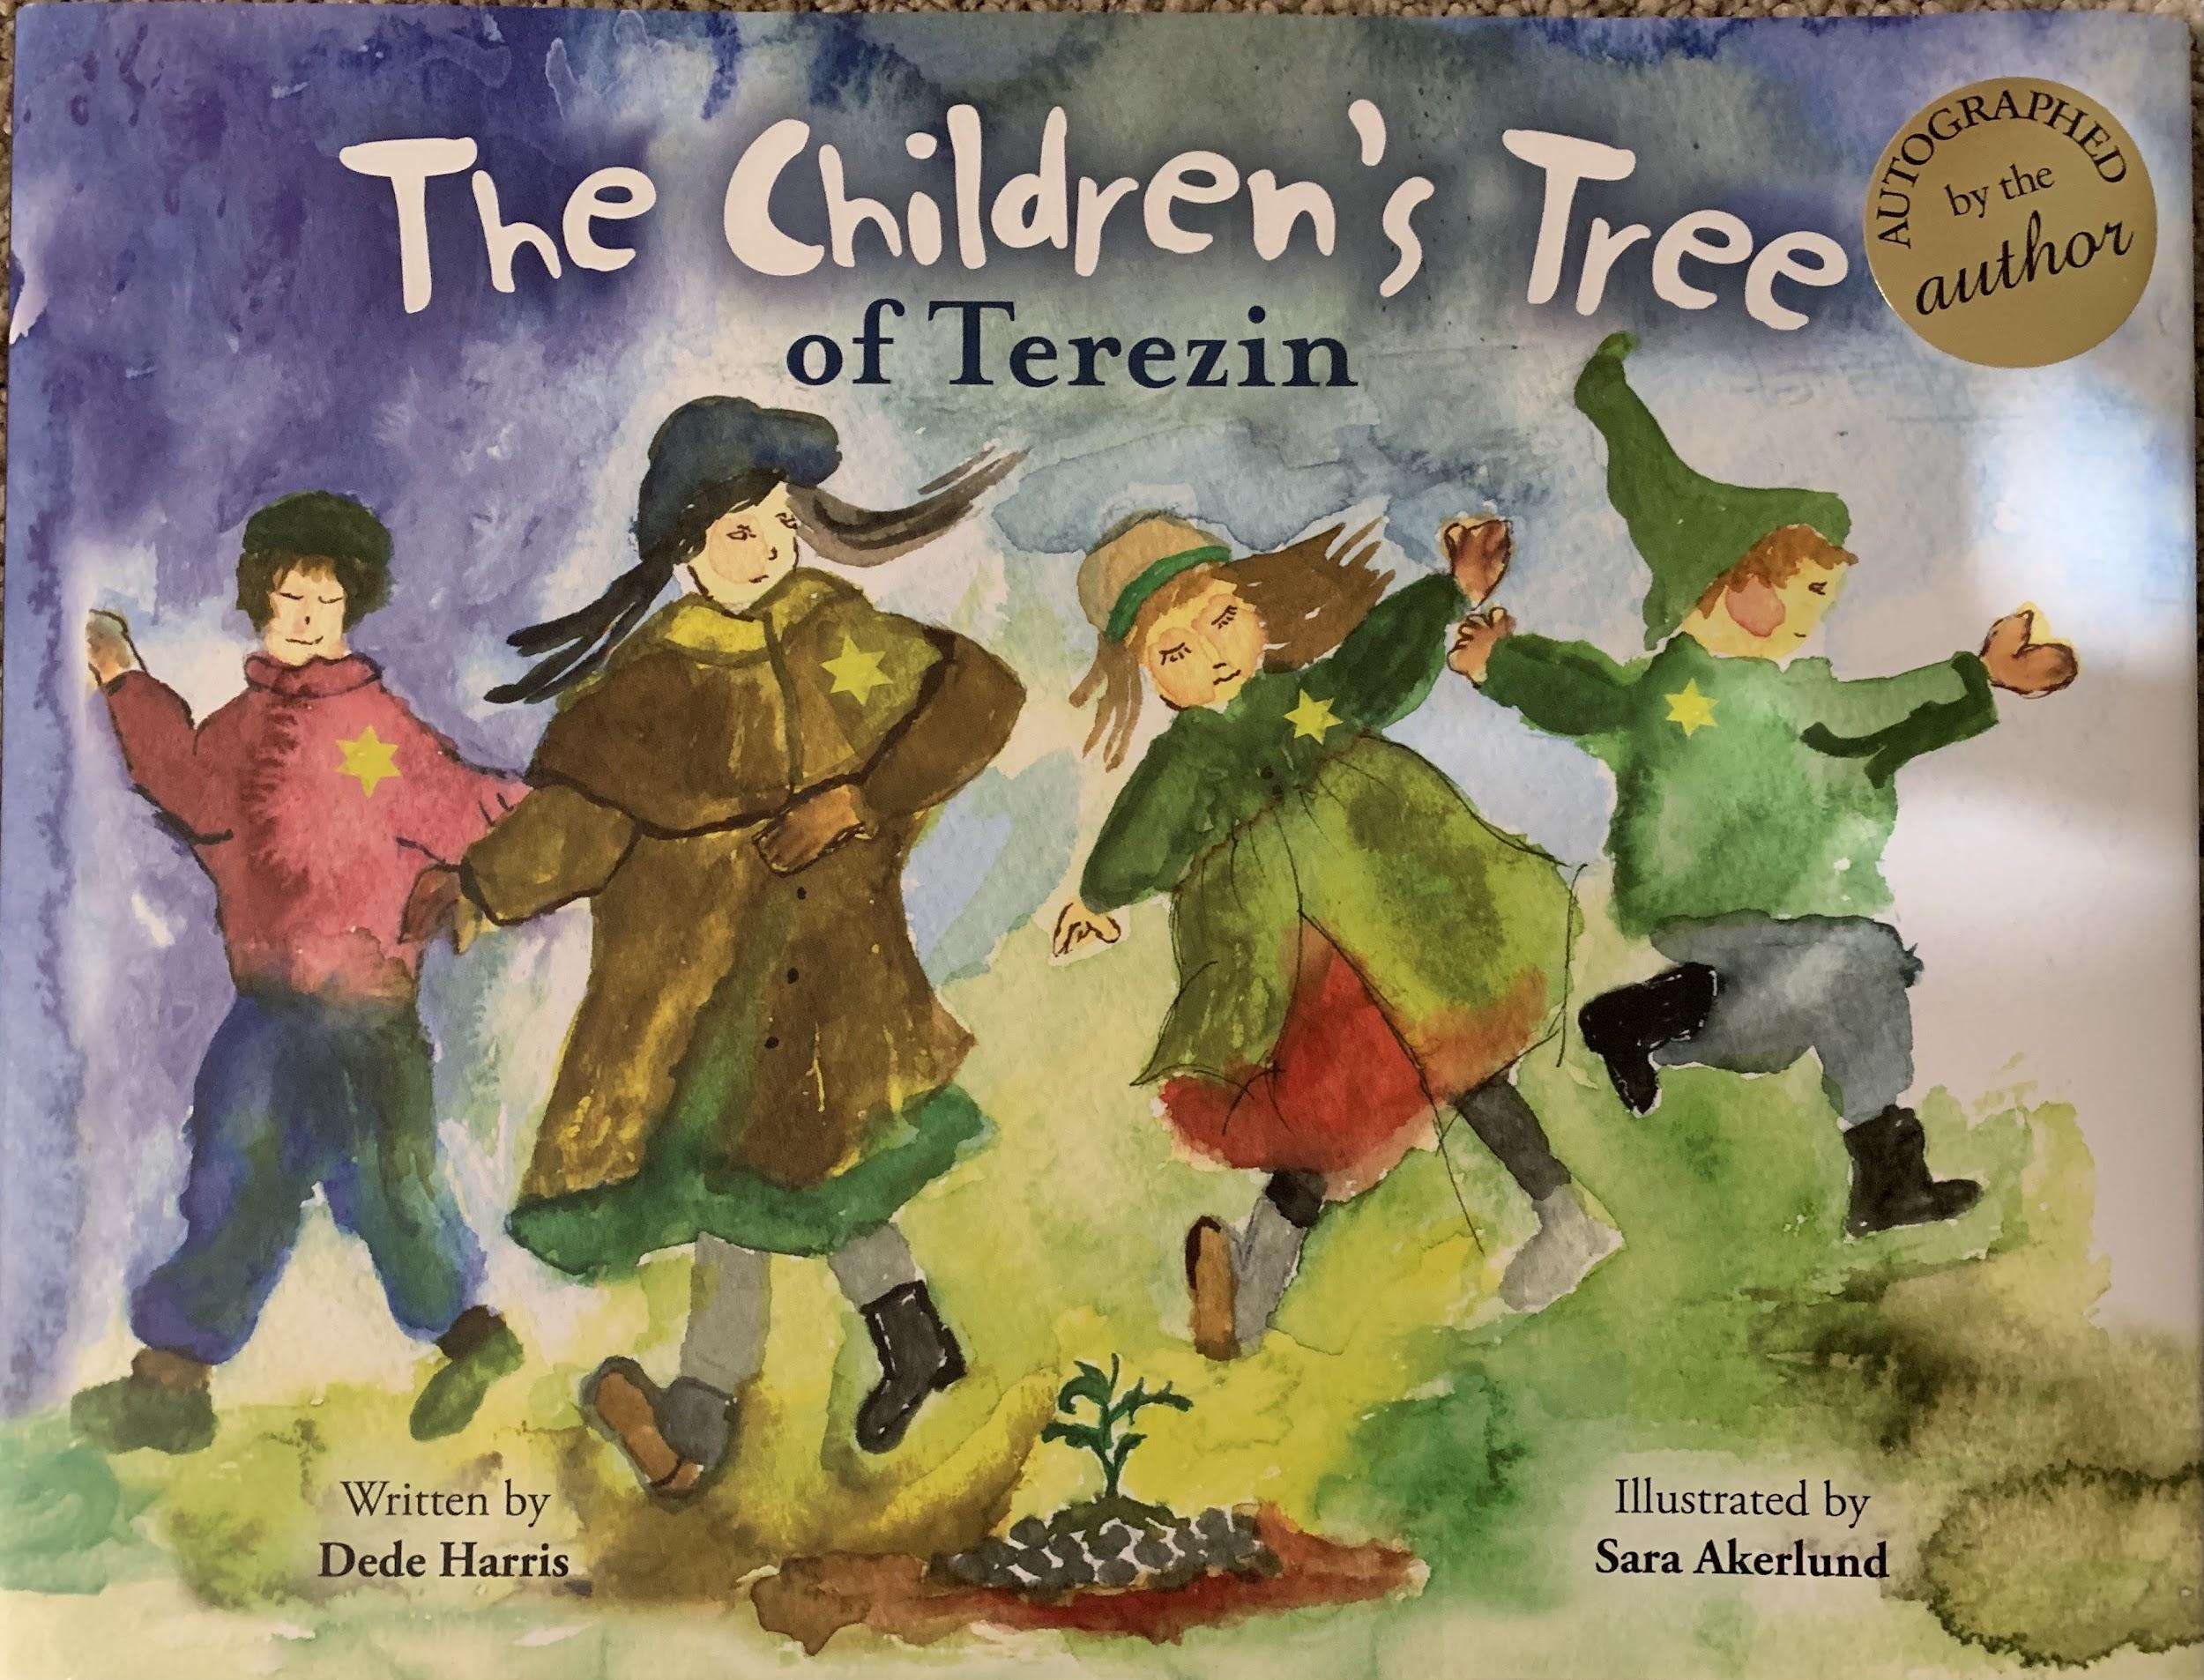
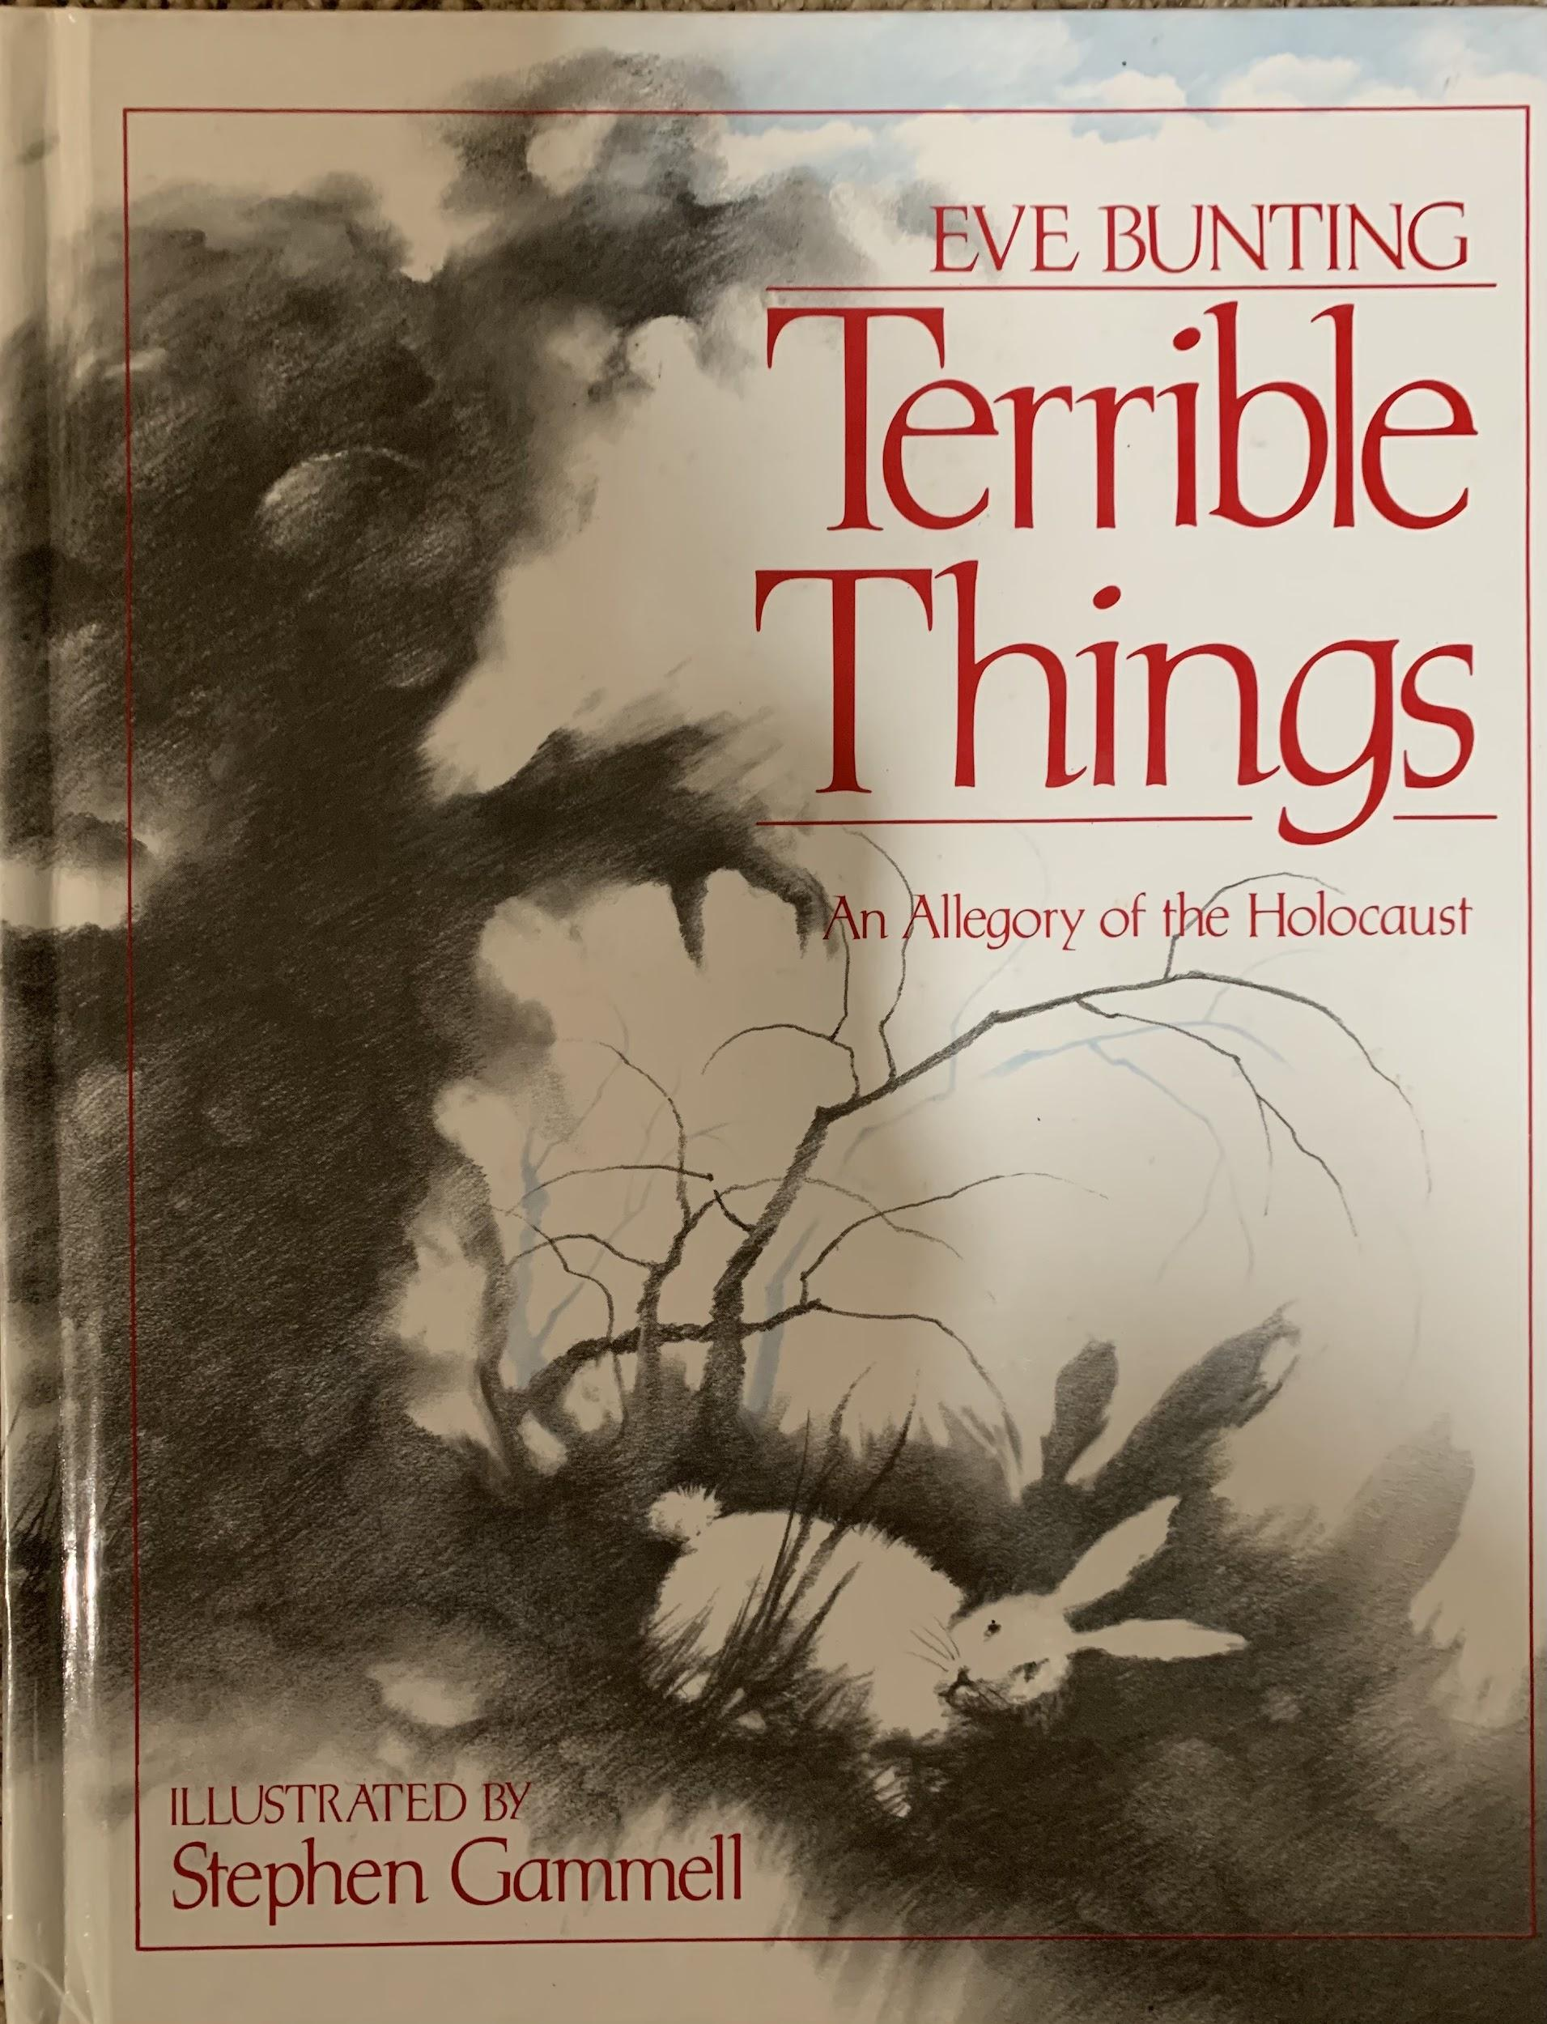
Other Resources
Valerie Prescott prescova@u4sd.org
5th Grade Teacher at Barkstall Elementary in Champaign, IL
Mindy Dyson dysonmi@u4sd.org
5th Grade Teacher at South Side Elementary in Champaign, IL

Slide 17
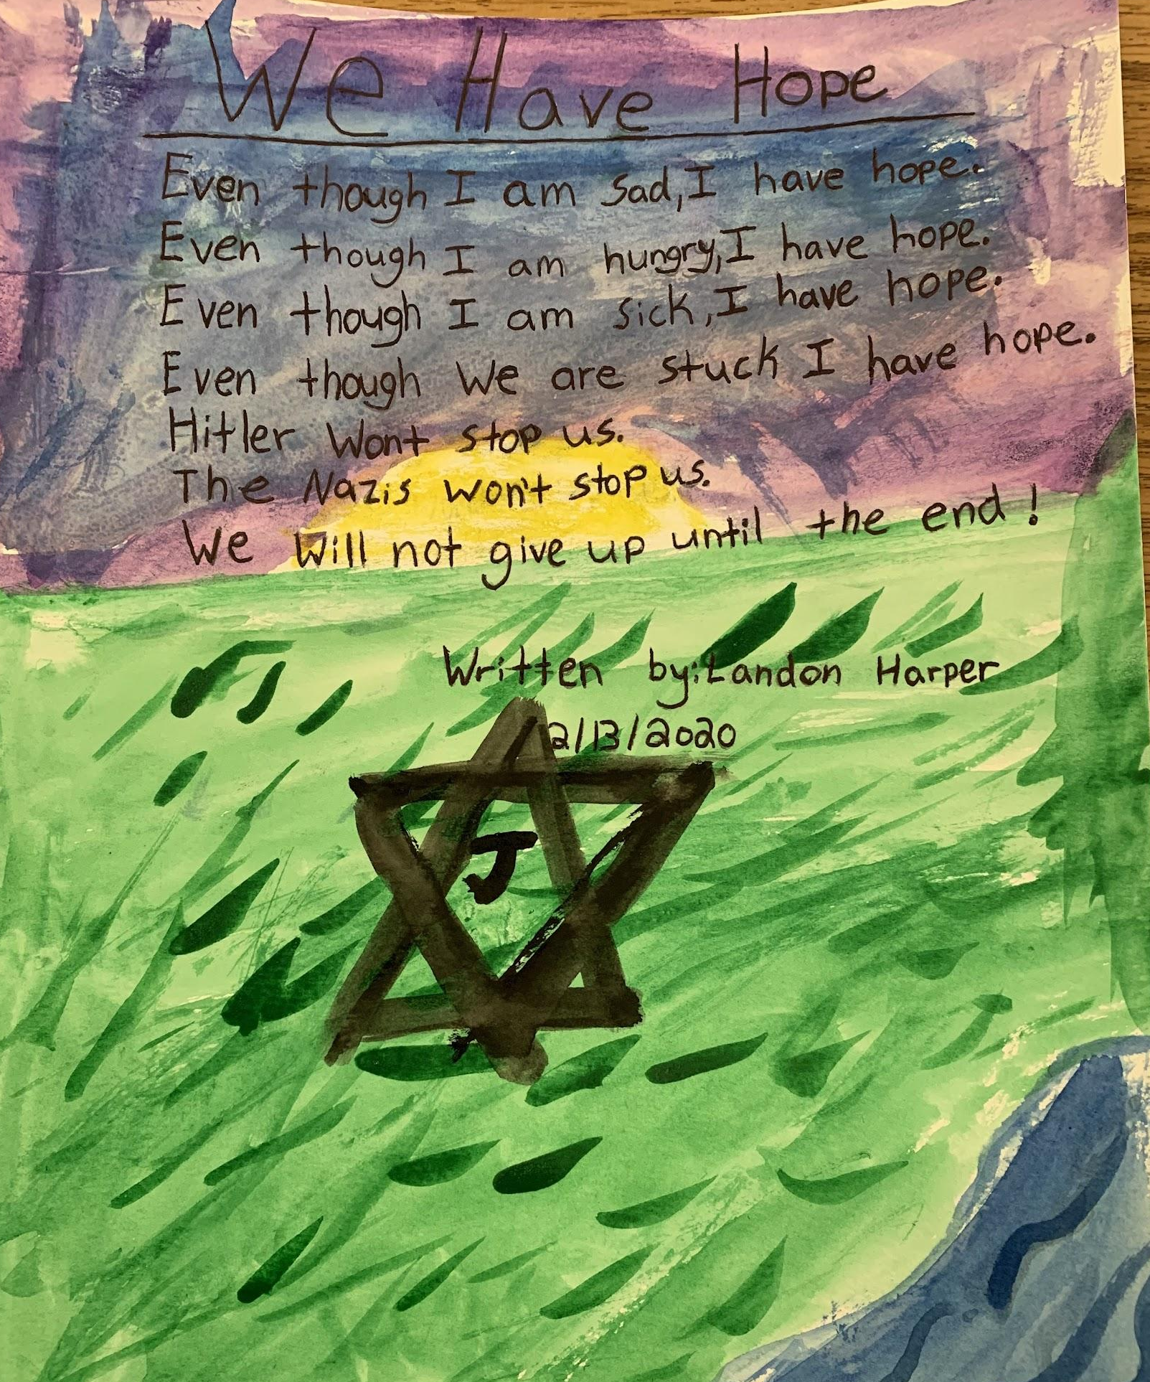
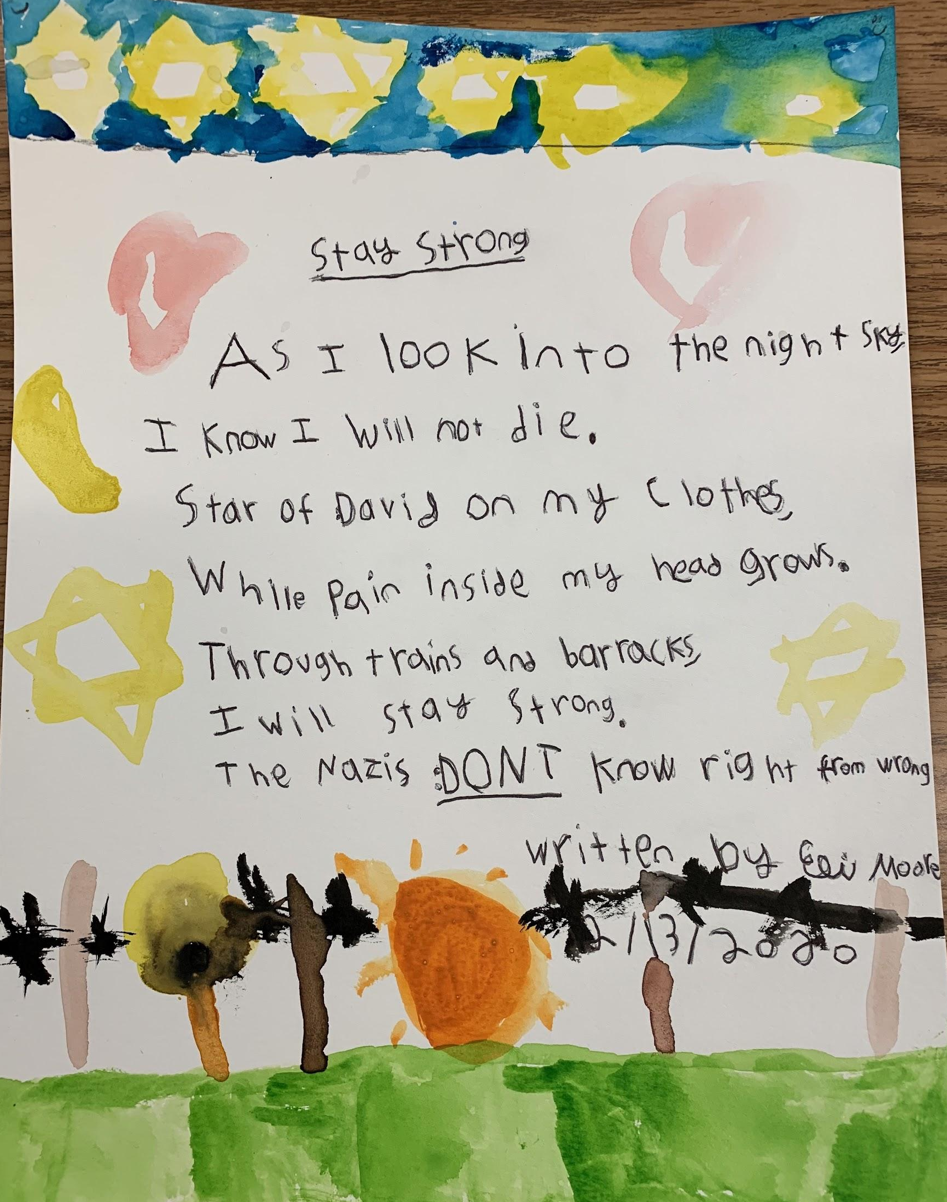
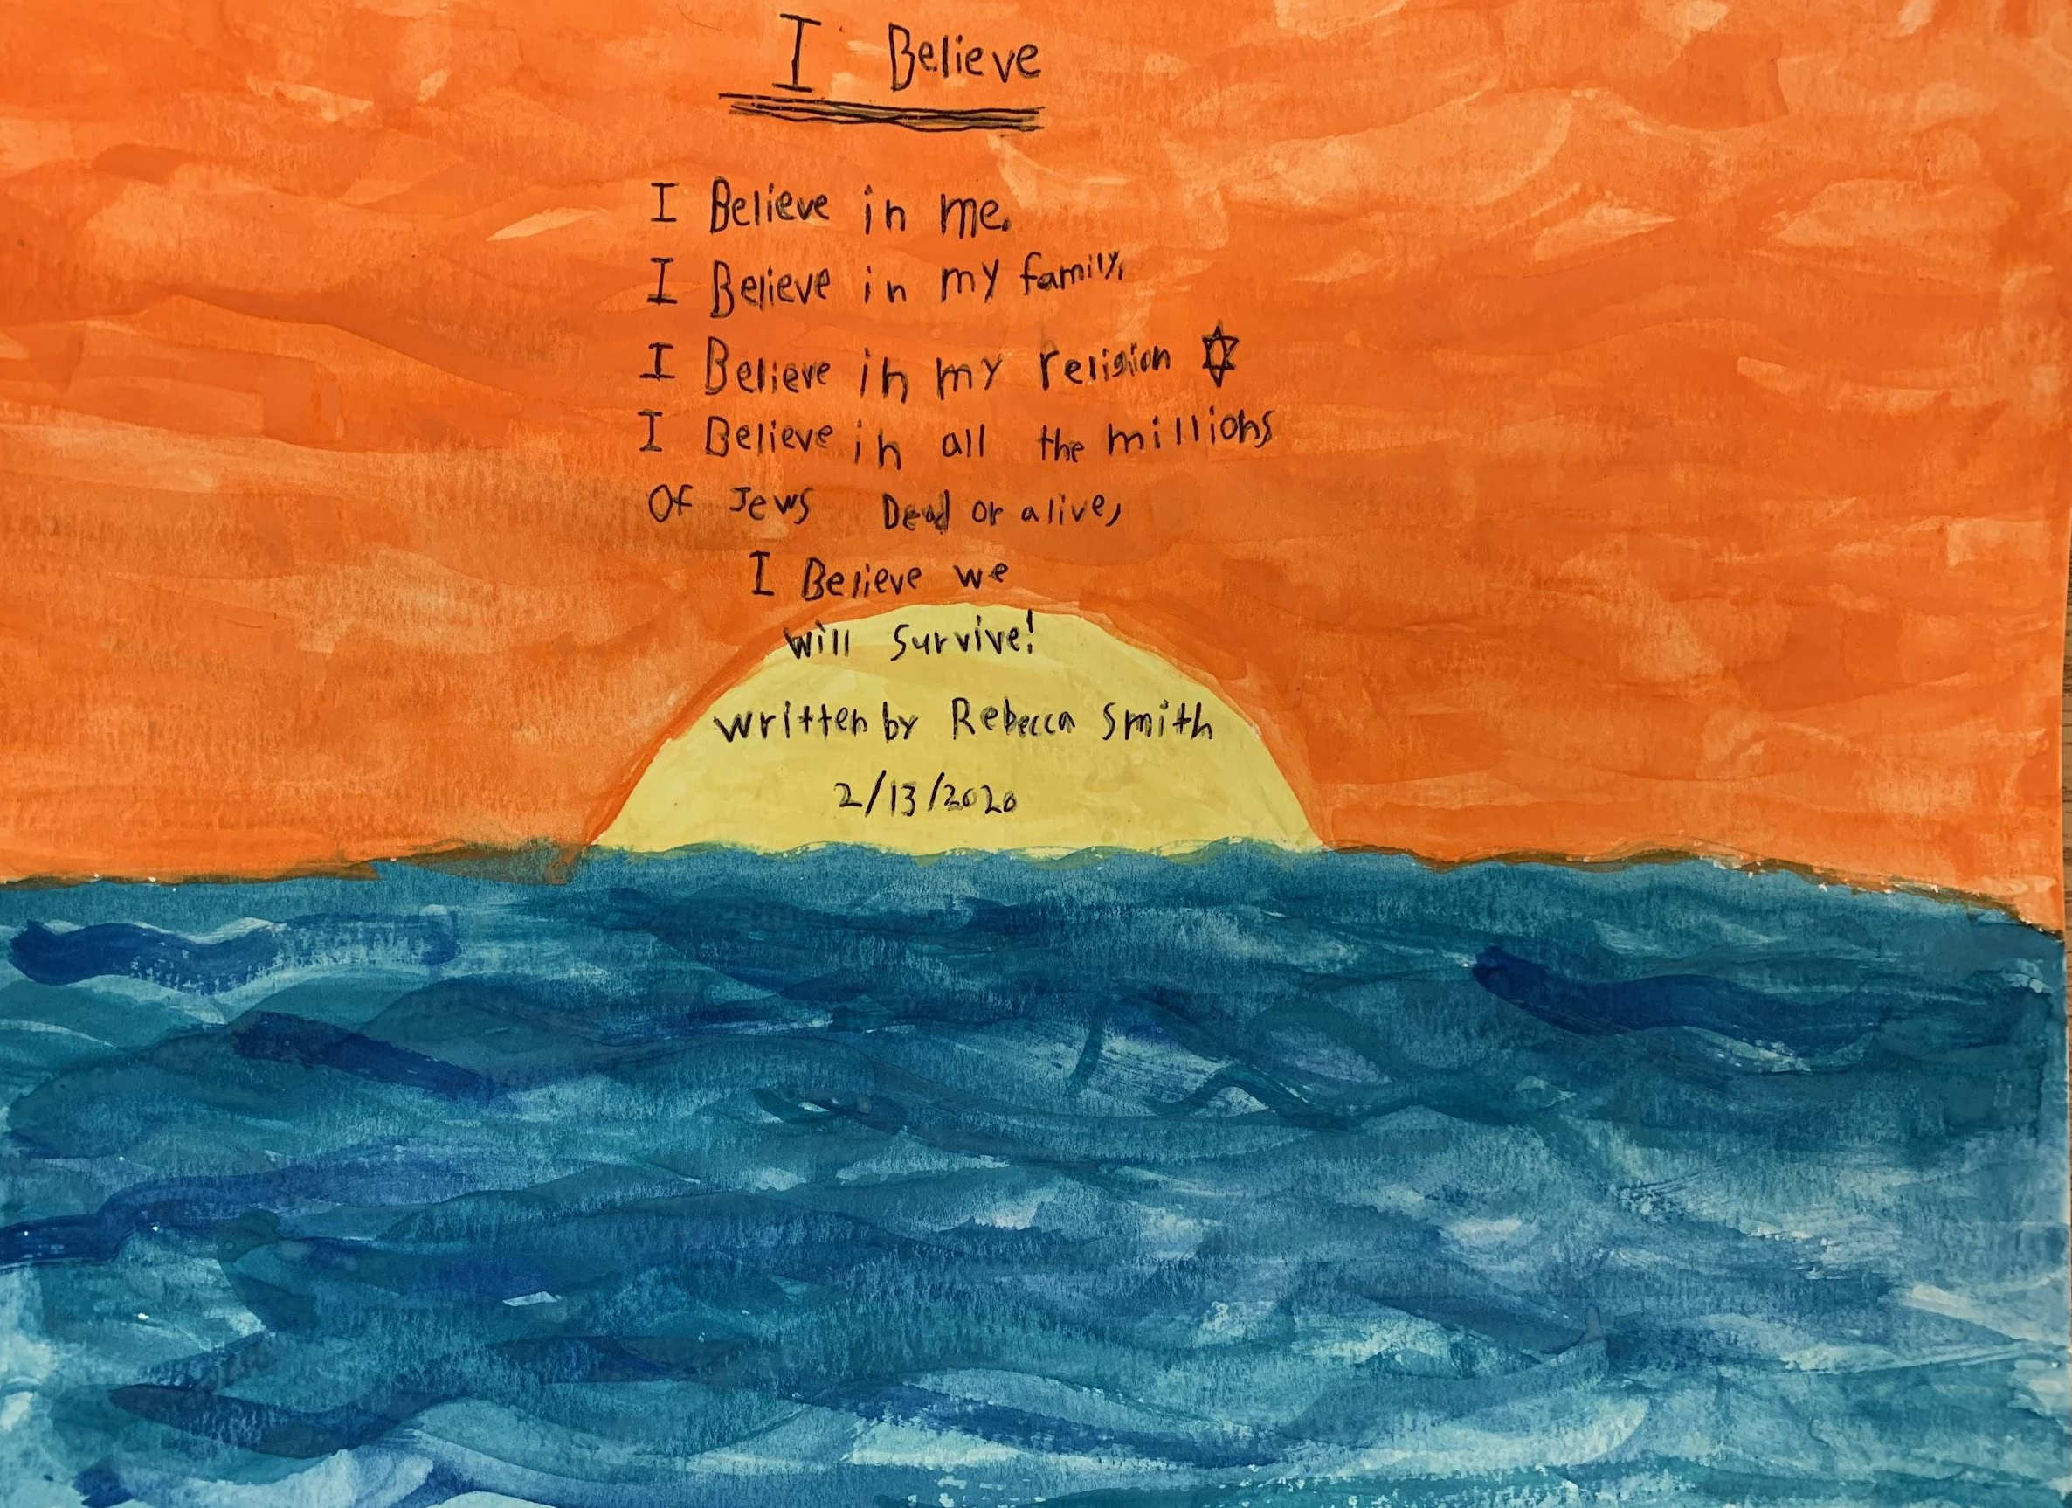
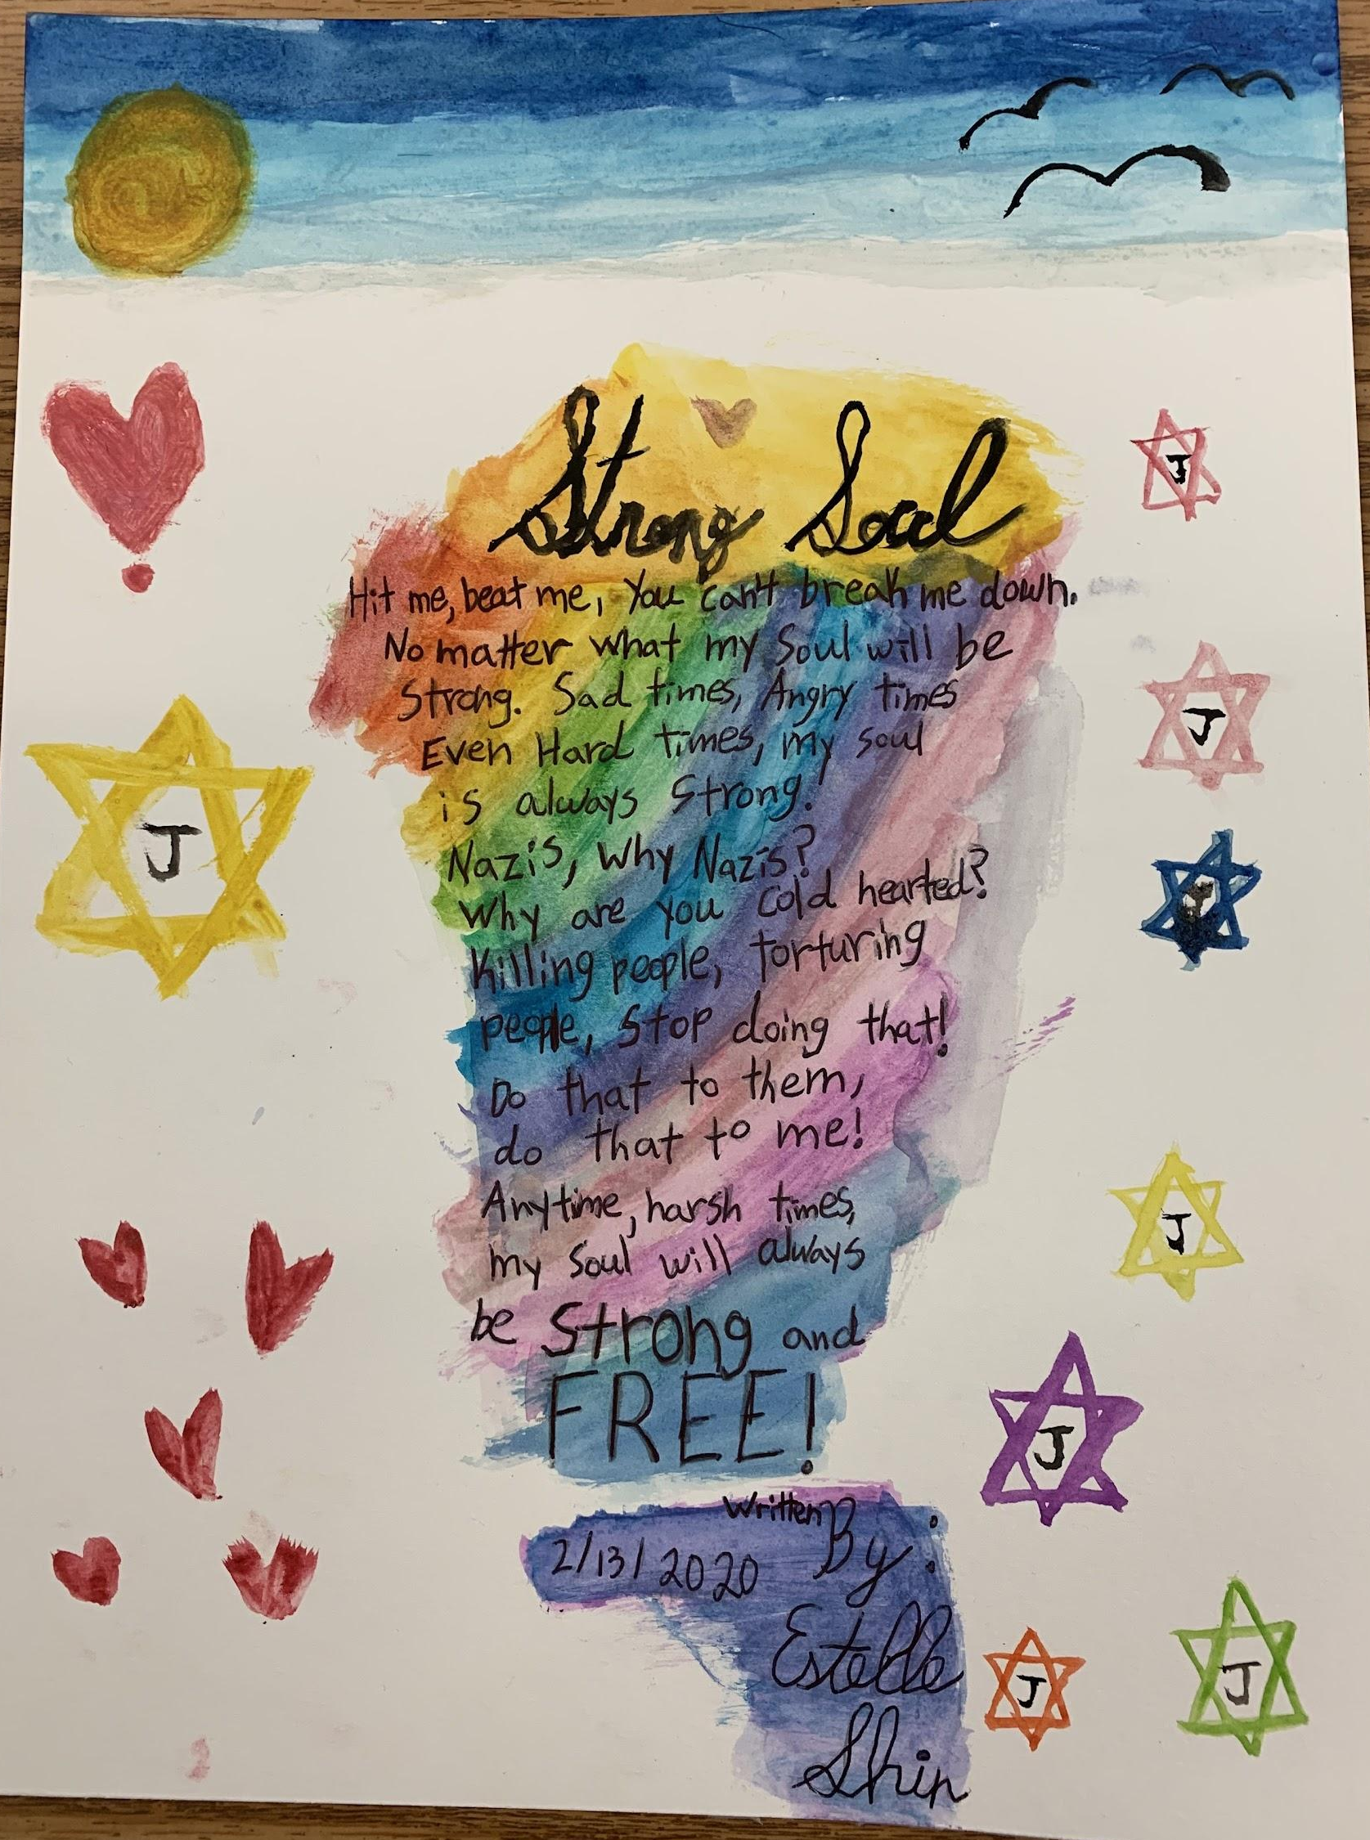
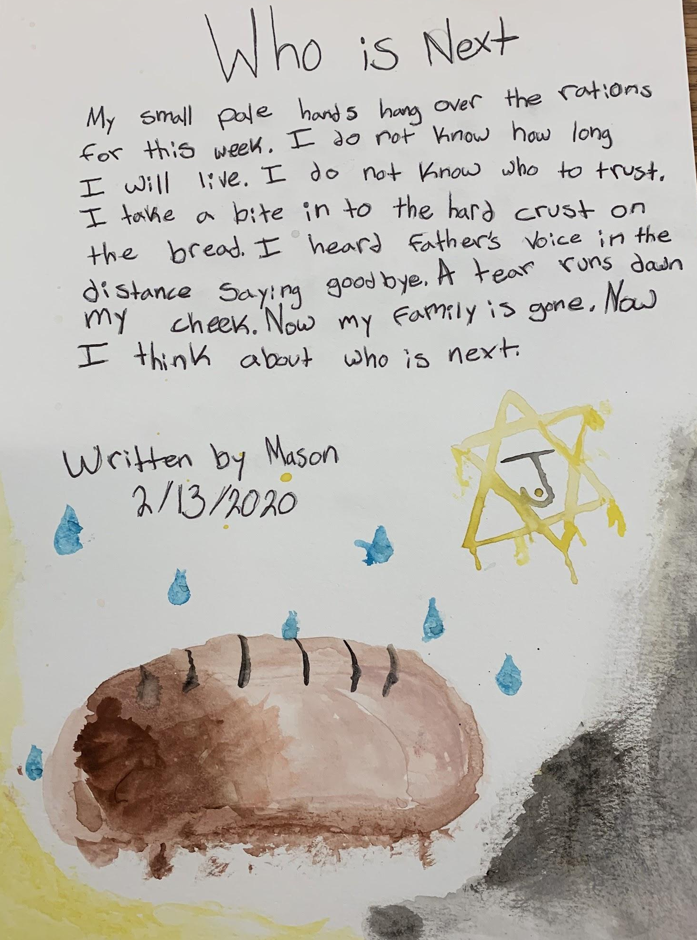
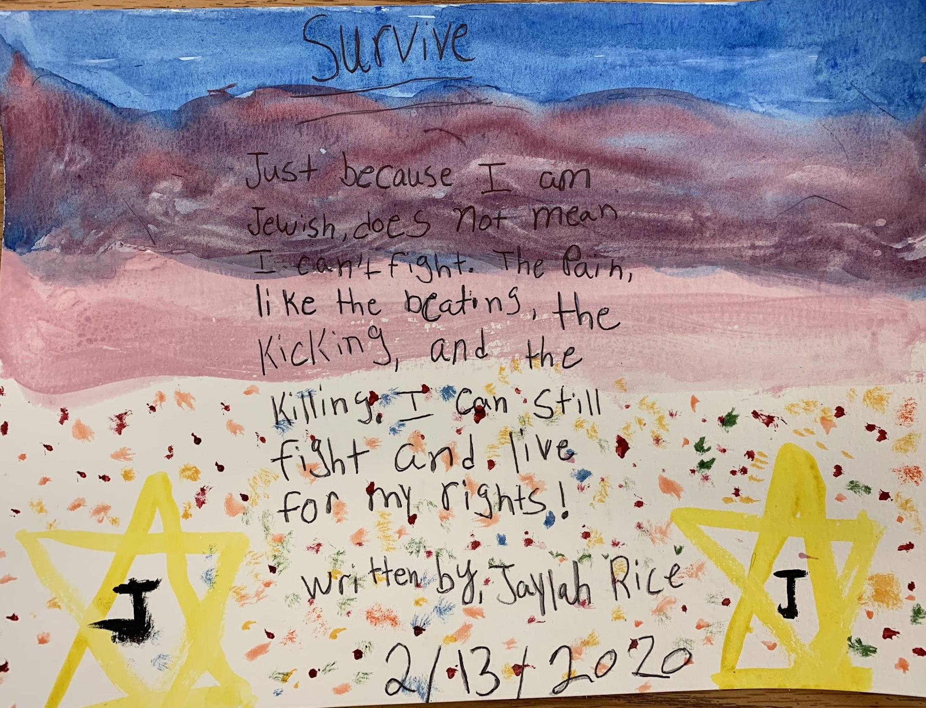
Walk Through Gallery

Slide 18
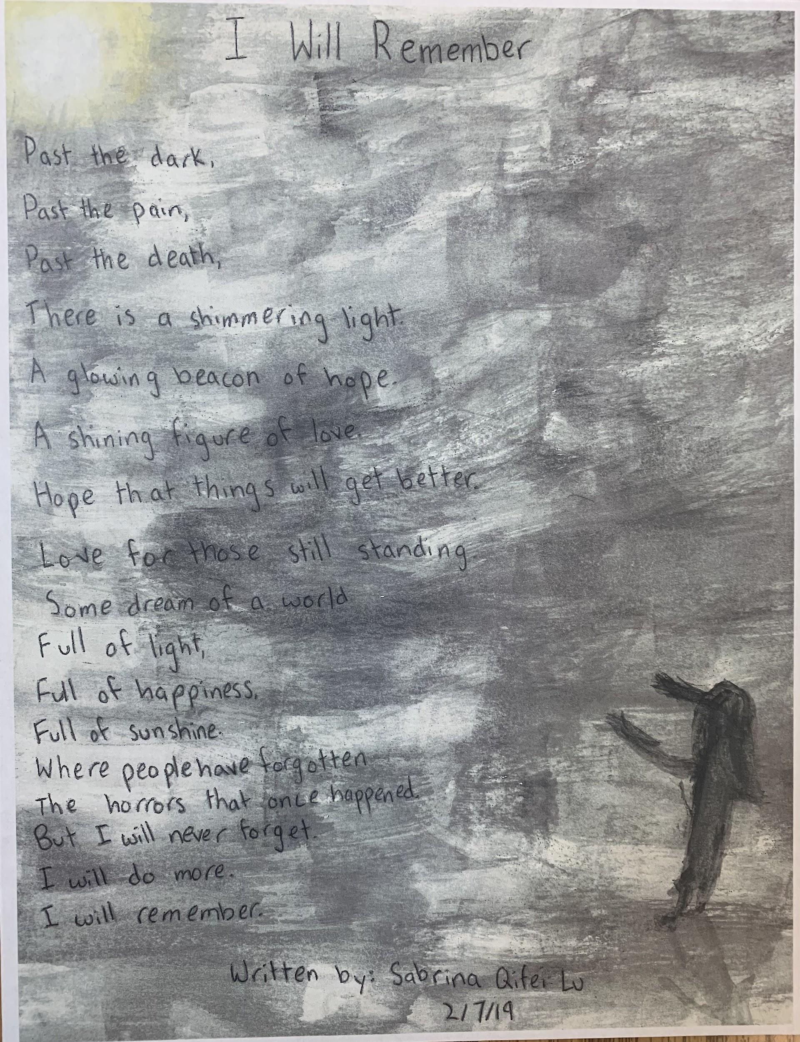
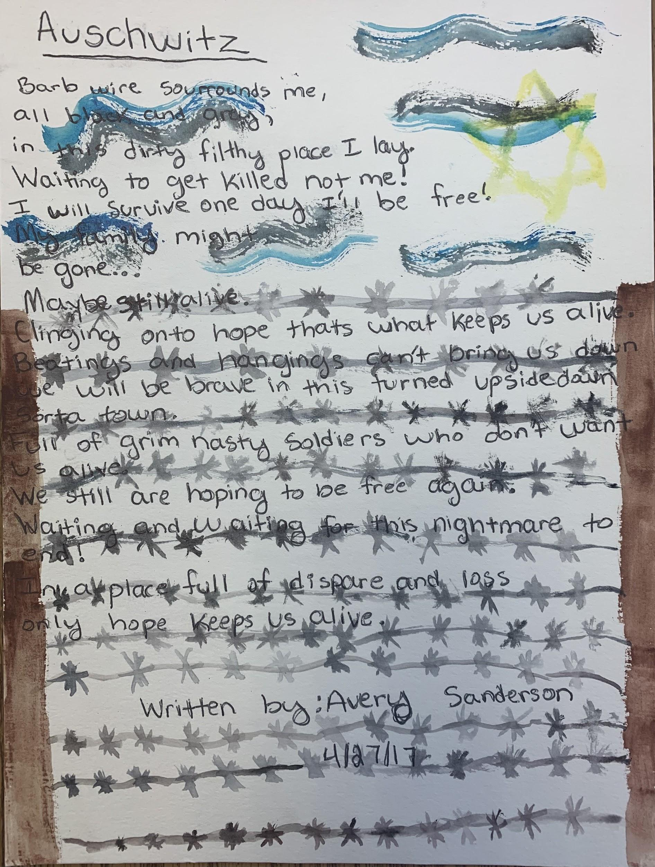
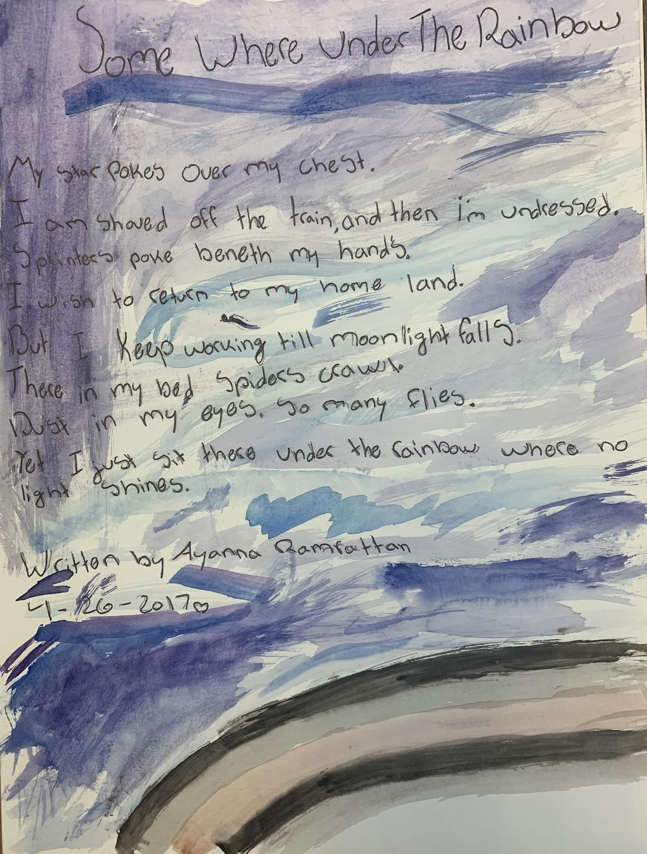
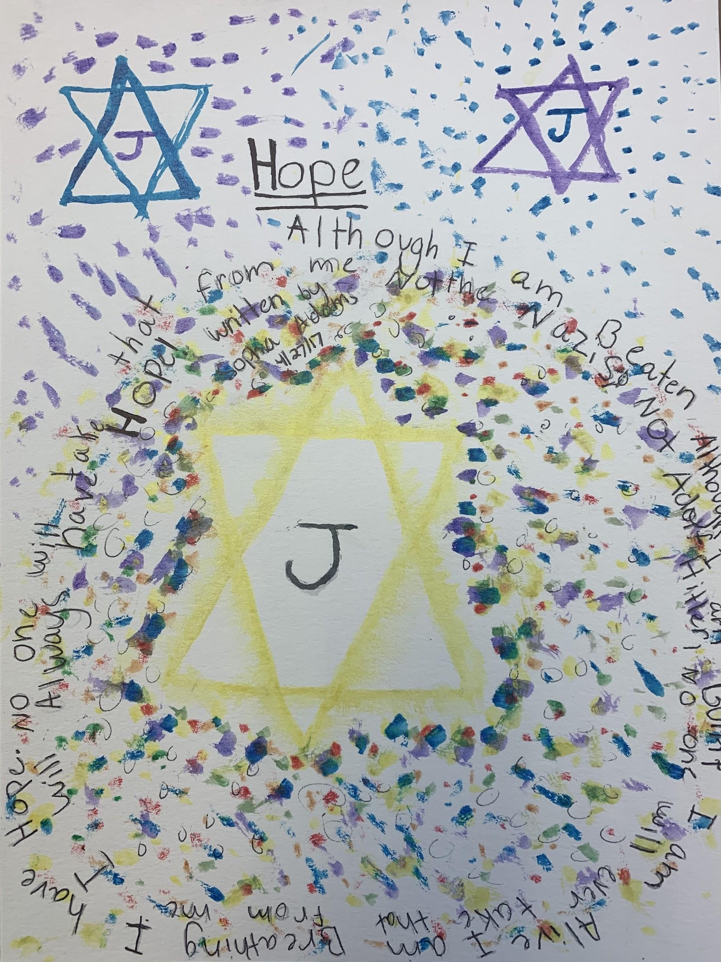
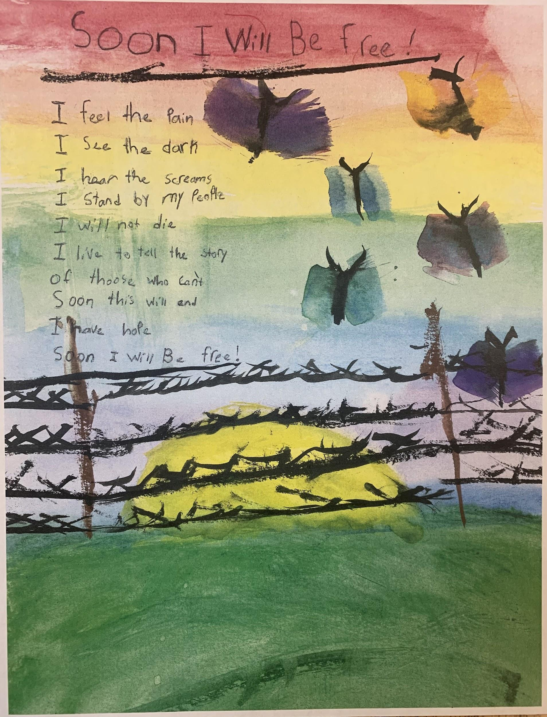

Slide 19
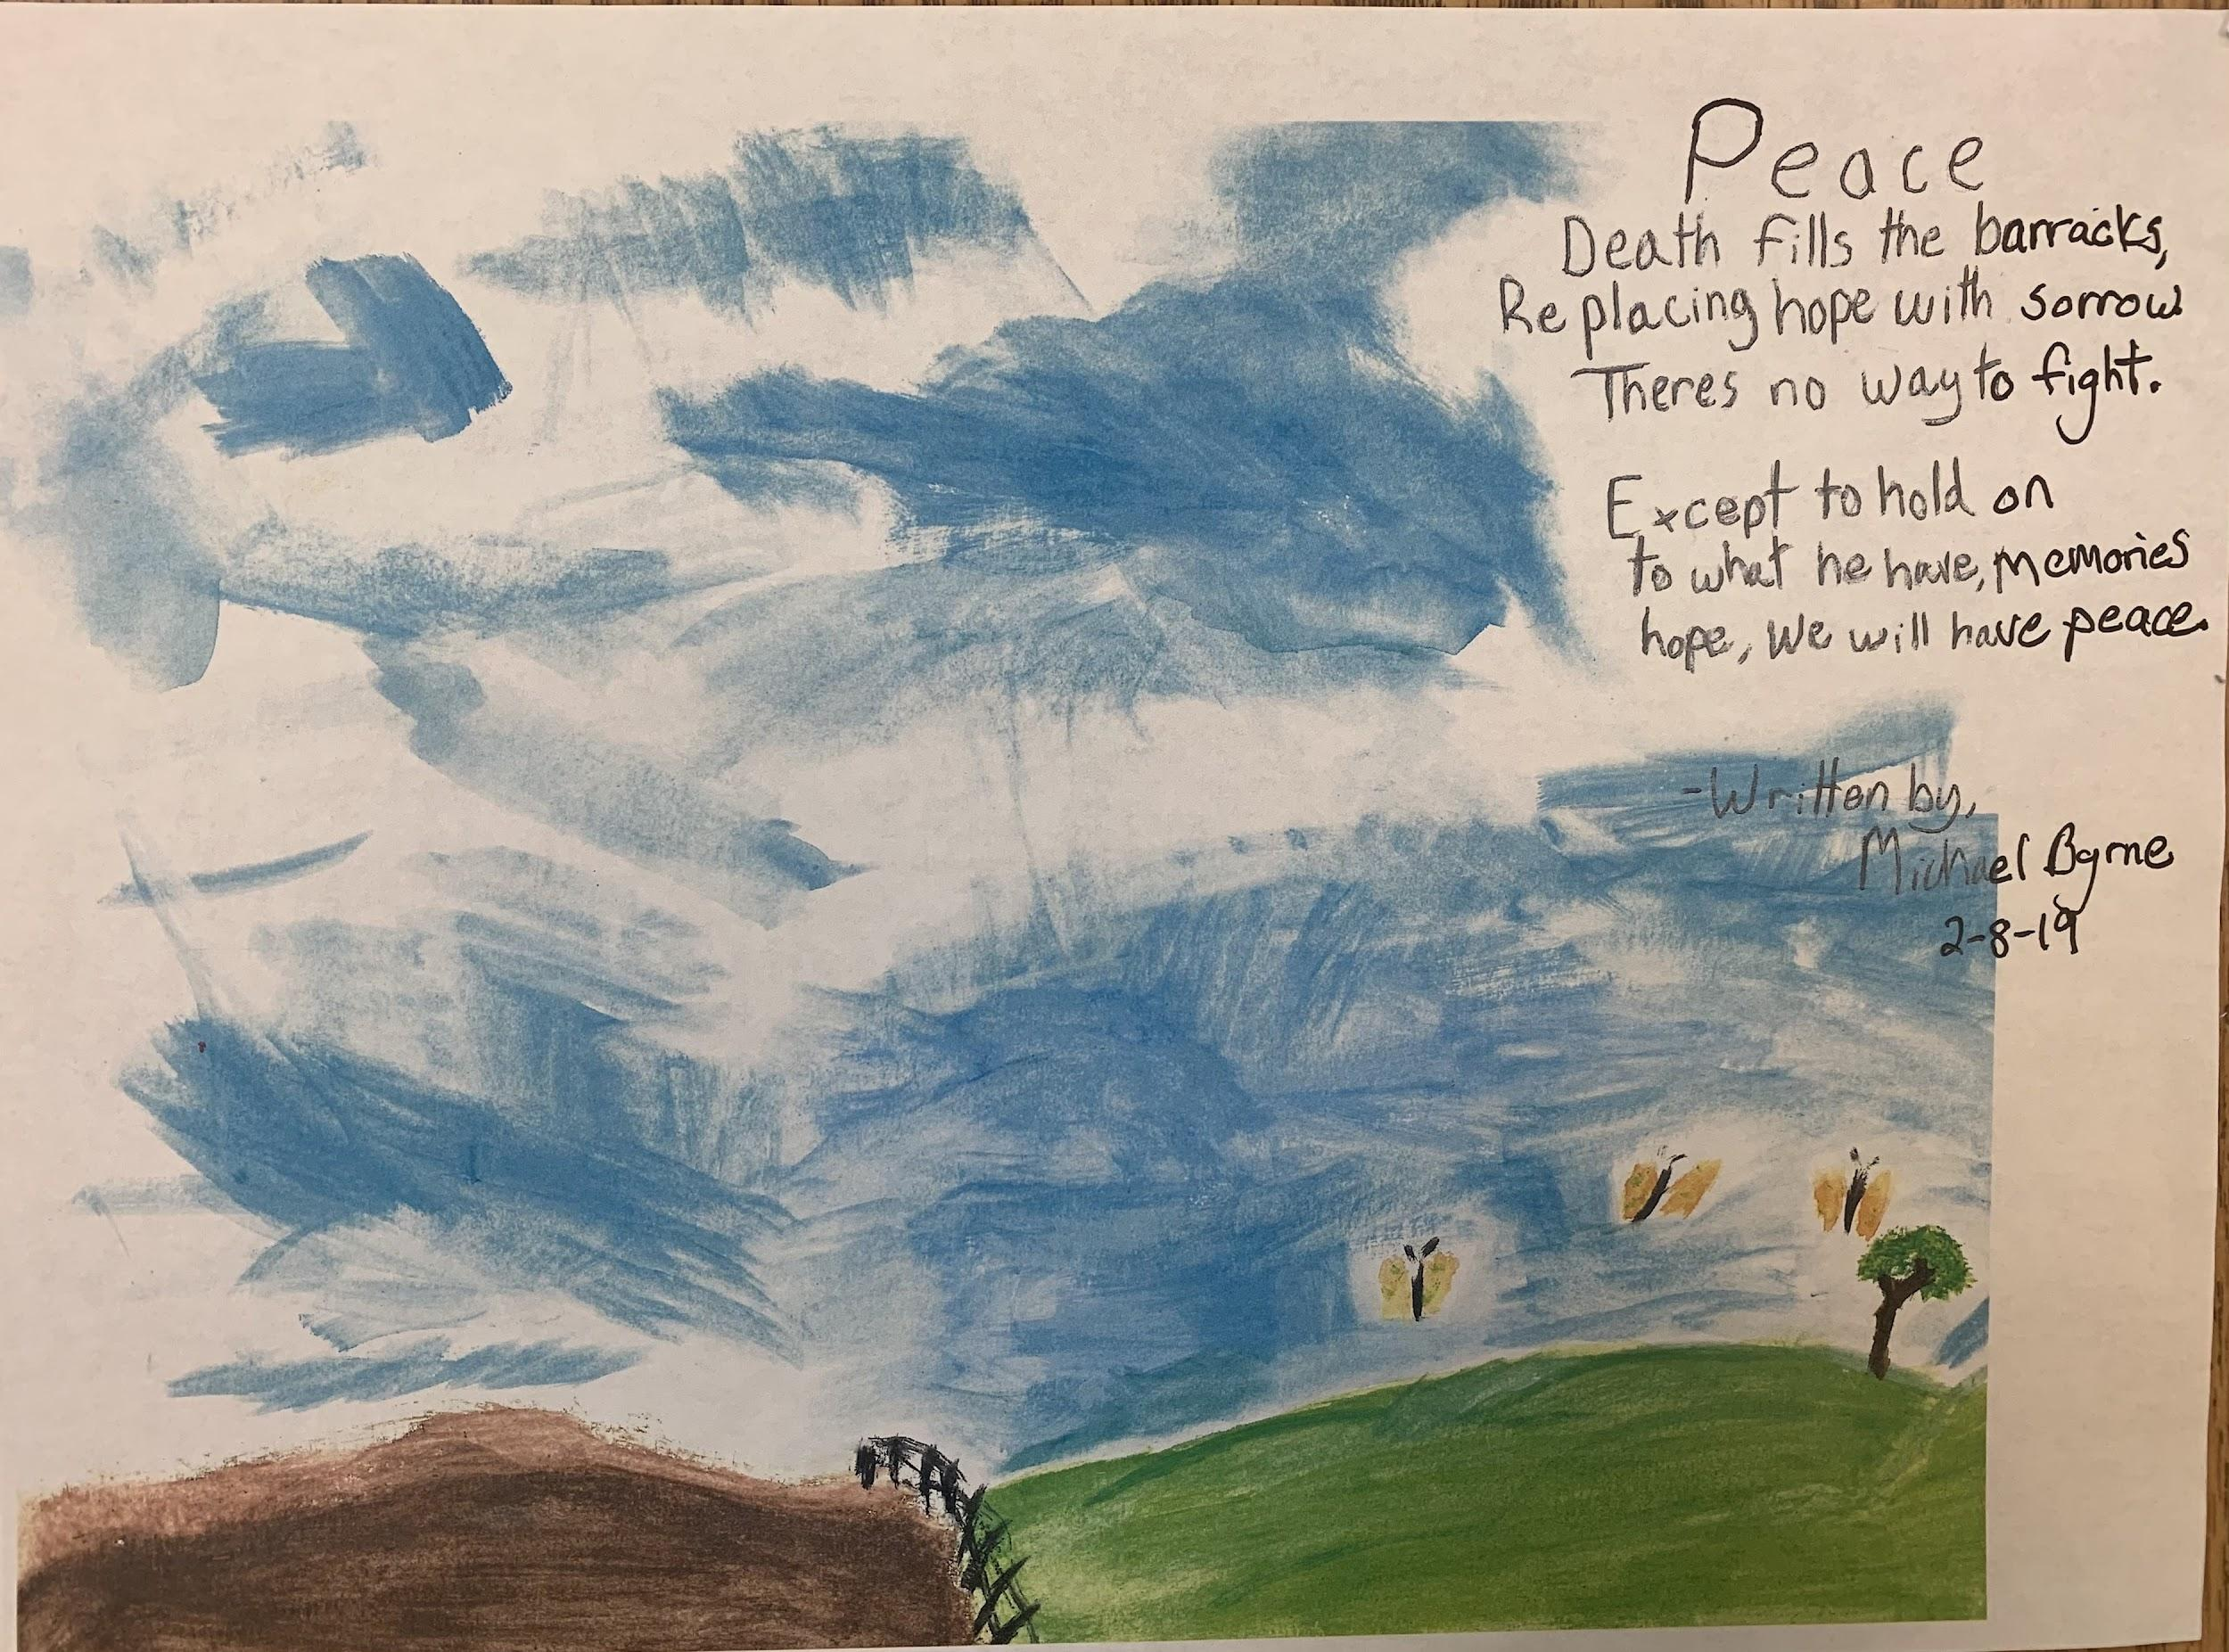
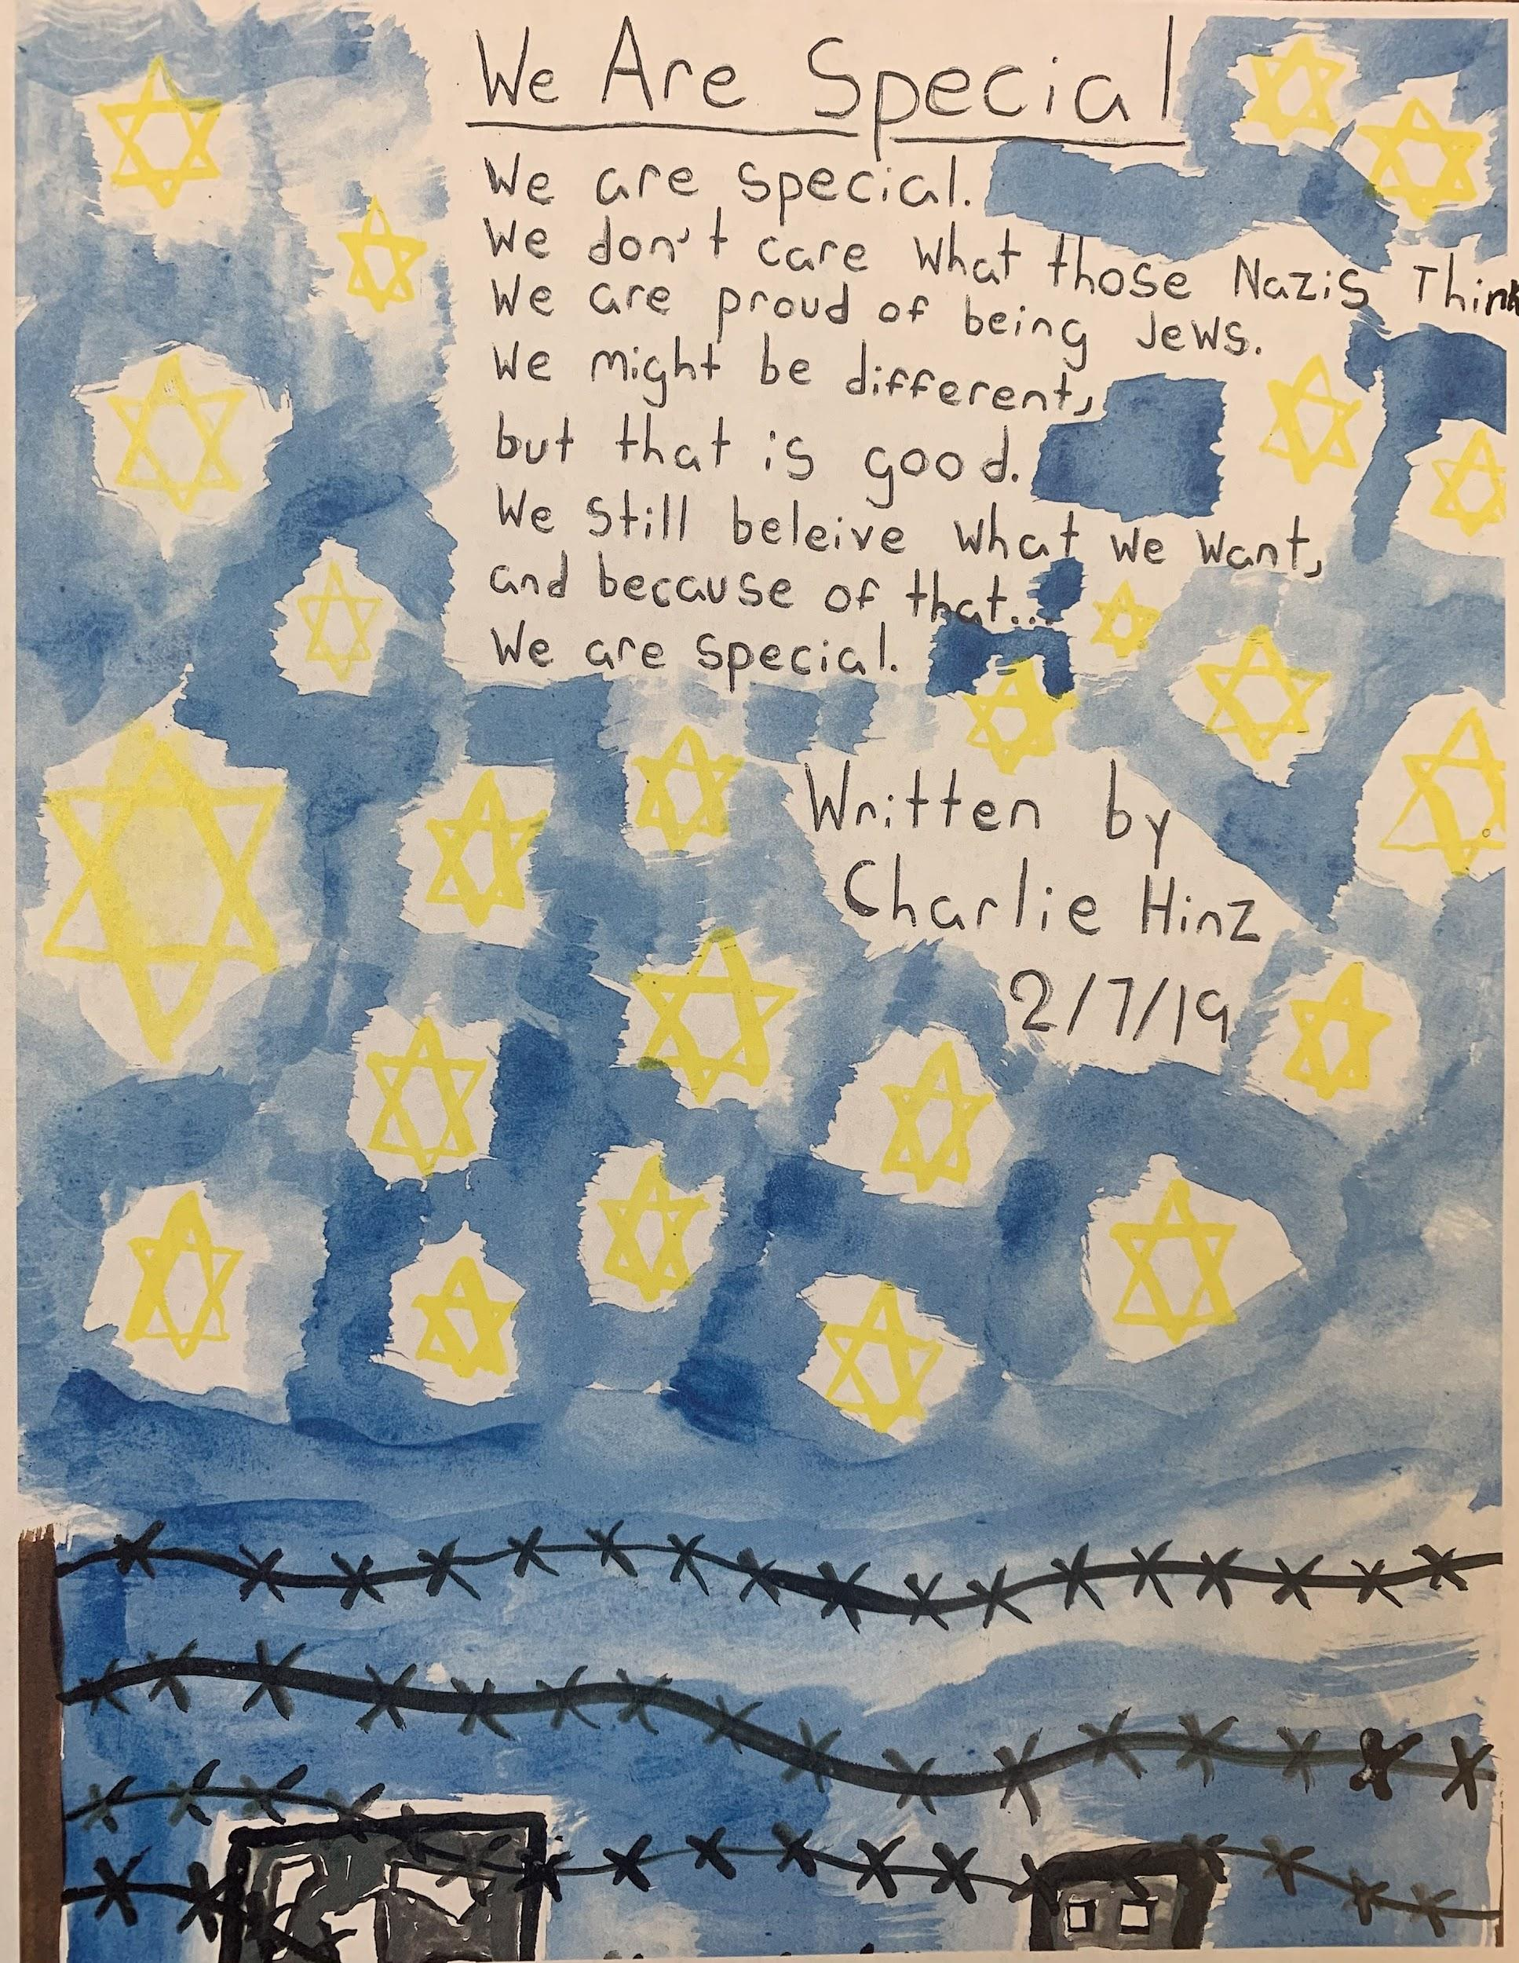
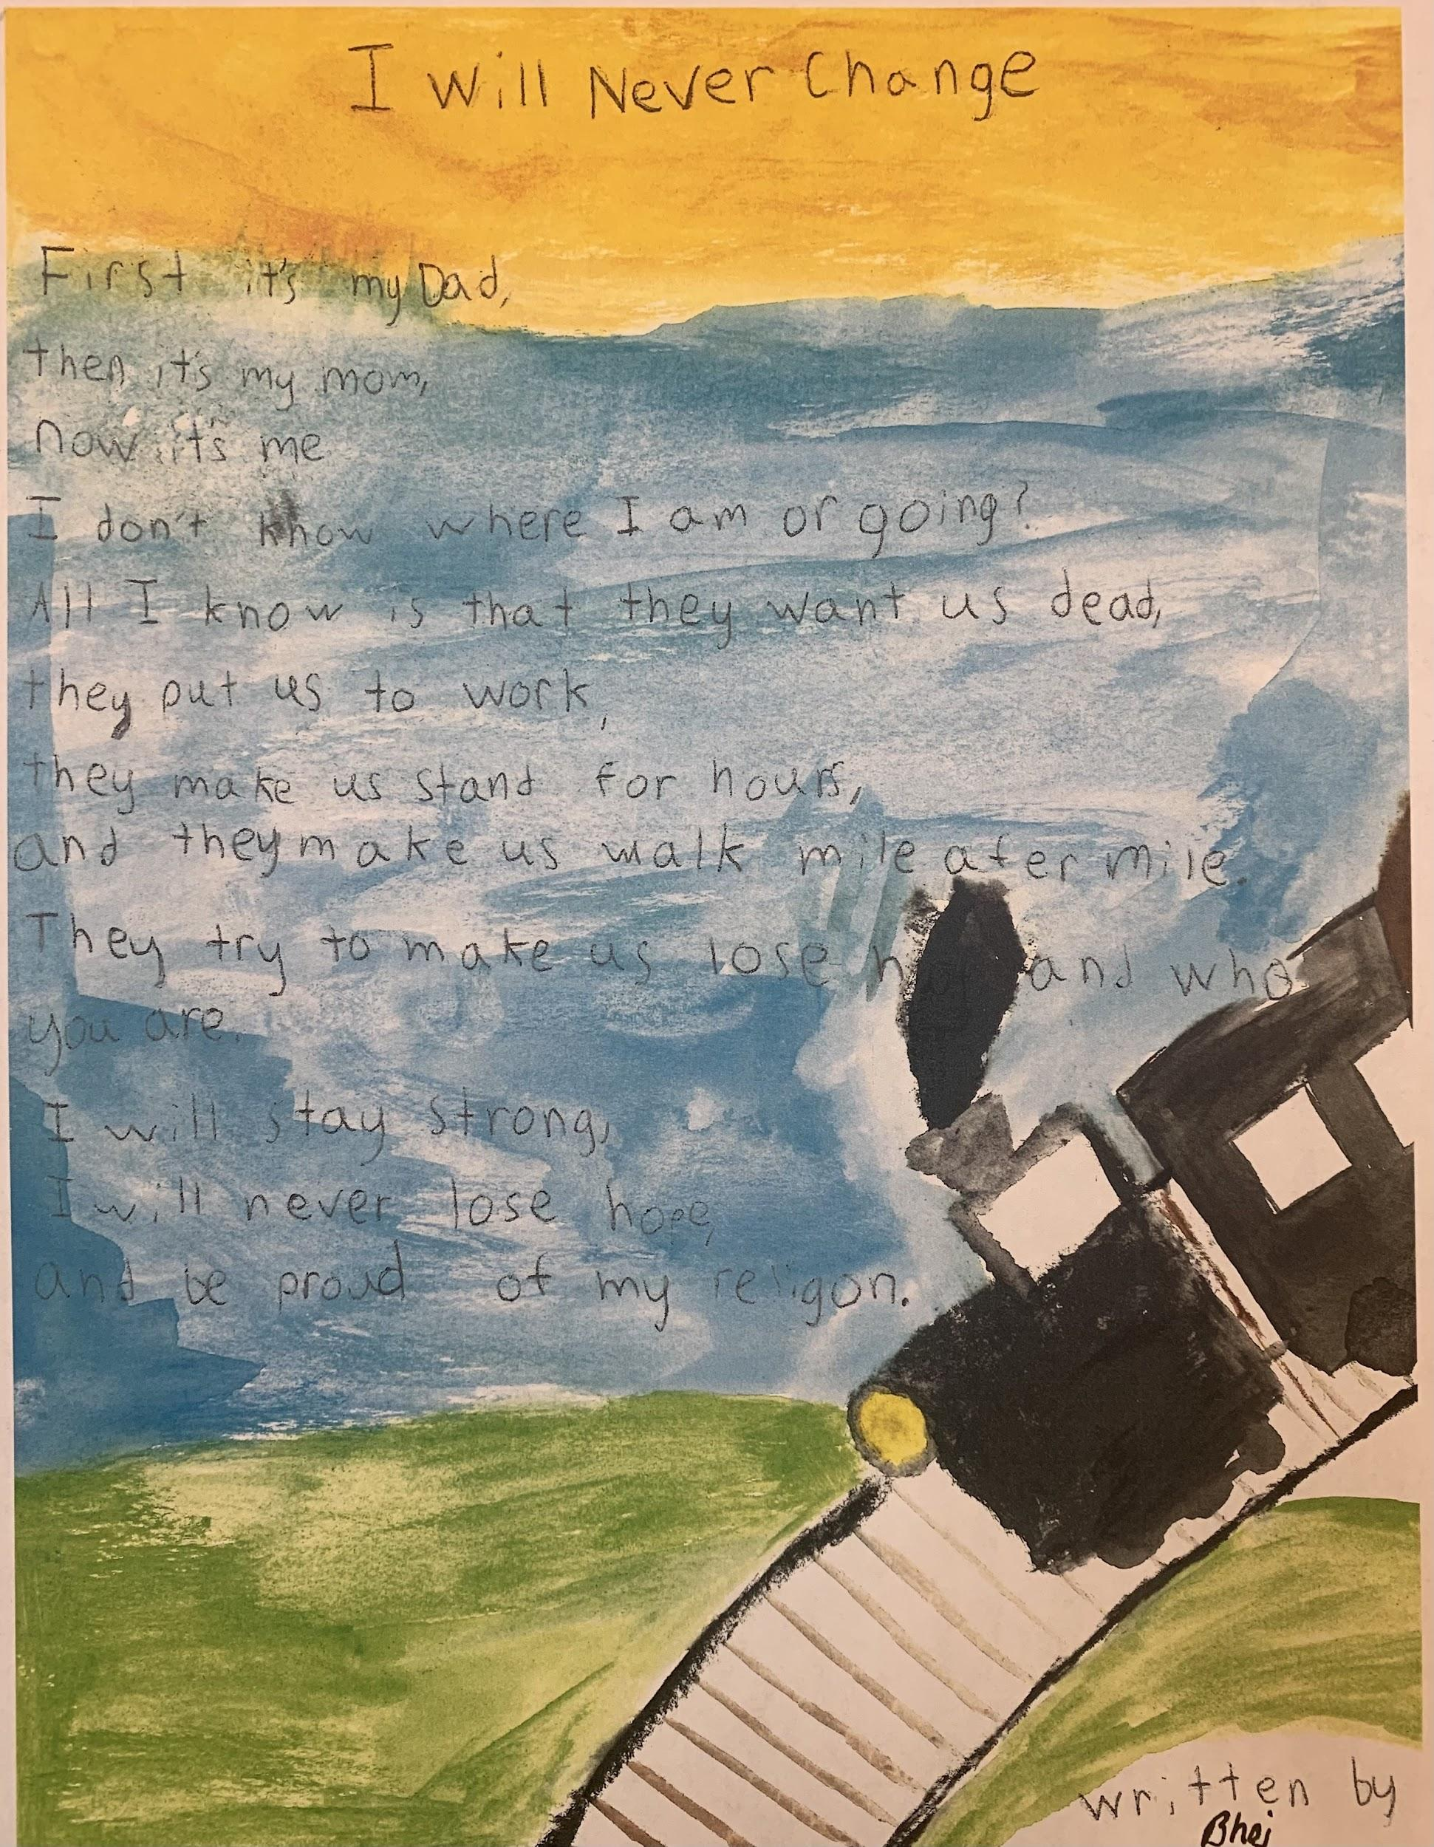
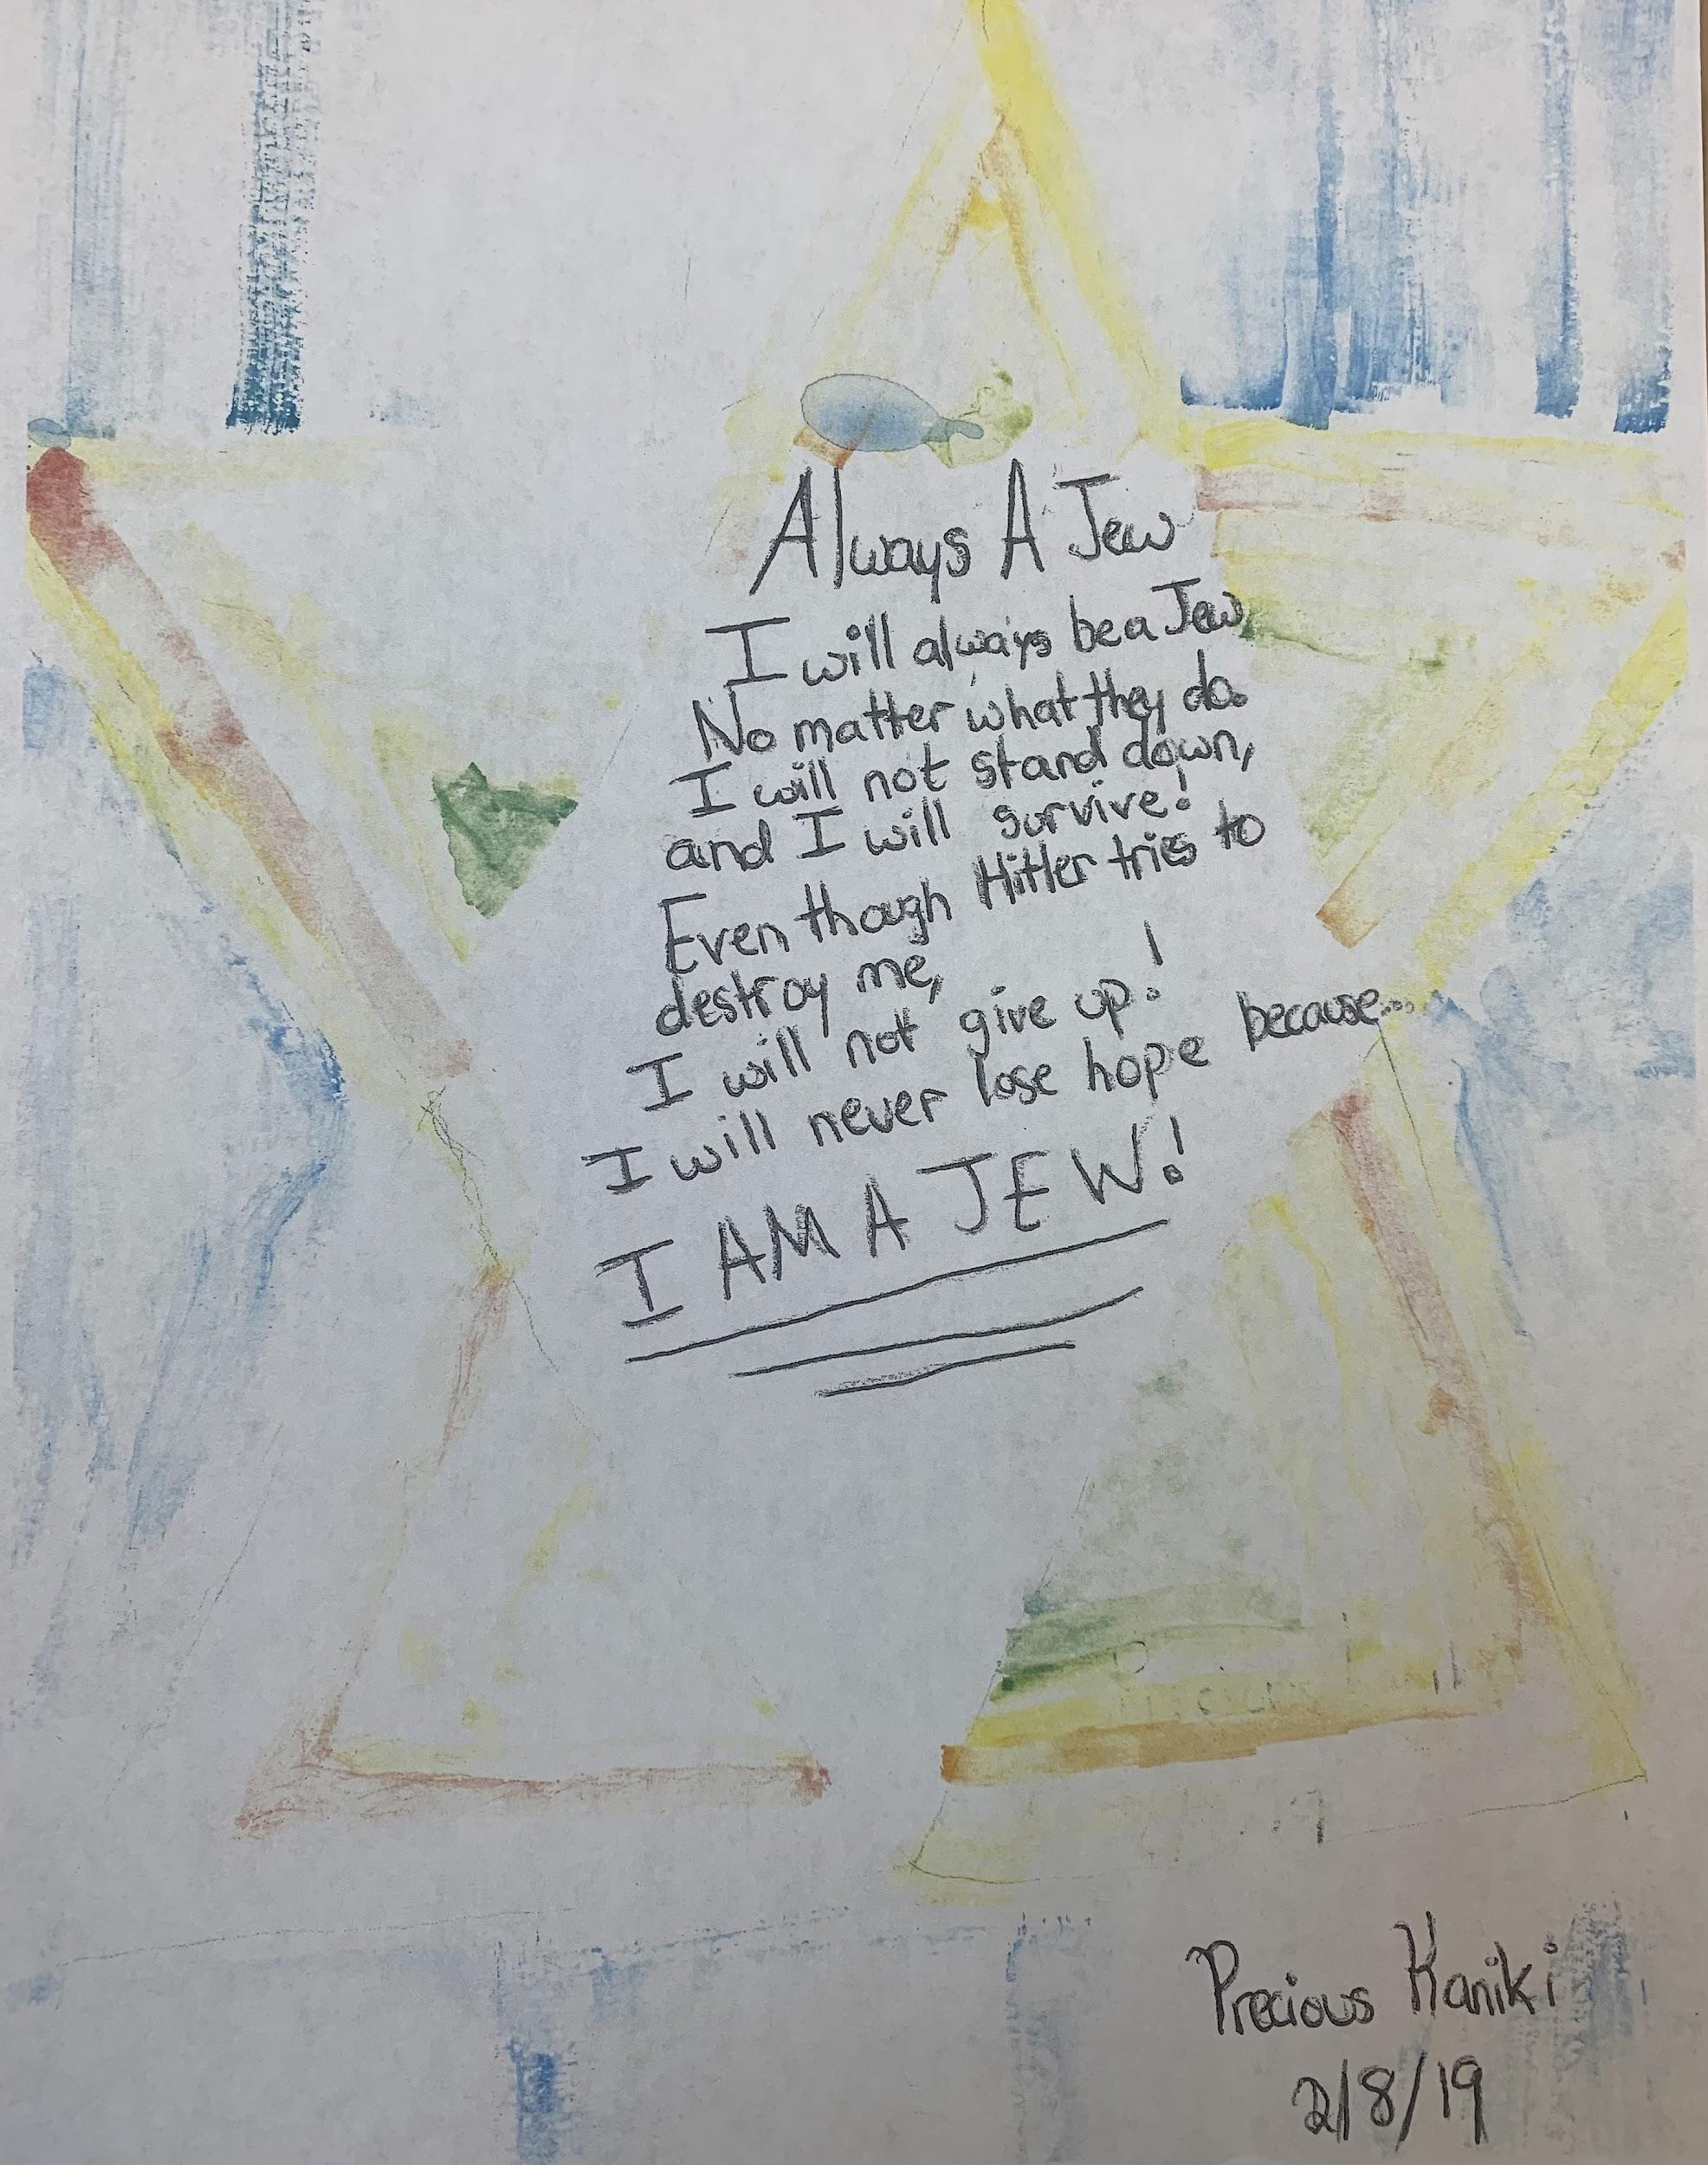

Slide 20
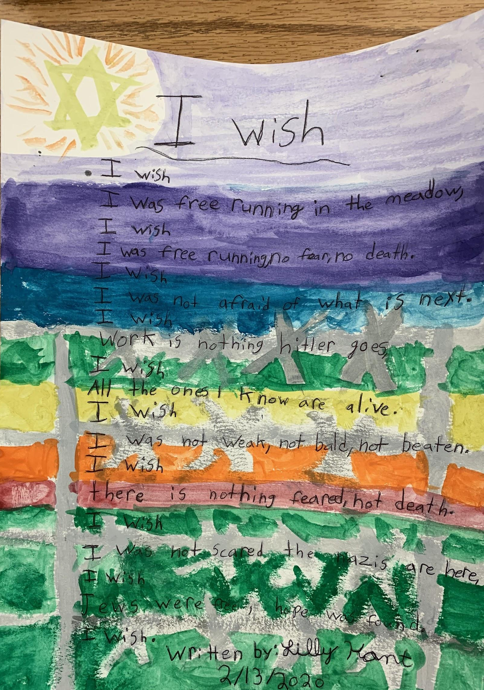
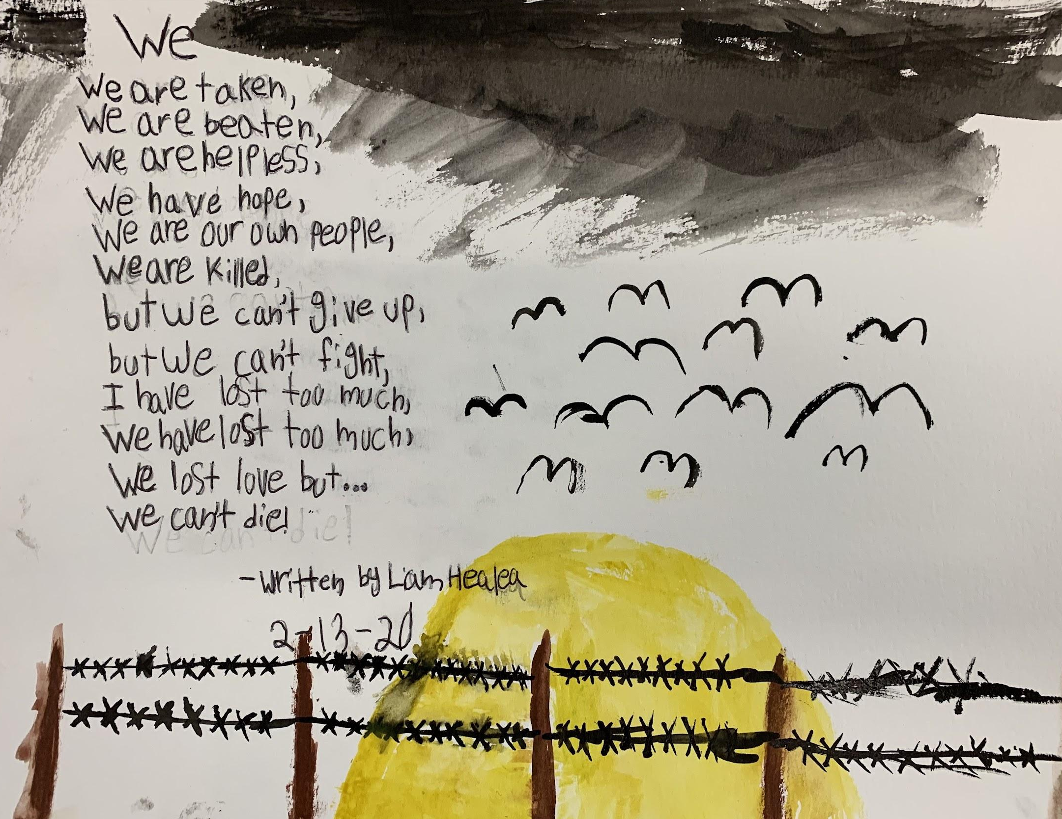
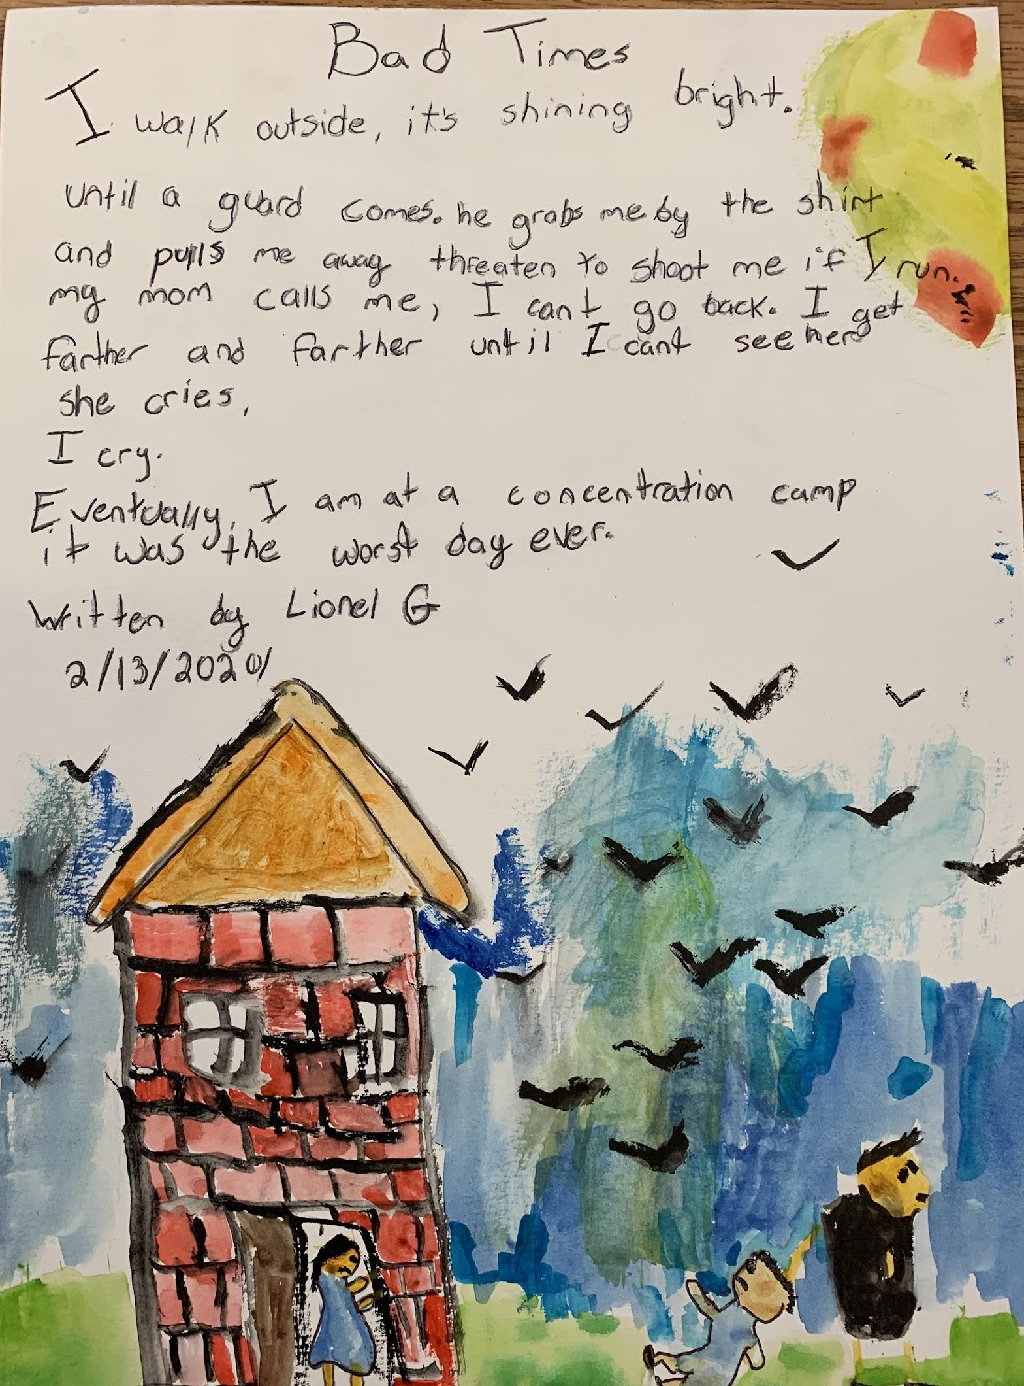
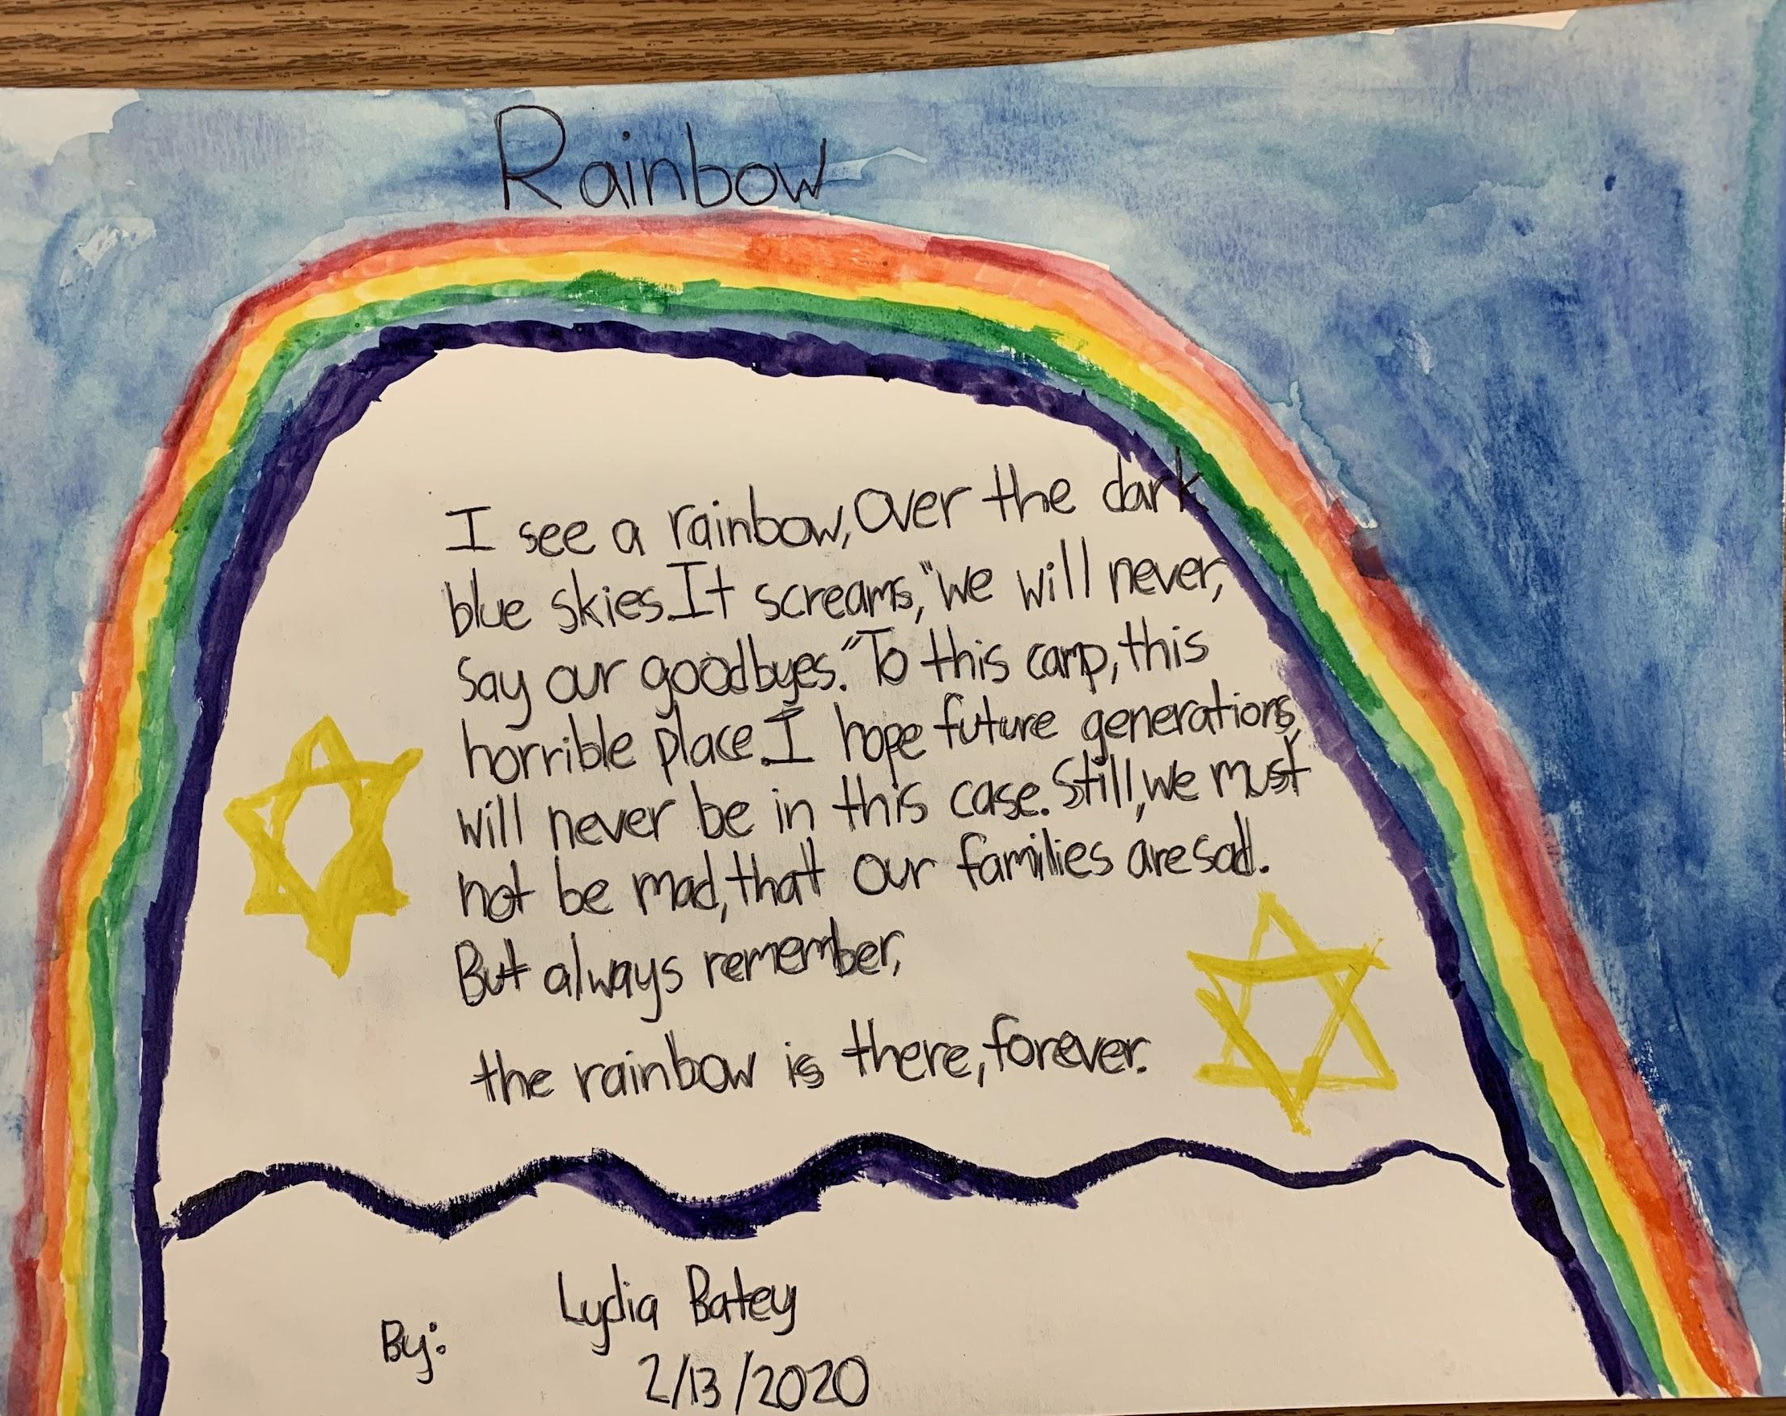
QUESTIONS??

