Slide 1
Local History and the Holocaust
Heidi Omlor

Slide 2
Background:
-USHMM “History Unfolded” project
History Unfolded: US Newspapers and the Holocaust
-Only one major Maine newspaper is available online-Lewiston Daily Sun and their evening edition, Lewiston Evening Journal

Slide 3
-Earlier studies have found that most news of the Holocaust ran somewhere in the middle of the paper, if at all. The New York Times ran an article by Rabbi Wise “announced that 2 million Jews in occupied Europe had been slain in an extermination campaign” in the middle of the paper.

Slide 4
By comparison, as early as March 1933, the Bangor Daily News ran three stories about the mistreatment of Jews in Germany, two of which ran on the front page.
At the same time in The Lewiston Evening Journal, the article “Expect an Exodus of Jews From Germany “ ran on the front page.

Slide 5
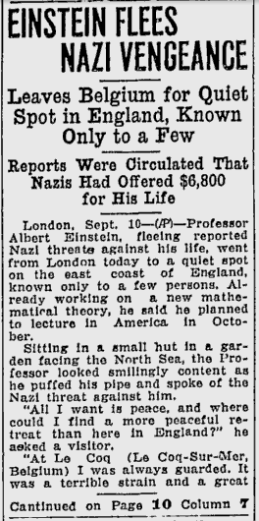
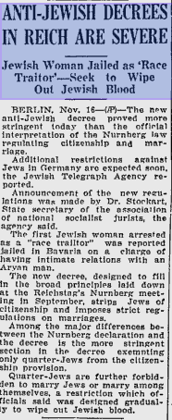
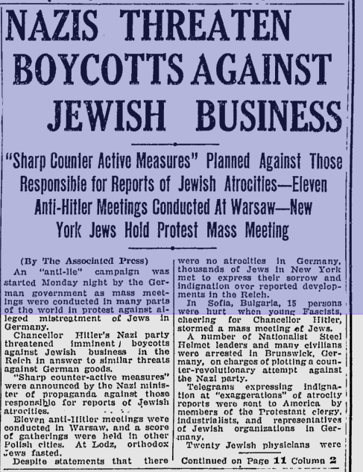

Slide 6
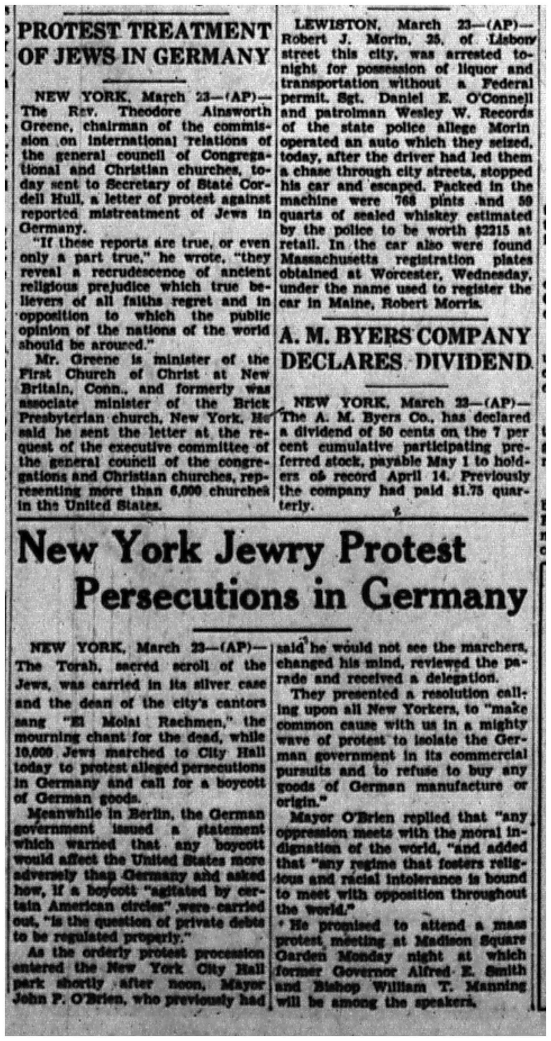
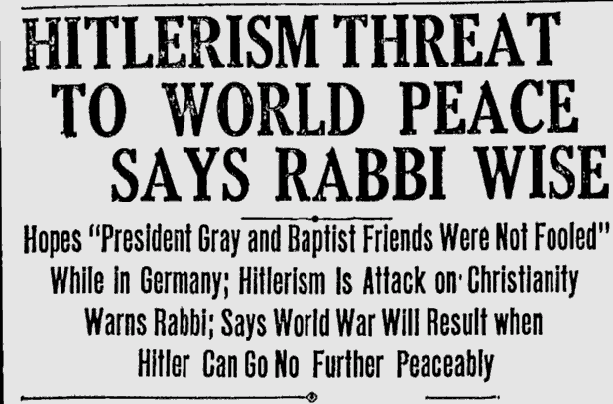
Jewish attempts to bring attention to the situation

Slide 7
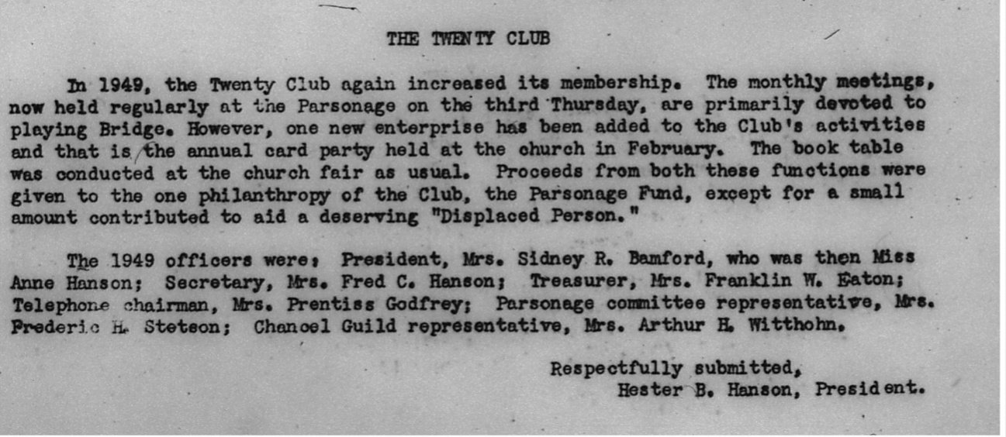
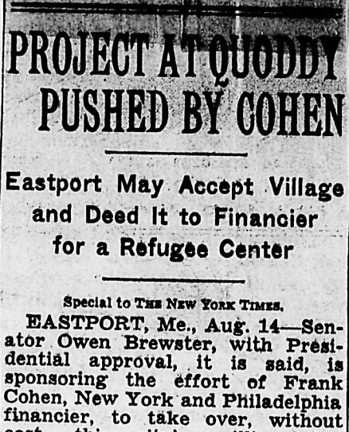
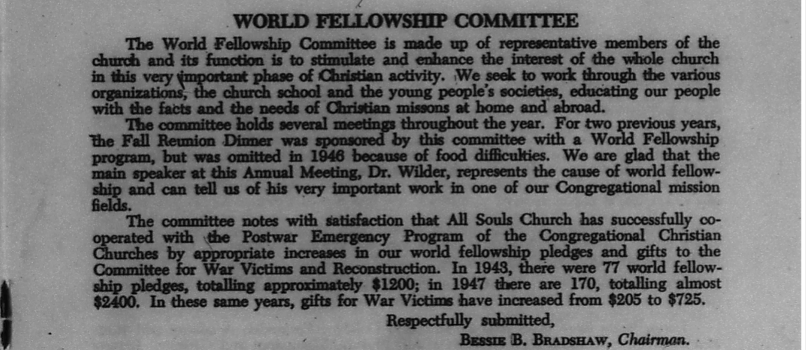
Help from other groups

Slide 8
Illinois Digital Newspaper Collection
Holocaust
Rwanda
Yugoslavia

Slide 9
Works Cited:
All Souls Congregational Church Bangor, Maine 1948 Annual
Report
“Anti Jewish Decrees in Reich are Severe” Bangor Daily
News, March 8, 1933.
“Einstein Flees Nazi Vengeance” Lewiston Evening Journal,
November 11, 1938.
Leff, Laurel. Buried by the Times: the Holocaust and America's Most Important Newspaper. Cambridge University Press, 2012.
Lipstadt, Deborah E. Beyond Belief: The American Press and the Coming of the Holocaust. Free Press, 1986.
“Nazis Threaten Boycotts Against Jewish Businesses,” Bangor Daily News, March 8, 1933.
“Project at Quoddy Pushed by Cohen” The New York Times, August 8, 1947.
United States Holocaust Memorial Museum. Accessed July
20, 2020. https://newspapers.ushmm.org/.

