Slide 1
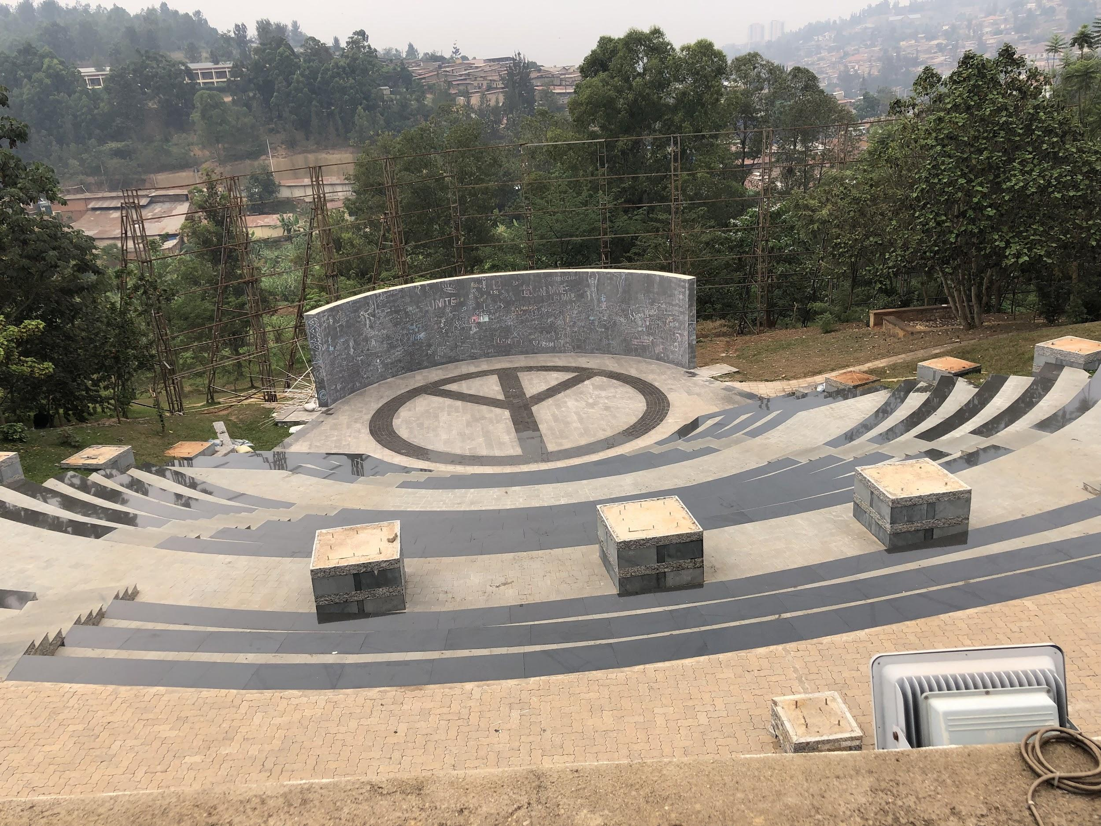
Genocide Against the Tutsi - Female Rescuers
The Righteous are Living Proof that a Choice was Possible
Colleen Simon
Center for Genocide Research and Education
colleen.simon@genocideresearch.org
October 27, 2020
Notes:
This is the official name and it is problematic name for some rescuers and victims. You can talk to your students about what the naming of this genocide implies? What do you think about it.

Slide 2
Objectives for Today’s Session
Craft a rationale/learning objective for teaching rescue
Define “rescue”
What made rescue possible
Differentiate between rescuers and acts of rescue
Why study female rescuers
Share specific examples of female rescuers

Slide 3
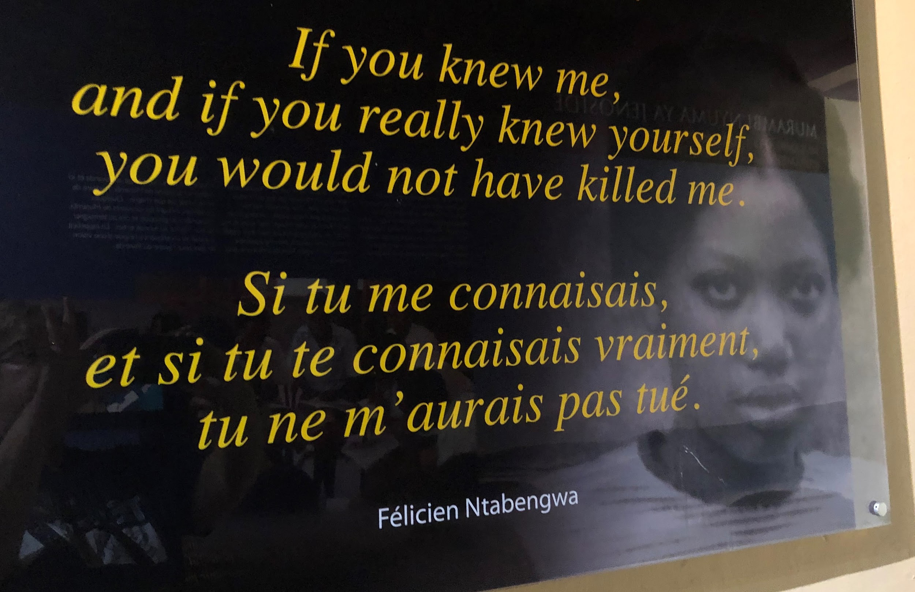
Notes:
Before the genocide Hutu and Tutsis worked together and formed a responsible community together. There was intermarriage.

Slide 4
What is Your Rationale to Teach about Rescuers?
Think about why you are teaching this history before deciding what and how to teach about the role of rescuers during the Rwandan genocide.
Why is this topic relevant to students today?
There are other genocides - why are you focusing on Rwanda?
What do you know about the history of this genocide?
What do you know about your unique student population?
How does this fit into the course you are teaching?
Example rationale statements from the USHMM website (adapted for Rwanda).
To reflect on the roles and responsibilities of individuals, groups, and nations when confronting the abuse of power, civil and human rights violations, and genocidal acts
To provide context for students to explore the fears, pressures, and motivations that influenced the decisions and behaviors of individuals during the genocide in Rwanda.
Notes:
Last week we heard Dr. Hilton talk about 700 million people under Nazi occupation or collaborating with the Nazis. A minute percentage engaged in rescue.

Slide 5
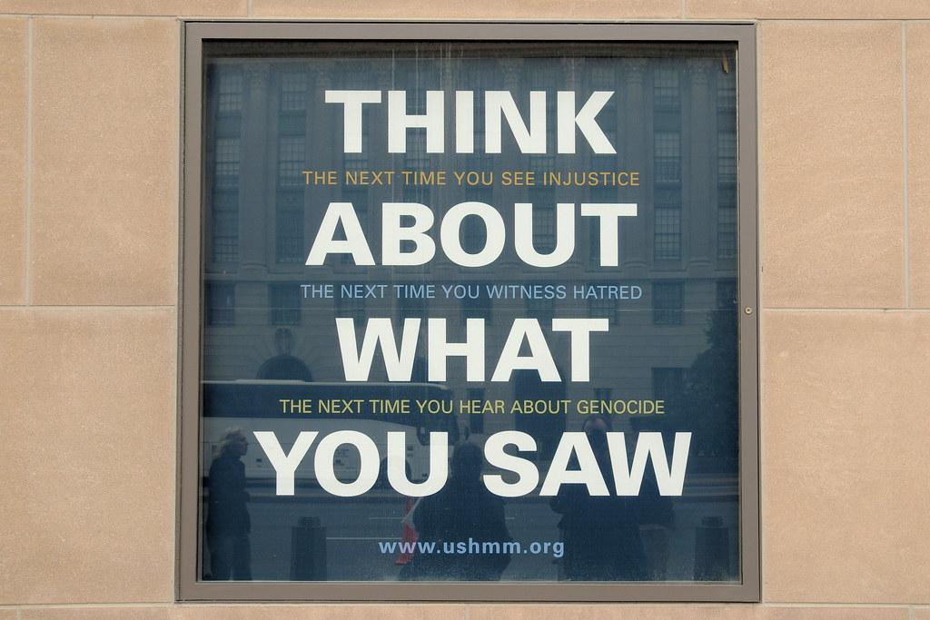
Guidelines from USHMM - Adapted for genocide in Rwanda.
Define the term genocide
The genocide in Rwanda was not inevitable.
Avoid simple answers to complex questions.
Strive for precision of language.
Strive to balance the perspectives that inform your study of the genocide.
Avoid comparisons of pain.
Avoid romanticizing history.
Contextualize the history.
Translate statistics into people
Make responsible methodological choices.

Slide 6
Altruistic Behavior
Samuel P. and Pearl Oliner define altruistic behavior as being directed toward assisting another with a high risk to the rescuer. These actions are not coerced and there is no expectation of reward.
A universalist view of the world that all people matter

Slide 7
kugira umutima mwiza - “to have a good heart.”
Many survivors when asked about their rescuers spoke of the person having a good heart. In Rwanda this is more than just kindness. Someone with a good heart is seen as someone with a positive mind, character and spirit. Someone who is attentive to others - has good morals.
When used with the adjective good it demonstrates all the meanings that go with what it means to be human - wisdom, righteousness, prudence, respect, courage, bravery, firmness, energy, and forcefulness.

Slide 8
Acts of Rescue
Scholar Lee Ann Fujii detailed different acts of rescue, but she interviewed men serving prison sentences for killings during the genocide and discovered that while they did commit murder, they also committed what Fujii calls acts of rescue.
If there was a personal connection or a perpetrator was alone - often he would save the life of a Tutsi - an act of rescue.

Slide 9
What is it to be a female rescuer?
Must go against the norm
Inyenzi - cockroaches
Must go against the norm
Women are subservient to men

Slide 10
Indakemwa - Those who are morally beyond reproach
Criteria for rescuer:
Saving one or more Tutsi
Not having received any reward for their actions
Committed no actions which would have harmed or led to the harm of any Tutsi
Who testified against the genocide
Does not spread genocide ideology.
Who can be a rescuer?
Altruistic personality
Expanded Universe of Obligation
Is able to see beyond the propaganda
Has the means to help
Notes:
Rescue in Rwanda:
Ibuka - , a Kinyarwanda word which means remember, is an umbrella group in Rwanda representing survivors, but has also collected the testimonies of 372 rescuers. This group ran out of money and only was able to talk to a small percentage of rescuers. There are studies that demonstrate that some rescuers do not come forward because their actions could also be seen as complicit in the genocide.
moral courage. He defines moral courage as “the ability and willingness to act according to our values (to do the right thing) even though others might disapprove of our actions, or do other harm to us. Moral courage means doing what you believe is the right thing even when your actions are contrary to the values, beliefs or expectations of the people around you.

Slide 11
System of Patriarchy - Life Before April 6, 1994
Rwandan law
Men sat as heads of household
Women were barred from inheriting property, entering into any legal agreement, or opening a bank account without spousal permission.,
Societal norms for women
Typically women were less educated than men,
Few women held positions of authority within any area of government.
Women expected to work hard without complaint
Homemaking, rearing and disciplining children, faithfulness to partners, and (for women with farms or gardens) making a success of subsistence agriculture.
The majority of Rwandan women in 1994 adhered to the traditional expectations of homemaking, child rearing, and creating community between households.

Slide 12
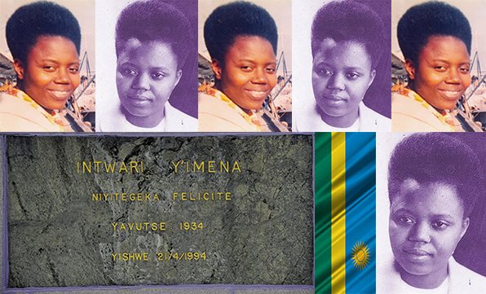
Félicitée Niyitegeka
Auxiliaries of the Apostolate is an order of lay women who choose to live a celibate life in service to the Church and dedicate their lives to spreading the gospel.
According to close friends and those whom she saved, Niyitegeka believed that if she was able to save even a single life, then it was her duty to do so.
According testimonies, Niyitegeka used her ‘limited power’ to offer shelter to fleeing Tutsi and helping others escape to the then Zaїre (present-day Democratic Republic of Congo.
Was killed on April 21, 1994 while trying to save Tutsi who sought asylum at the centre.
Notes:
Rescue in Rwanda:
Ibuka - , a Kinyarwanda word which means remember, is an umbrella group in Rwanda representing survivors, but has also collected the testimonies of 372 rescuers. This group ran out of money and only was able to talk to a small percentage of rescuers. There are studies that demonstrate that some rescuers do not come forward because their actions could also be seen as complicit in the genocide.

Slide 13
Félicitée Niyitegeka
“Dearest brother,
Thank you for wanting to help me. I would rather die than abandoning the forty-three persons for whom I am responsible. Pray for us, that we may come to God. Say ‘goodbye’ to our old mother and our brother. When I come to God, I shall pray for you. Keep well. Thank you for thinking of me. If God saves us, as we hope, we shall see each other tomorrow.
Your sister,
Felicitas Niyitegeka.”

Slide 14
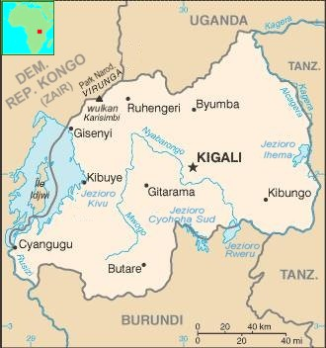
Geography of Rescuers
Nyundo, Gisenyi

Slide 15
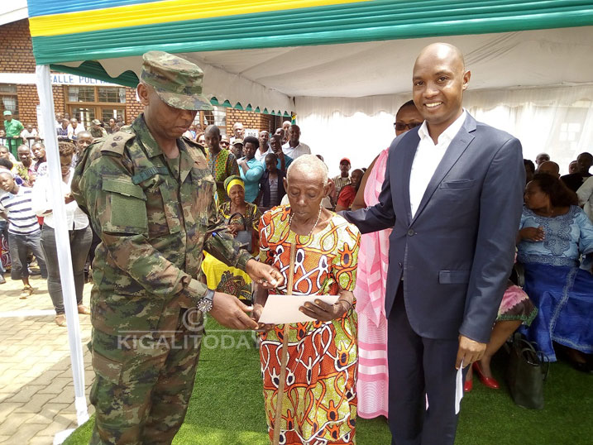
Thérèse Nyirabayovu
A well known and respected midwife, Nyiarayovu was 67 at the time of the genocide. A widow living with her children. Her decision to give shelter to Tutsis was based on her belief that it was a duty to save fellow human beings in danger.
Thérèse was made aware of the risk she was taking on a number of occasion - her home was searched, she was questioned repeatedly, and a grenade was thrown at her house. The danger persisted even after the genocide. While staying in the refugee camps in the former Zaire, Thérèse was under constant threat from the militiamen who had heard of her actions.
Therese Nyirabayovu, received a certificate of appreciation - National Heroes Day 2/02/2017

Slide 16
Geography of Rescuers
Kigali

Slide 17
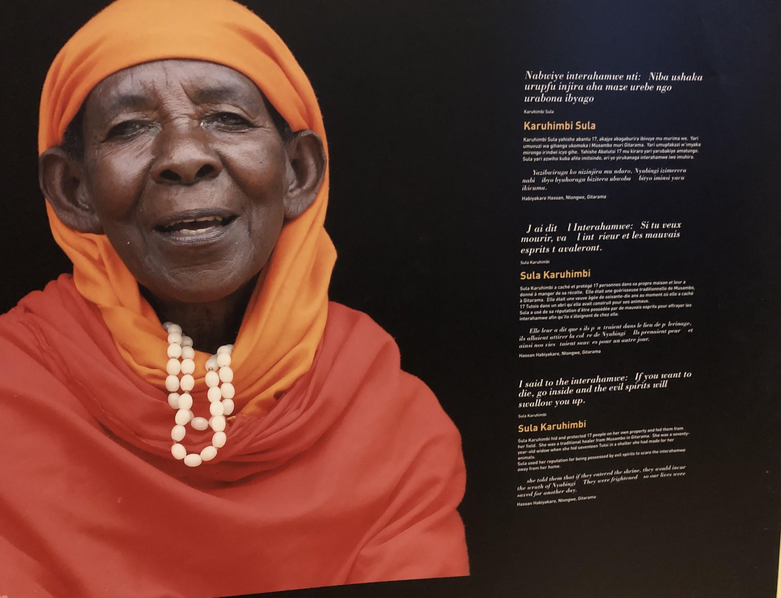
Sula (Zura) Karuhimbi
I said to the interahamwe: If you want to die go inside and the evil spirits will swallow you up.
Sula Karuhimbi hid and protected 17 people on her own property and fed them from her field. She was a traditional healer from Musambo Gitarama. She was a seventy-two year old widow when she hid 17 Tutsi in a shelter she had made for her animals.
Sula used her reputation for being possessed by evil spirits to scare the interahamwe away from her home.
She told them that if they entered the shrine, they would incur the wrath of Nyabingi. They were frightened so our lives were saved for another day.
Hassan Habiyakare Ntongwe, Gitarama
Notes:
You can have students look at her picture in the museum at the Kigali Genocide Memorial, listen to her testimony and read her obituary. What information is the same and what is different? Why do you think this is so? All panels are written in Kinyarwanda, French and English.

Slide 18
Geography of Rescuers
Musambo Gitarama

Slide 19
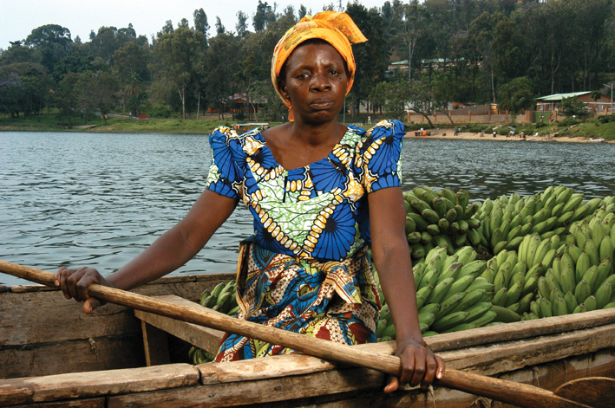
Josephine Dusabimana
Pi
“I see each person as a human being that worth love and right to live.”
Genocide rescuer, Josephine Dusabimana
Dusabimana offered up all she had in order to rescue others during the genocide against the Tutsi in 1994. With the little means she had, she shared her food, her space, her money, her goats, her strength, and, of course, the security of herself and her family.

Slide 20
Geography of Rescuers
Kibuye

Slide 21
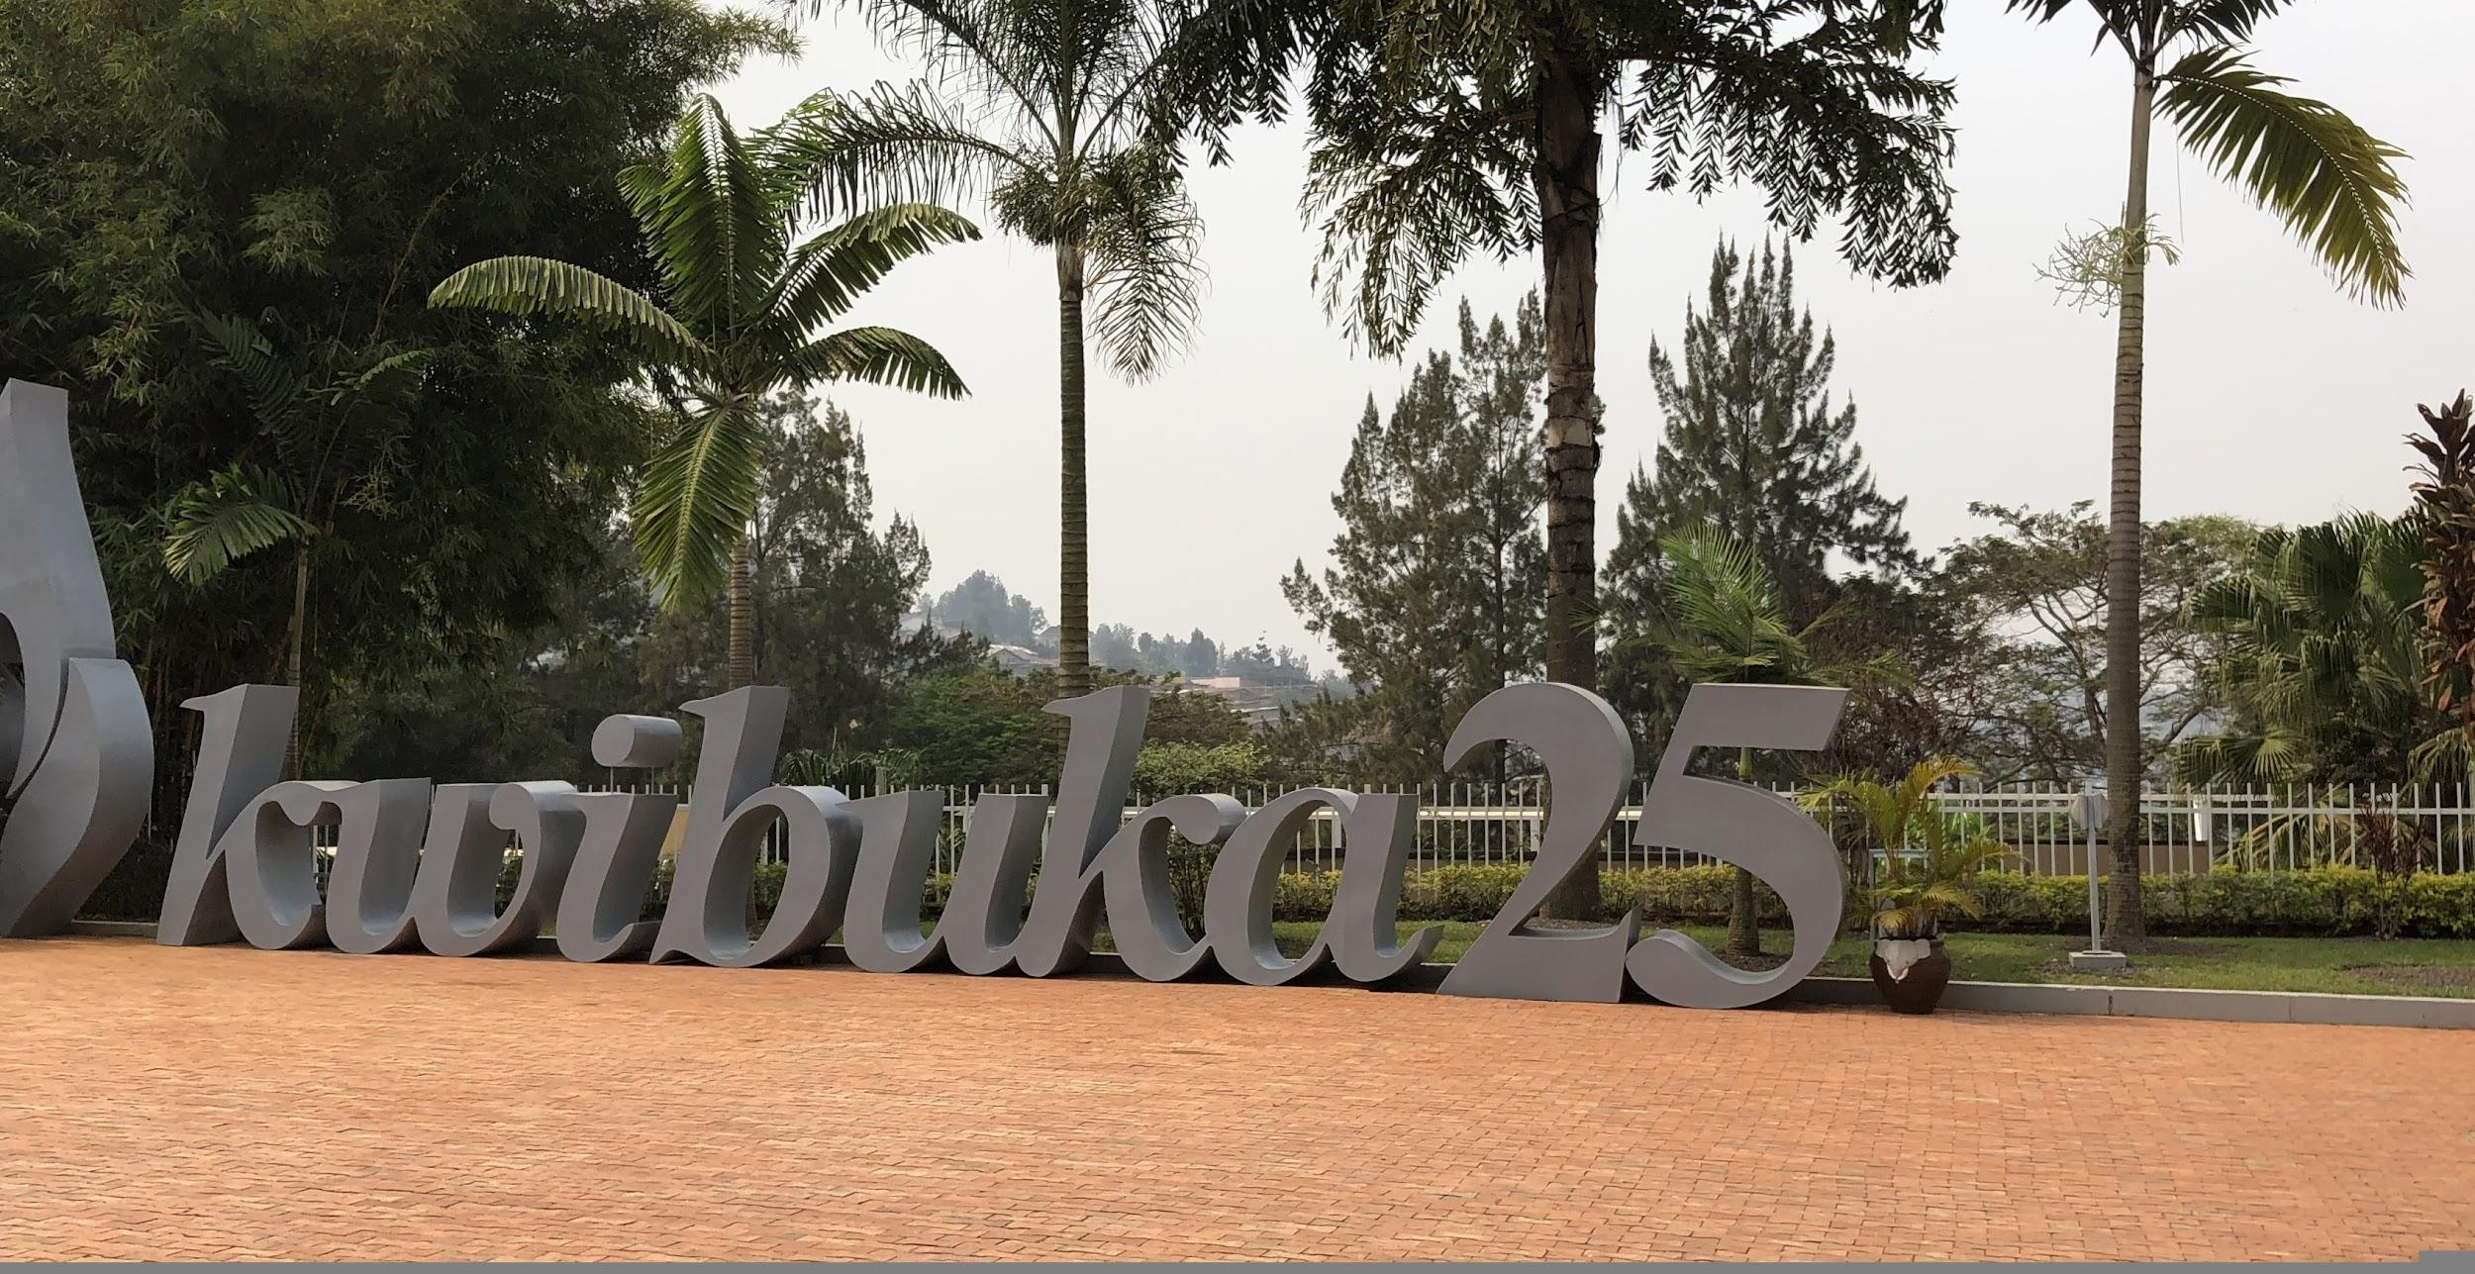
Questions to consider:
What are students learning about rescue during the genocide?
What are students learning about women who rescued during the genocide?
What surprises them?
What do these testimonies teach them about Rwanda?
Notes:
(they may catch on to the amount of bribery that went on or family turning on family)

Slide 22
Teaching Ideas - Situational and Dispositional Factors
Geography of Rescue - Situational Factors
Examine what rescue looked like for the two women who lived in or near the capital. What obstacles did they need to overcome versus those women who lived near the border with DRC (Zaire).
kugira umutima mwiza - Dispositional Factors
Read the stories of these women and look for examples within their personality that would exemplify the personality of rescuers as defined by the Oliners. How were they able to look beyond the propaganda?

Slide 23
Testimony
iWitness
https://iwitness.usc.edu/sfi/Sites/rwanda/
Genoicde Archive of Rwanda
https://genocidearchiverwanda.org.rw/index.php/Category:Testimonies
USHMM
https://www.ushmm.org/genocide-prevention/countries/rwanda/eyewitness-testimony

Slide 24
Sources
Adler, Reva N.; Loyle, Cyanne E.; and Globerman, Judith (2007) "A Calamity in the Neighborhood: Women's Participation in the Rwandan Genocide," Genocide Studies and Prevention: An International Journal: Vol. 2: Iss. 3: Article 3.
BROWN, SARA E. GENDER AND THE GENOCIDE IN RWANDA: Women as Rescuers and Perpetrators. ROUTLEDGE, 2019.
Herr, Alexis. Rwandan Genocide: the Essential Reference Guide. ABC-CLIO, an Imprint of ABC-CLIO, LLC, 2018.
https://www.newtimes.co.rw/news/felicite-niyitegeka-was-always-heroine
https://proof.org/stories-of-courage/2013/3/18/dusabimana
Ingelaere, Bert. Inside Rwanda's Gacaca Courts: Seeking Justice after Genocide. The University of Wisconsin Press, 2018.
Merelli, Annalisa. “A Rwandan Hero Who Exploited Superstition to Saved Lives Has Died at 106.” Quartz Africa, Quartz, 2018, qz.com/africa/1498815/rwandan-hero-sula-zula-karuhimbi-dead-at-106/.
“Témoignage J008.” Accueil, www.cpch.eu/Temoignage-J008.html.

