Slide 1
Using Literature’s Light to Illuminate the Darkness: Incorporating Multiple Types of Literature in the Study of the Holocaust:
Rebecca L. Lawson
Sullivan High School
August 2020

Slide 2
Purpose of Our Time Together
To be exposed to Holocaust-related literature
To gain ideas that can be integrated into units you are already teaching
To see how Holocaust-related literature can be aligned to Common Core State Standards

Slide 3
Some Key Thoughts:
Know what they know - Be sure that they understand who the literature is about. Help them understand life before the Holocaust
Make it personal - Connect to individual people who students can relate to - age, family, interests, etc. Give faces to numbers.

Slide 4
Know What They Know
This is very critical especially because a lot of Holocaust-related literature has unique vocabulary that can intimidate students
Religious and Historical Background Information:
Discuss Judaism – Help them understand what Judaism is and some of the things many Jewish people do or use as a part of their religion
Special Times: Passover, Yom Kippur, Chanukah, Bar and Bat Mitzvahs, etc.
Objects: Menorah, Yarmulke, Star of David, Mezuzah, Dreidel, etc.
Other: Clothing, the concept of Kosher food, etc.
Life before the Holocaust

Slide 5
Know What They Know
Look at the literature you select
What vocabulary words do they need to know to feel comfortable with reading the literature?
Can you give them a pre-reading vocabulary list?
What historical events do they need to understand to be prepared for their reading?
Can you review these events before reading?
What locations do they need to know about?
Can you find maps?

Slide 6
Make It Personal
Select literature that is about people close to their age
Select literature that involves issues they can relate to
Allow them to find pieces of literature
Have them react and respond
Make writing assignments meaningful
Use resources (like USHMM ID cards) to help them connect to individuals

Slide 7
Make It Personal
There are many pieces about people who are different ages and genders and in different victim groups
Think about your students and what kinds of people will they connect to best
Provide a variety of options for assignments if you can - poetry, research, drawing, art, music, dance, food, etc.

Slide 8
Make It Personal: Connect to Self
Once the victims are recognized as people, have students connect to them on a personal level
Memoirs, poetry, drama, and film
Online Biographies
Online photo exhibits
Survivors, rescuers, resistors, liberators, and other testimonies

Slide 9
Make It Personal: Connect to Self
Why memoirs?
Real person
Many good ones available
Other books are fine to use also, but most educators encourage memoirs and non-fiction over fiction.

Slide 10
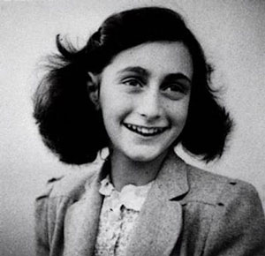
Make It Personal:
The Diary of Anne Frank
Anne Frank
Teenager
Girl
Romance
Self-discovery
Family issues
Pet cat
In hiding
Death

Slide 11
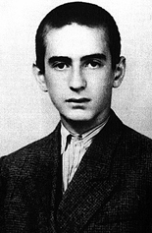
Make It Personal: Night
Elie Wiesel
Teenager
Boy
Religious struggles
Family issues
In camps
Music
Deaths of family members
Survival

Slide 12
Student comments on reading Night
“Reading Night was the best part of the Holocaust Unit. Elie was a boy about my age, so I could relate to him better. I’m really close to my dad too.”
“I hate poetry. Reading a book is much better.”
“It was good because you felt like you were there with him.”
“He was really descriptive. I didn’t like some of what he said. How could people do those things? It was too graphic in some parts.”
“I never finished it. The words were really weird, and I didn’t know what they meant. Sorry.”

Slide 13
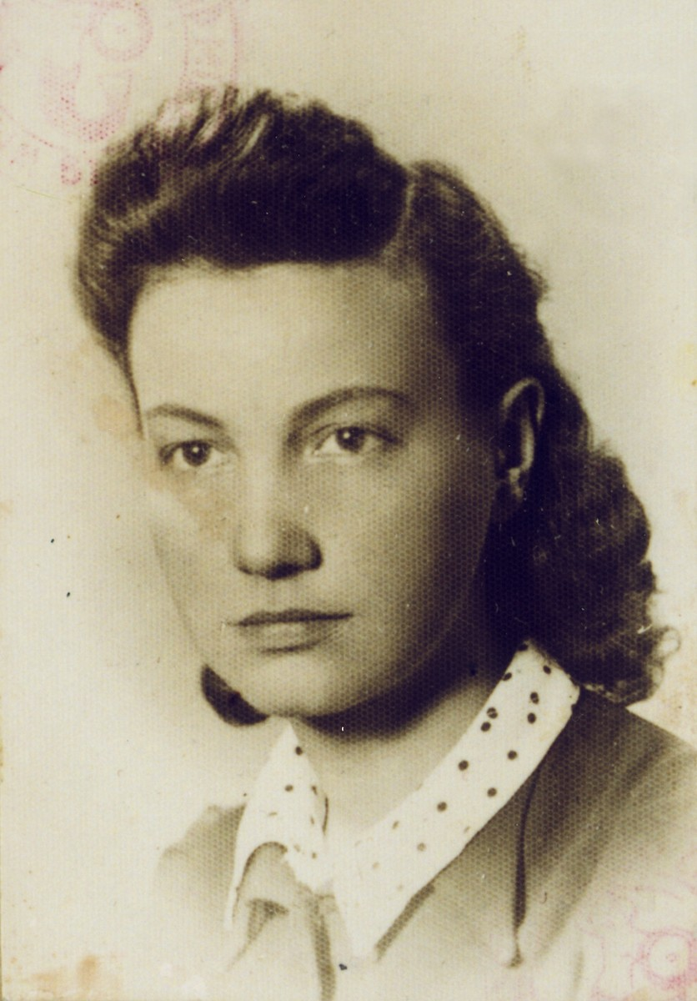
Make It Personal:
On Both Sides of the Wall
Vladka Meed
Young adult - 20s
Girl
Resistance fighter
Life in the ghetto
Deaths of family members
False identity papers
Warsaw Ghetto Uprising
Survival

Slide 14
Make It Personal: Poetry
Primary Resources:
Holocaust Poetry by Hilda Schiff
Erika: Poems of the Holocaust by William Heyen
I Never Saw Another Butterfly by Hannah Volakova
The Poetry of Survival by Daniel Weissbort
Auschwitz and After By Charlotte Delbo

Slide 15
Make It Personal: Poetry
Why poetry?
Strong images
Vocabulary
Unique voices
Accessible
Creative
Short
Wide variety of perspectives, emotions, and voices
Class discussion
Tie to state goals

Slide 16
Make It Personal and Know What They Know: Poetry
I often start my unit with “The Hangman” by Maurice Ogden
Into our town the Hangman came,
Smelling of gold and blood and flame.
And he paced our bricks with a diffident air,
And built his frame in the courthouse square.
The scaffold stood by the courthouse side,
Only as wide as the door was wide;
A frame as tall, or little more,
Than the capping sill of the courthouse door.
And we wondered, whenever we had the time,
Who the criminal, what the crime
That the Hangman judged with the yellow twist
of knotted hemp in his busy fist.
And innocent though we were, with dread,
We passed those eyes of buckshot lead --
Till one cried: "Hangman, who is he
For whom you raised the gallows-tree?"

Slide 17
Make It Personal and Know What They Know: Poetry
“The Hangman” by Maurice Ogden
Then a twinkle grew in the buckshot eye,
And he gave us a riddle instead of reply:
"He who serves me best," said he,
"Shall earn the rope of the gallows-tree."
And he stepped down, and laid his hand
On a man who came from another land.
And we breathed again, for another's grief
At the Hangman's hand was our relief
And the gallows-frame on the courthouse lawn
By tomorrow's sun would be struck and gone.
So we gave him way, and no one spoke,
Out of respect for his Hangman's cloak.
2.
The next day's sun looked mildly down
On roof and street in our quiet town,
And stark and black in the morning air
Was the gallows-tree in the courthouse square.

Slide 18
Make It Personal and Know What They Know: Poetry
“The Hangman” by Maurice Ogden
And the Hangman stood at his usual stand
With the yellow hemp in his busy hand;
With his buckshot eye and his jaw like a pike
And his air so knowing and business-like.
And we cried, "Hangman, have you not done
Yesterday, with the foreign one?"
Then we fell silent, and stood amazed,
"Oh, not for him was the gallows raised."
He laughed a laugh as he looked at us:
"Did you think I'd gone to all this fuss
To hang one man? That's a thing I do
To stretch a rope when the rope is new."
Then one cried "Murder!" and one cried "Shame!"
And into our midst the Hangman came
To that man's place. "Do you hold," said he,
"with him that was meant for the gallows-tree?"

Slide 19
Make It Personal and Know What They Know: Poetry
“The Hangman” by Maurice Ogden
And he laid his hand on that one's arm.
And we shrank back in quick alarm!
And we gave him way, and no one spoke
Out of fear of his Hangman's cloak.
That night we saw with dread surprise
The Hangman's scaffold had grown in size.
Fed by the blood beneath the chute,
The gallows-tree had taken root;
Now as wide, or a little more,
Than the steps that led to the courthouse door,
As tall as the writing, or nearly as tall,
Halfway up on the courthouse wall.
3.
The third he took -- we had all heard tell --
Was a usurer, and an infidel.
"What," said the Hangman "have you to do
With the gallows-bound, and he a Jew?"

Slide 20
Make It Personal and Know What They Know: Poetry
“The Hangman” by Maurice Ogden
And we cried out, "Is this one he
Who has served you well and faithfully?"
The Hangman smiled: "It's a clever scheme
to try the strength of the gallows-beam."
The fourth man's dark, accusing song
Had scratched our comfort hard and long;
"And what concern," he gave us back.
"Have you for the doomed -- the doomed and Black?"
The fifth. The sixth. And we cried again,
"Hangman, Hangman, is this the man?"
"It's a trick," he said. "that we hangmen know
For easing the trap when the trap springs slow."
And so we ceased, and asked no more,
As the Hangman tallied his bloody score.
And sun by sun, and night by night,
The gallows grew to monstrous height.

Slide 21
Make It Personal and Know What They Know: Poetry
“The Hangman” by Maurice Ogden
The wings of the scaffold opened wide
Till they covered the square from side to side;
And the monster cross-beam, looking down,
Cast its shadow across the town.
4.
Then through the town the Hangman came,
Through the empty streets, and called my name --
And I looked at the gallows soaring tall,
And thought, "There is no one left at all
For hanging, and so he calls to me
To help pull down the gallows-tree."
So I went out with right good hope
To the Hangman's tree and the Hangman's rope.
He smiled at me as I came down
To the courthouse square through the silent town.
And supple and stretched in his busy hand
Was the yellow twist of the hempen strand.

Slide 22
Make It Personal and Know What They Know: Poetry
“The Hangman” by Maurice Ogden
And he whistled his tune as he tried the trap,
And it sprang down with a ready snap --
And then with a smile of awful command
He laid his hand upon my hand.
"You tricked me. Hangman!," I shouted then,
"That your scaffold was built for other men...
And I no henchman of yours," I cried,
"You lied to me, Hangman. Foully lied!"
Then a twinkle grew in the buckshot eye,
"Lied to you? Tricked you?" he said. "Not I.
For I answered straight and I told you true --
The scaffold was raised for none but you.
For who has served me more faithfully
Then you with your coward's hope?" said he,
"And where are the others who might have stood
Side by your side in the common good?"

Slide 23
Make It Personal and Know What They Know: Poetry
“The Hangman” by Maurice Ogden
"Dead," I whispered. And amiably
"Murdered," the Hangman corrected me:
"First the foreigner, then the Jew...
I did no more than you let me do."
Beneath the beam that blocked the sky
None had stood so alone as I.
The Hangman noosed me, and no voice there
Cried "Stop!" for me in the empty square.

Slide 24
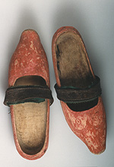
Make It Personal: Poetry
A Cartload of Shoes
By: Abraham Sutzkever
Learning tasks: Please do these with me
What impact do the questions have?
What words and phrases are powerful?
What are the shoes representing?
What images are powerful?
What kinds of people are represented?
What impact do the rhyme and rhythm have at the end?
What vocabulary should be taught before reading?
How would you summarize the content?
What is the tone of the poem?

Slide 25
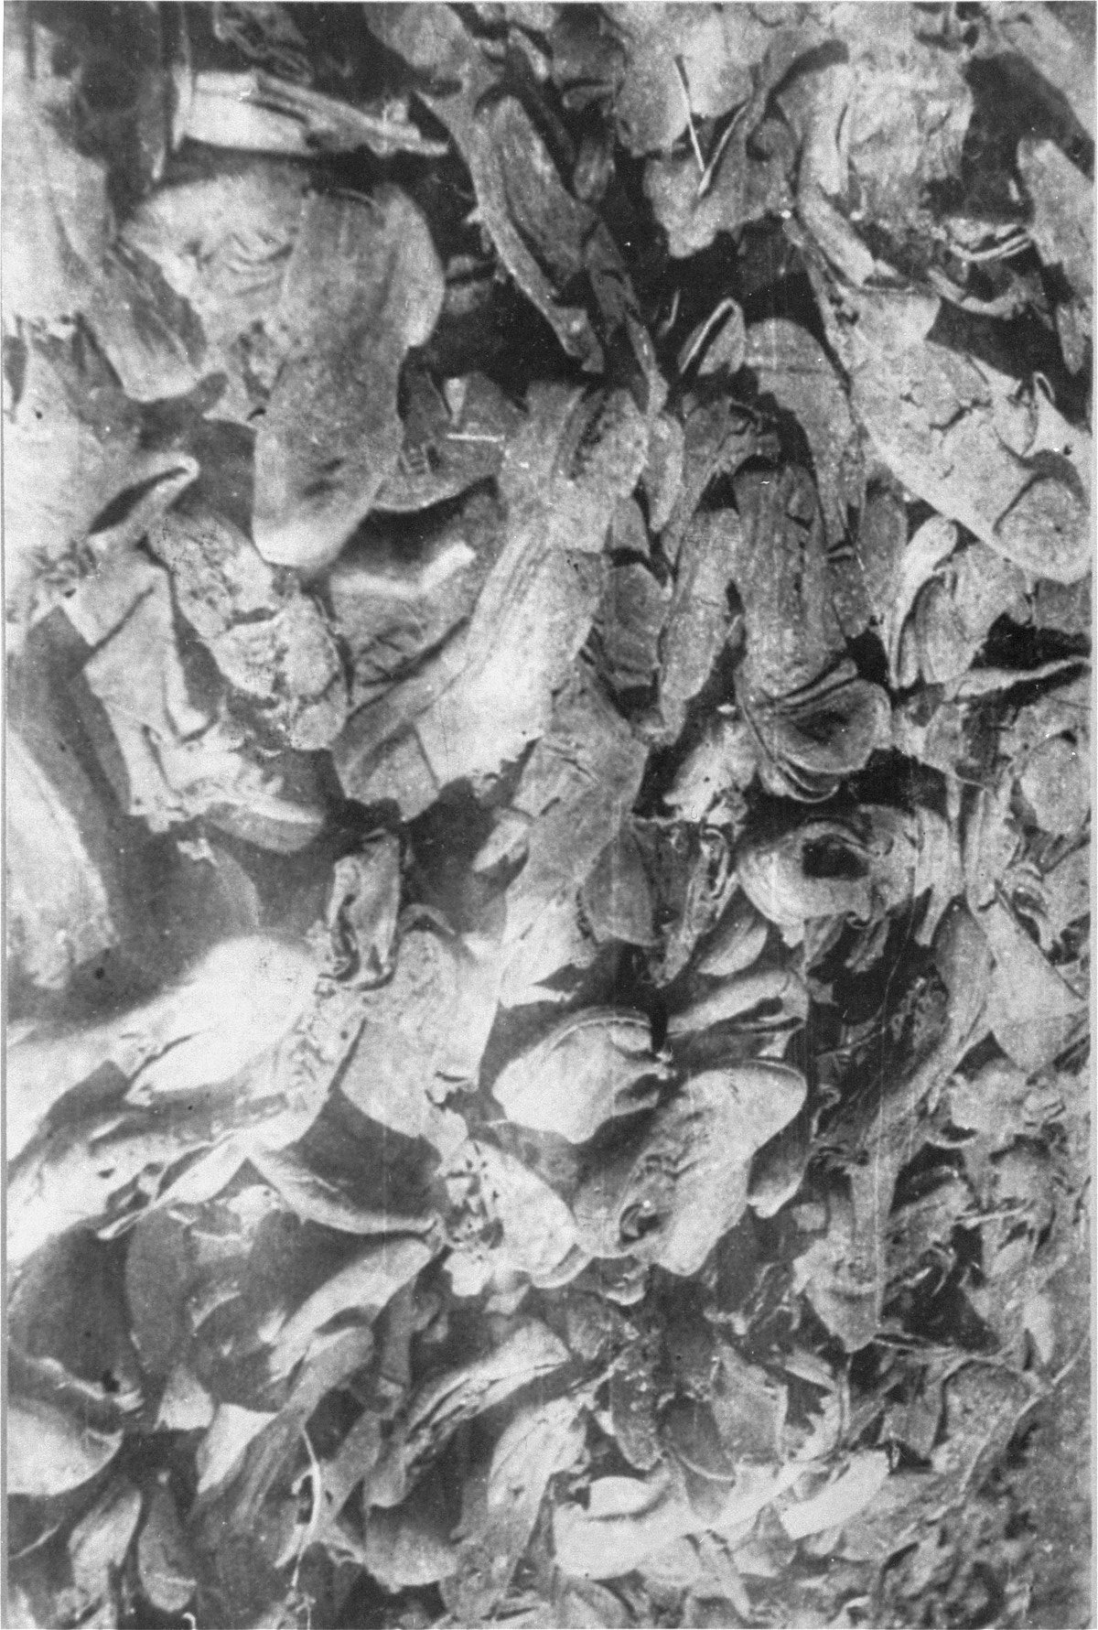
Make It Personal: Poetry
A Cartload of Shoes
By: Abraham Sutzkever
The wheels hurry onward, onward.
What do they carry?
They carry a cartload
Of shivering shoes.
The wagon like a canopy
In the evening light;
The shoes – clustered
Like people in a dance.

Slide 26
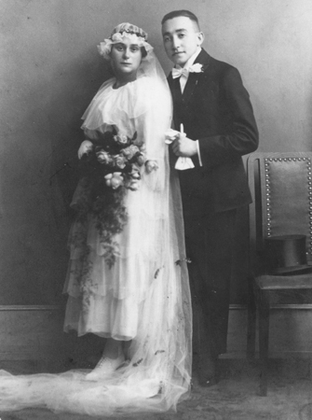
Make It Personal: Poetry
A Cartload of Shoes (continued)
By: Abraham Sutzkever
A wedding, a holiday?
Has something blinded my eyes?
The shoes – I seem
To recognize them.
The heels go tapping
With a clatter and a din.
From our old Vilna streets
They drive us to Berlin.
I should not ask
But something tears my tongue
Shoes, tell me the truth

Slide 27
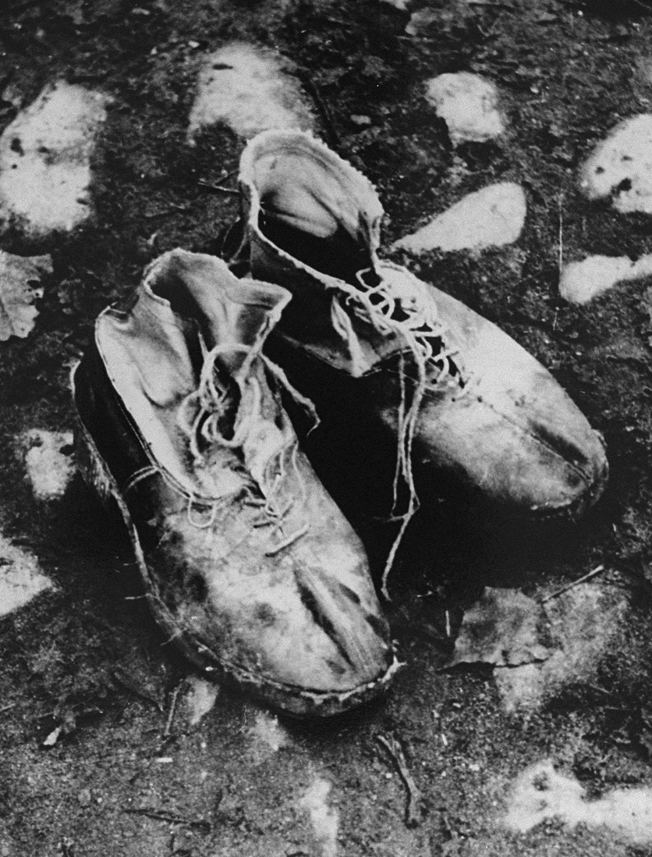
Make It Personal: Poetry
A Cartload of Shoes (continued)
By: Abraham Sutzkever
Where are they, the feet?
The feet from those boots
With button like dew -
And here, where is the body
And there, where is the bride?
Where is the child
To fill those shoes
Why has the bride
Gone barefoot?

Slide 28
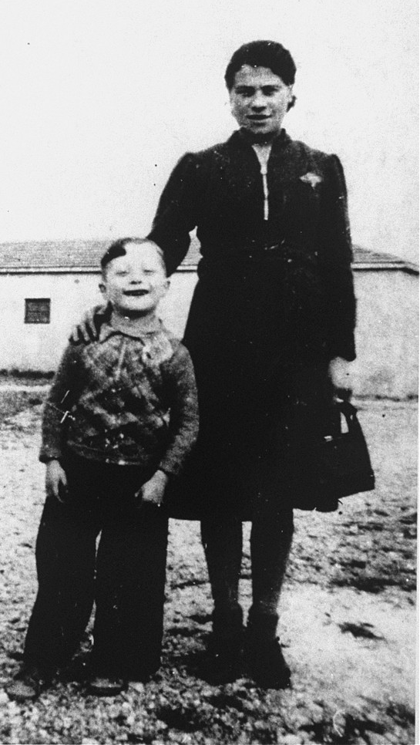
Make It Personal: Poetry
A Cartload of Shoes (continued)
By: Abraham Sutzkever
Through the slippers and the boots
I see those my mother used to wear
She kept them for the Sabbath
Her favorite pair
And the heels go tapping
With a clatter and a din,
From our old Vilna streets
They drive us to Berlin

Slide 29
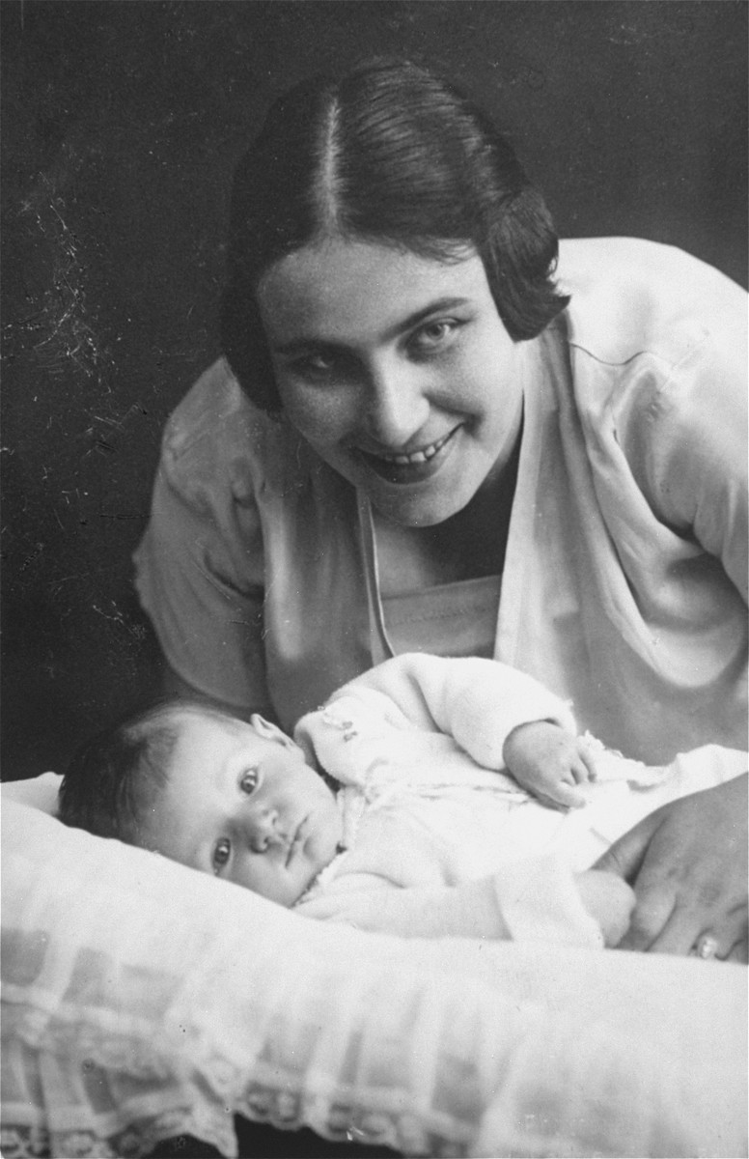
Make It Personal: Poetry
A Cartload of Shoes (continued)
By: Abraham Sutzkever
Discussion:
Learning tasks: Please do these with me
What impact do the questions have?
What words and phrases are powerful?
What are the shoes representing?
What images are powerful?
What kinds of people are represented?
What impact do the rhyme and rhythm have at the end?
What vocabulary should be taught before reading?
How would you summarize the content?
What is the tone of the poem?

Slide 30
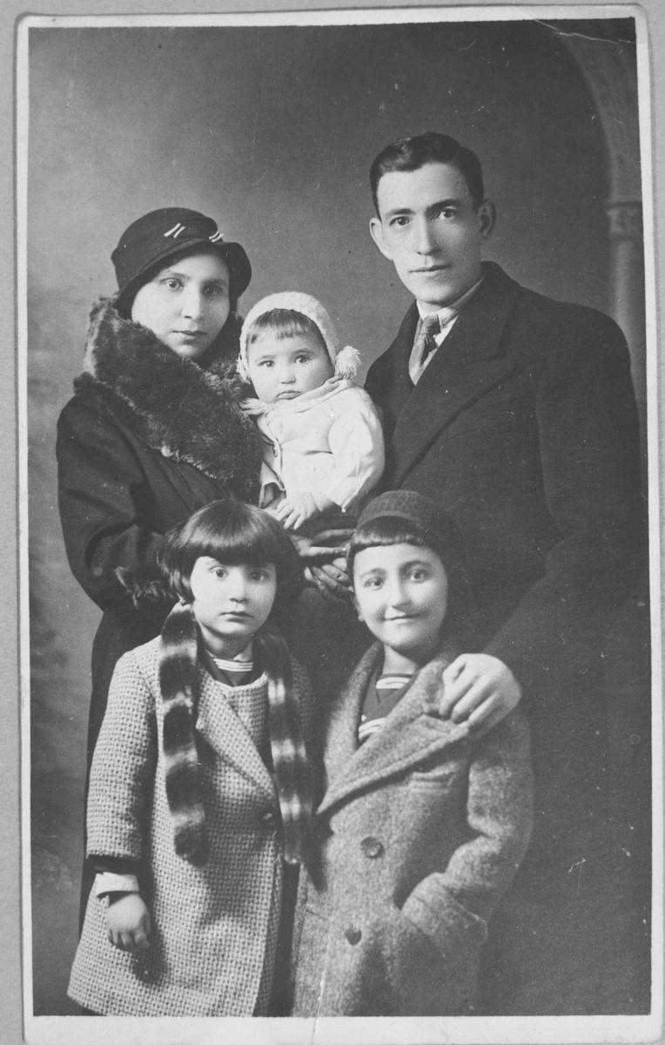
Make It Personal: Poetry
“O the Night of the Weeping Children”
By: Nelly Sachs
Learning tasks: Please do these with me
What metaphors can you find?
What words and phrases are powerful?
Is there a rhythm or a rhyme pattern?
How are word sounds used?
What images are powerful?
What vocabulary should be taught before reading?
How would you summarize the content?
What is the tone of the poem?

Slide 31
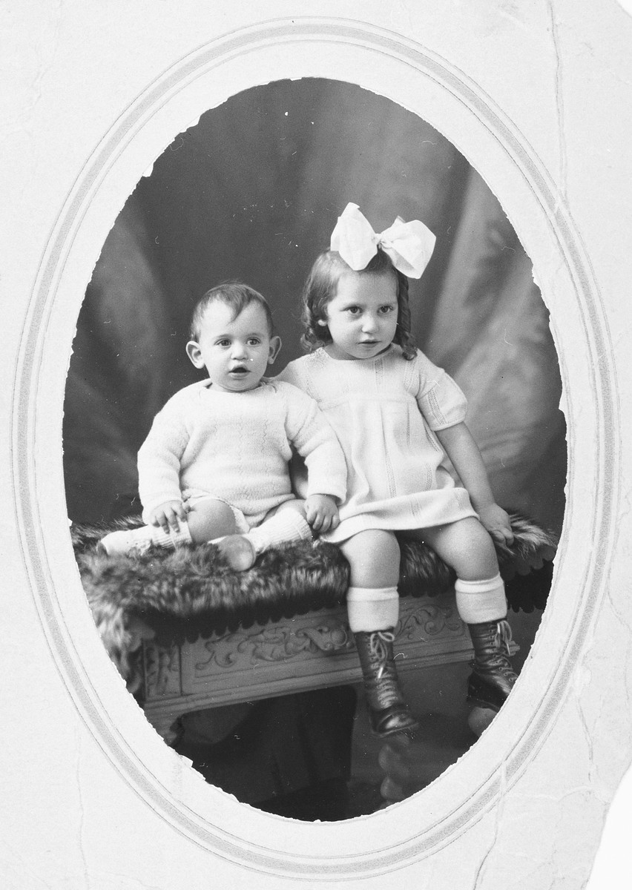
Make It Personal: Poetry
“O the Night of the Weeping Children”
By: Nelly Sachs
O the night of the weeping children!
O the night of the children branded for death!
Sleep may not enter here.
Terrible nursemaids
Have usurped the place of mothers,
Have tautened their tendones with the false death,
Sow it on to the walls and into the beams-
Everywhere it is hatched in the nests of horror.

Slide 32
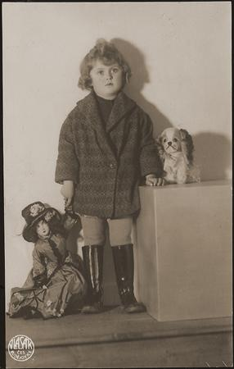
Make It Personal: Poetry
“O the Night of the Weeping Children”
By: Nelly Sachs
Instead of mother’s milk, panic suckles
those
little ones
Yesterday mother still drew
Sleep toward them like a white moon,
There was a doll with cheeks
derouged by kisses.
In one arm,

Slide 33
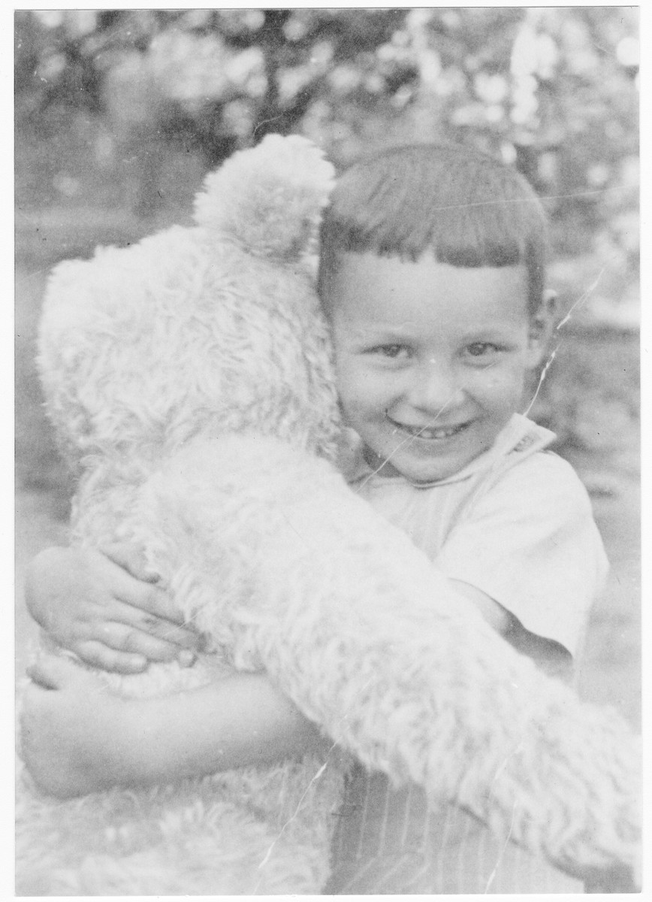
Make It Personal: Poetry
“O the Night of the Weeping Children”
By: Nelly Sachs
The stuffed pet, already
Brought to life by love,
in the other -
Now blows the wind of dying,
Blows the shifts over the hair
That no one will comb again
AND NOW LET’S DISCUSS...

Slide 34
Make It Personal: Poetry
“O the Night of the Weeping Children”
Discussion:
What metaphors can you find?
What words and phrases are powerful?
Is there a rhythm or a rhyme pattern?
How are word sounds used?
What images are powerful?
What vocabulary should be taught before reading?
How would you summarize the content?
What is the tone of the poem?

Slide 35
Know What They Know: Poetry
“Refugee Blues”
by W.H. Auden
Learning tasks: Please do these with me
How can this poem be divided by events of the Holocaust?
What is the impact of repeating “my dear” throughout the poem?
What are your thoughts about the rhythm pattern of this poem?

Slide 36
Know What They Know: Poetry
“Refugee Blues”
Say this city has ten million souls,
Some are living in mansions, some are living in holes:
Yet there’s no place for us, my dear, yet there’s no place for us.
Once we had a country and we thought it fair,
Look in the atlas and you’ll find it there:
We cannot go there now, my dear, we cannot go there now.
In the village churchyard there grows an old yew,
Every spring it blossoms anew;
Old passports can’t do that, my dear, old passports can’t do that.

Slide 37
Know What They Know: Poetry
“Refugee Blues”
The consul banged the table and said:
‘If you’ve got no passport, you’re officially dead’;
But we are still alive, my dear, but we are still alive.
Went to a committee; they offered me a chair;
Asked me politely to return next year:
But where shall we go today, my dear, but where shall we go today?
Came to a public meeting; the speaker got up and said:
‘If we let them in, they will steal our daily bread’;
He was talking of you and me, my dear, he was talking of you and me.

Slide 38
Know What They Know: Poetry
“Refugee Blues”
Thought I heard the thunder rumbling in the sky;
It was Hitler over Europe, saying: ‘They must die’;
We were in his mind, my dear, we were in his mind.
Saw a poodle in a jacket fastened with a pin,
Saw a door opened and a cat let in:
But they weren’t German Jews, my dear, but they weren’t German Jews.
Went down the harbour and stood upon the quay,
Saw the fish swimming as if they were free:
Only ten feet away, my dear, only ten feet away.

Slide 39
Know What They Know: Poetry
“Refugee Blues”
Walked through a wood, saw the birds in the trees;
They had no politicians and sang at their ease:
They weren’t the human race, my dear, they weren’t the human race.
Dreamed I saw a building with a thousand floors,
A thousand windows and a thousand doors;
Not one of them was ours, my dear, not one of them was ours.
Stood on a great plain in the falling snow;
Ten thousand soldiers marched to and fro:
Looking for you and me, my dear, looking for you and me.

Slide 40
Know What They Know: Poetry
“Refugee Blues”
Discussion:
Learning tasks: Please do these with me
How can this poem be divided by events of the Holocaust?
What is the impact of repeating “my dear” throughout the poem?
What are your thoughts about the rhythm pattern of this poem?
How can you tie this poem to “Hangman” - same topic but different

Slide 41
Make It Personal: Poetry
English Teacher Alert:
The poetry section of this unit works well with
Illinois English/Language Arts State Goal 1.B.4b:
“Analyze, interpret and compare a variety
of texts for purpose, structure, content,
detail, and effect”

Slide 42
Student comments on reading Holocaust poetry
“I liked the poems the best. They were short, and we read them in class.”
“Reading the poems was the best part. ‘A Single Hair’ was so sad. I will never forget it. I almost cried when you read it to us.”
“I liked the poetry. My favorite was ‘Hangman.’ It said a lot about being a bystander.
“Cut the poetry section. It is boring, and no one understands them except for you.”

Slide 43
Making It Personal: Drama
Why use Holocaust dramas?
Hear the voices
Variety of perspectives
Active participation
Strong images
Accessible

Slide 44
Making It Personal: Drama
Plays used in my classes:
The Diary of Anne Frank by Frances Goodrich and Albert Hackett
Who Will Carry the Word? By Charlotte Delbo
Plays performed at SHS:
Who Will Carry the Word? By Charlotte Delbo
I Never Saw Another Butterfly by Celeste Raspanti

Slide 45
Student comments about Holocaust plays
“Reading Who Will Carry the Word? was really different. We took our time and everyone in class was someone. I liked reading it aloud because we heard their voices.”
“My character died before she ever spoke. That made me mad, but it made me realize that a lot of people were never heard.”
“I hadn’t realized that women were in camps too.”
“This play starts where the story of Anne Frank stops. It was important to find out what happened to people after they were taken away.
“Being in ‘I Never Saw Another Butterfly’ was one of the most important things I did while I was in high school. It was such a powerful play.

Slide 46
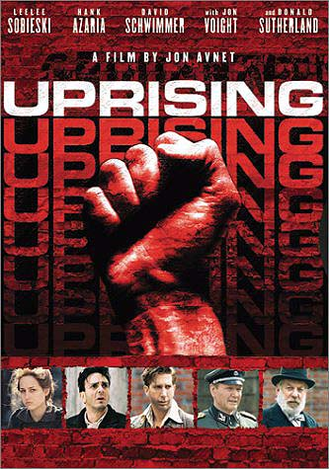
Making It Personal: Film
Why use Holocaust films?
Variety of perspectives
Good for visual learners
Strong images
Accessible
New
Special

Slide 47
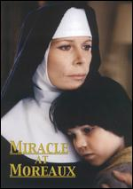
Making It Personal: Film
Miracle at Moreaux
Good for younger children and teenagers
Shows rescuer aspect
Deals with Anti-Semitism
Deals with aspects of Judaism and Catholicism
Based on a true story

Slide 48

Making It Personal: Film
Freedom Writers
Newer movie
Connects students to the Holocaust through watching inner city students reading the Diary of Anne Frank and meeting Miep Gies
Good for ethics discussions
Rescuer aspect
Relevance??? Extra Credit???

Slide 49
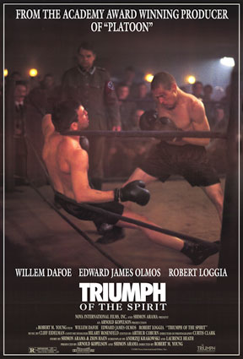
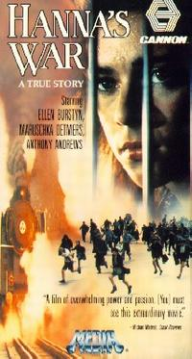

Making It Personal: Film

Slide 50
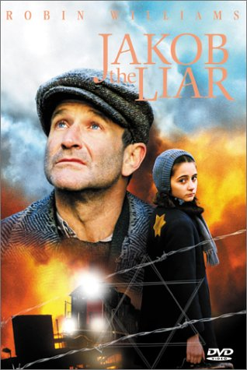

Making It Personal: Film

Slide 51

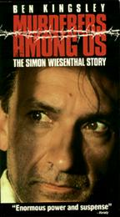
Making It Personal: Film

Slide 52
Student comments about films
“Watching ‘Hanna’s War’ was really neat. She was a brave woman.”
“I’ll never forget watching ‘Schindler’s List’ in your room with all those people. We were so quiet. I’m glad you discussed parts of it with us. I rented it and made my mom watch it with me.”
“That movie about Simon W. was pretty good. I liked how it showed what happened after the war. It made me mad though. How could they find that guy not guilty?
“The movie about the kids and the nuns was one of the best things we watched. That one girl was really mean at the beginning but was nicer at the end when she understood. I thought it was funny when Louie explained to the Nazi guy where the Jews were.

Slide 53
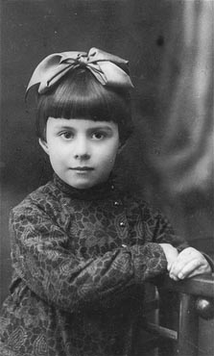
Specific Curricular Ideas
Poetry Writing
“A Picture is Worth a Thousand Words”
USHMM: Photo Archives
Go to document

Slide 54
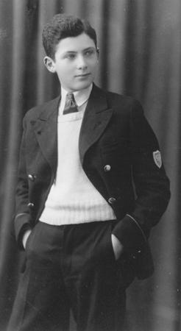
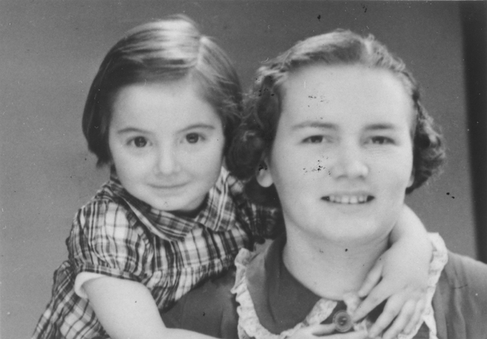
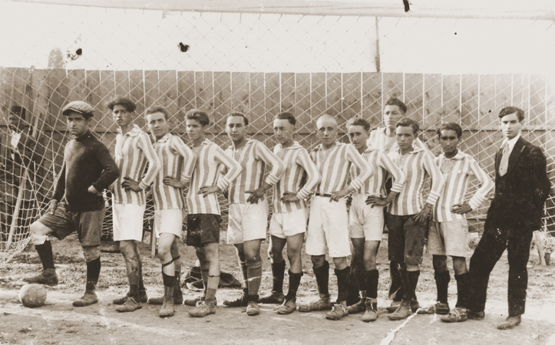
Specific Curricular Ideas
Poetry Writing
“Tell Them We Remember”
USHMM: 597 ID Cards
Go to document

Slide 55
Specific Curricular Ideas
Poetry Writing
“Blackout Poetry” with Night
Go to Assignment
It had to be Juliek.
He was playing a fragment of a Beethoven concerto. Never before had I heard such a beautiful sound. In such silence.
How had he succeeded in disengaging himself? To slip out from under my body without my feeling it?
The darkness enveloped us. All I could hear was the violin, and it was as if Juliek's soul had become his bow. He was playing his life. His whole being was gliding over the strings. His unfulfilled hopes. His charred past, his extinguished future. He played that which he would never play again.
I shall never forget Juliek. How could I forget this concert given before an audience of the dead and dying? Even today, when I hear that particular piece by Beethoven, my eyes close and out of the darkness emerges the pale and melancholy face of my Polish comrade bidding farewell to an audience of dying men.
I don't know how long he played. I was overcome by sleep. When I awoke at daybreak, I saw Juliek facing me, hunched over, dead. Next to him lay his violin, trampled, an eerily poignant little corpse.

Slide 56
Specific Curricular Ideas
“Visualizing People Connected to the Holocaust”
A Teacher’s Guide to the Holocaust
Go to “People” and click on links…
Some of the available ones include::
Survivors, rescuers, resistors, liberators, and others
USHMM: Personal Histories
History dropdown
Select Personal Histories
Select area of interest

Slide 57
Specific Curricular Ideas
“Holocaust Alphabet Book”
“Holocaust Research Projects” – Assigned Topics or Personal Choice???
Other Ideas I am willing to discuss:
Food and dance as a part of the unit
Cross-curricular projects
The Winter Celebration
Learning Yiddish

Slide 58
Thanks for listening…
Any
Questions???

