Slide 1


Slide 2

THE SCHULICH FOUNDATION & UJA
SCHOLARSHIP ELIGIBILITY
SCHOLARSHIP PROCESS & TIMELINE
Q&A

Slide 3

THE SCHULICH FOUNDATION & UJA

Slide 4


Slide 5
SCHOLARSHIP ELIGIBILITY

Slide 6


SCHOLARSHIP ELIGIBILITY
GENERAL CRITERIA
STEM PROGRAMS & CAREER PATH
FINANCIAL NEED

Slide 7


SCHOLARSHIP PROCESS
ELIGIBILITY & ENROLMENT
Ensure you have been accepted into an eligible University program and meet other scholarship criteria

Slide 8
SCHOLARSHIP PROCESS & TIMELINE

Slide 9

Gather Financial Document & Transcript
2024 tax documents required: T1, NOA, T2/T2125 (if applicable)
Create an Account on UJA Community Scholarships Portal
Visit: ujacommunityscholarships.ca
Complete the Scholarship Application
Questions? info@communityscholarships.ca

Slide 10
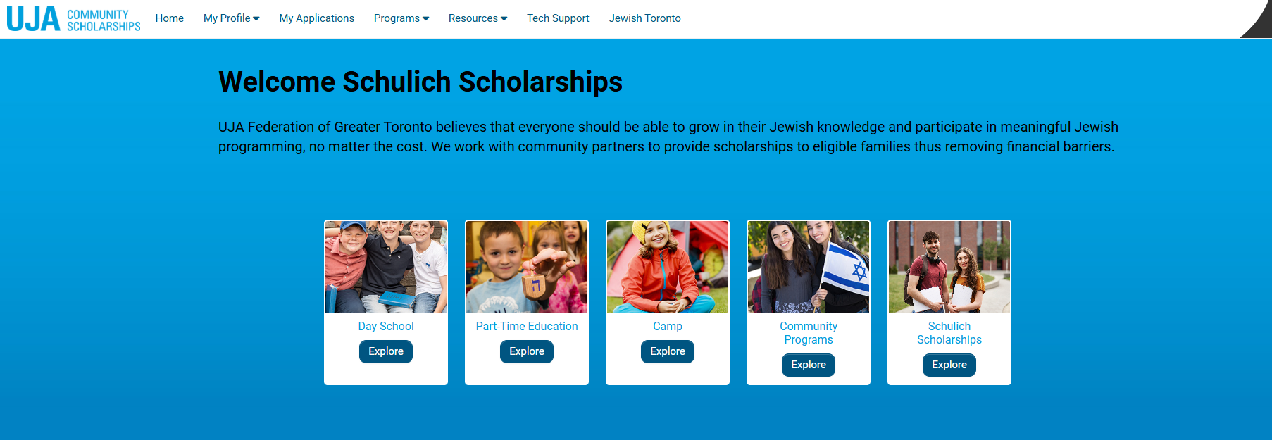

SCHOLARSHIP APPLICATION

Slide 11


SCHOLARSHIP TIMELINE
March 15, 2026: Application deadline*
April – June, 2026: Interviews
June 2026: Finalists notified

Slide 12


Slide 13


